Slide 1
Organising
Workplace mapping

Slide 2

What is mapping
In simple terms it is creating a map of the workplace
Unite maps allow us to;
See our strengths and weaknesses, where we have members and where we don’t.
Where we have shop stewards or workplace leaders
To task our leaders (are the workers participating in collective actions)
To measure if the campaign has momentum

Slide 3
Mapping
Mapping must be ongoing
Regularly updated by the organising team
Every work area identified
Every worker allocated to a team member

Slide 4
Leader cards and pledges
Leader cards to get members to make a personal commitment
Contact 5 to 10 workers
Review results at team meetings
Peer pressure

Slide 5
How do we map
We could do it alone but having a small team is easier
Use your leaders
  As one of their tasks have them map their own area
  Add this information to your workplace map
Gather as much information as possible you could also gather additional issues that only affect certain areas.

Slide 6
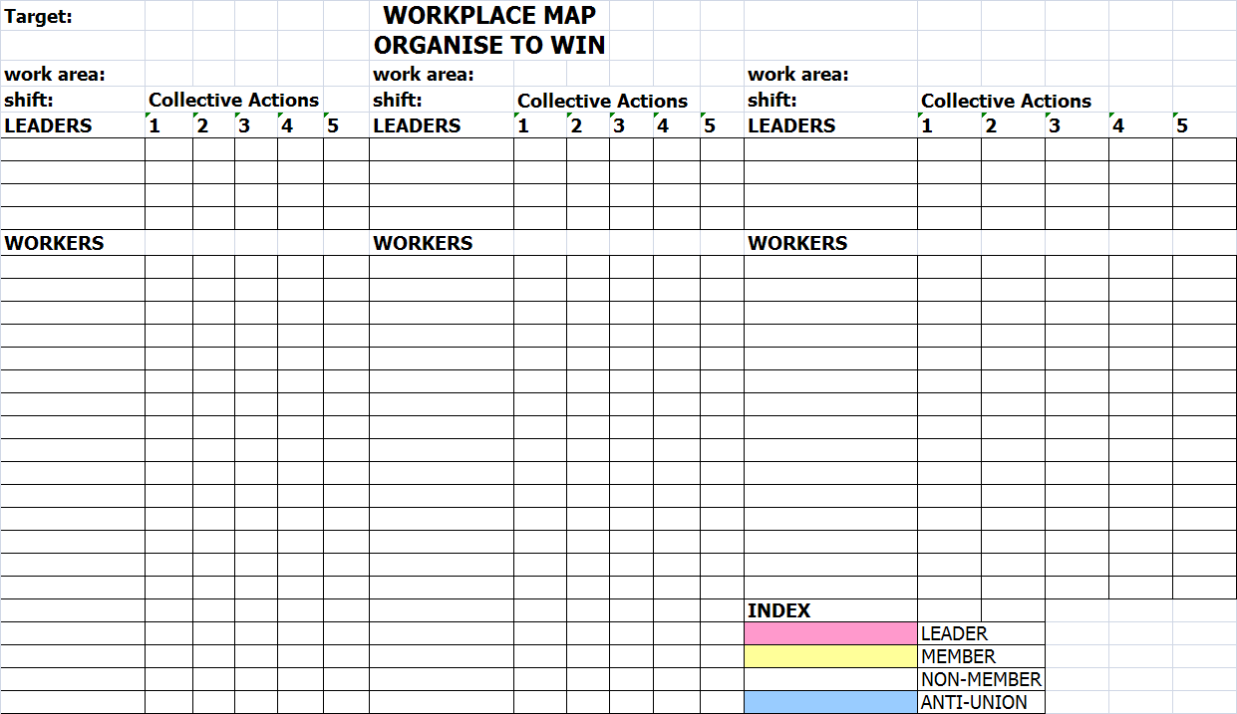

Slide 7
Activity
Activity
  Complete the workplace map
  Use the colour codes to identify target groups
  Use the map in your work book and the handouts provided

