Slide 1
Broad Industrial Strategy
Work Voice Pay

Slide 2
Work, Voice, Pay
‘I am delighted that our research consistently proves that Unite negotiations secure better pay deals for working people. But we are determined to help further improve delivery for our members at the workplace. At its core this pledge focuses on what our Union does best:
Securing good jobs and decent work
Making sure workers have a strong and effective voice
Getting decent pay and conditions
As part of this programme Unite is providing this industrial toolkit to support Unite shop stewards.’

Slide 3
Unite Industrial Strategy Why?
To tackle declining living standards
-Through extending collective bargaining and improve bargaining outcomes
-The decline of collective bargaining coverage experienced over the last thirty years has mirrored the fall in the share of GDP going to wages.

Slide 4
We Will Look at:
Getting The Best From Our Bargaining Data.
The Available Guides For: Work, Voice, Pay,
-Pay Claim Guide -Campaigning Around Pay
-Trade Union Recognition Template
-Trade Union Facilities Template
-Agency Workers Template
-Apprenticeship Template
Growing our Union.

Slide 5
An Introduction to Unites
Broad Industrial Strategy
Why do we need a Broad Industrial Strategy?
What are the Core Principles of the Broad Industrial
Strategy?
-Secure Work
-A Strong Voice
-Decent Pay and Conditions

Slide 6
Sharon Graham

Slide 7
Secure Work:
-Secure permanent full time/part-time jobs.
-No to compulsory redundancies.
-Yes to creative form of apprenticeships.
-Rate for the job stop ‘undercutting’ and ‘exploitation’.
-Delivering a safe working environment.
-Equal opportunity with no discrimination.

Slide 8
An Introduction to Unites
Broad Industrial Strategy
Why do we need a Broad Industrial Strategy?
What are the Core Principles of the Broad
Industrial Strategy?
-Secure Work
-A Strong Voice
-Decent Pay and Conditions

Slide 9
A Strong Voice:
-Union voice for non-recognised workers.
-Extending the scope of Bargaining (Agency working, Jon Security).
-Getting a good deal for everyone (National and sectoral bargaining-looking beyond your worksite).
-A stake in the future.

Slide 10
Decent Pay and Conditions
-Decent pay that reflects my contribution.
-Life/Work Balance.
-Training
-A pension fit for retirement.

Slide 11
Decent Pay and Conditions
12 week Pay Campaigns
-Work, Voice, Pay & Conditions integrated.
-Analyse pay deals and collective agreements and pursue ‘best in
sector’ deals and clauses.
-Coordinate bargaining
- Cross-site/ Cross-company/ Sector.
- Establish combines/networks.

Slide 12
What Industrial Support is Available
for Work Place Reps?
Current Pay and Anniversary Date Details From Thousands of Negotiations
The Database Currently Contains:
A list of anniversary date and pay percentage details for:
-All workplaces
-The workplaces in each sector
-The workplaces in each unite region

Slide 13
What Can the Industrial Data Be Used For?
When determining the employer’s ability to pay.
When finding out what other employers in a region have agreed
When comparing what other employers in the same sector have recently agreed?
By aligning anniversary dates of an employer or a sector

Slide 14
We are now going to Access Our Pay and Anniversary Date Details

Slide 15
You can Access By Regions

Slide 16
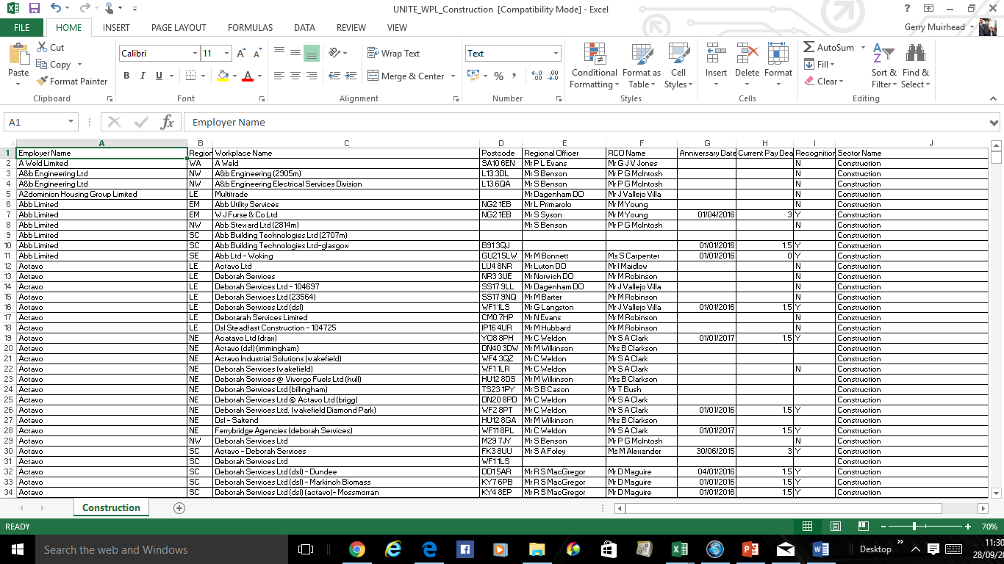
You can Access By Sector

Slide 17
We are now Going to look At
the Guides For Work, Voice Pay
-Pay Claim Guide
-Campaigning Around Pay
-Trade Union Recognition Template
-Trade Union Facilities Template
-Agency Workers Template
-Apprenticeship Template

Slide 18
We are now Going to look At the Guides For ‘Work, Voice Pay’.
What do you like about the Guides?
How Can we use the Guides in our role?
Is there anything else that
should be included in the guides/any
other guides which could help?

Slide 19
Any Questions

