Slide 1
Broad Industrial Strategy
Co-ordination of our Industrial Data

Slide 2
Broad Industrial Strategy
Co-ordination of our Industrial Data
Sharon Graham
Executive Officer

Slide 3
Access to Bargaining Data for the first time

Slide 4
Why the Broad Industrial Strategy
The decline of collective bargaining coverage over the last 30 years has mirrored the fall in the share of GDP going to wages
To tackle the crisis in living standards we must extend the coverage of bargaining and improve bargaining outcomes

Slide 5
Aims of our Broad Industrial Strategy
Key aims
Intensify focus on our industrial work
Core job must be the workplace
Re-establish our Union’s industrial brand
Every worker should know what Unite stands for

Slide 6
A strategy for the whole Union
Our Broad Industrial Strategy will deliver focus on areas that matter to all Unite workplaces
Secure Work
Strong Voice
Decent Pay
We are producing valuable tools relevant to all Sectors

Slide 7
Secure Work
Permanent employment
No compulsory redundancies
Rate for job to stop “undercutting” and “exploitation”
A safe workplace
No discrimination or victimisation
Good apprenticeships

Slide 8
Strong Voice
A Unite voice for workers without a trade union
Extending the scope of bargaining.
Negotiating on agency working, job security and other issues
A good deal for everyone.
Campaigning together, to deliver the same standards across companies and sectors
A stake in the future.
Meaningful consultation and negotiation on the future of the workplace

Slide 9
Decent Pay and Conditions
Good pay that reflects your contribution
A strong work-life balance with reasonable hours and decent holidays
Training
A good pension that provides a comfortable retirement

Slide 10
Key Phases of Industrial Data
Phase 1: Industrial data attached to all 100% Campaigns
100% Campaigns – every workplace strike ready
Phase 2: Industrial data attached to all Officers’ allocations
Phase 3: Industrial data attached to all workplaces with 10 or more members nationally (recognised or unrecognised)
Phase 4: Where we are not - companies put into the database where we do not have members or recognition

Slide 11
Building tools for activists
Pay
Search for the latest Unite negotiated pay rises and get the best deal for our members
Search by Company, Sector, Region, Post Code and Officer
Negotiations (Anniversary Date)
Find when workplaces within your company or sector are next negotiating and co-ordinate bargaining
Search by Company, Sector, Region, Post Code and Officer
Agreements
We are working to deliver access to Unite agreements to help set industrial standards

Slide 12
Access the data

Slide 13
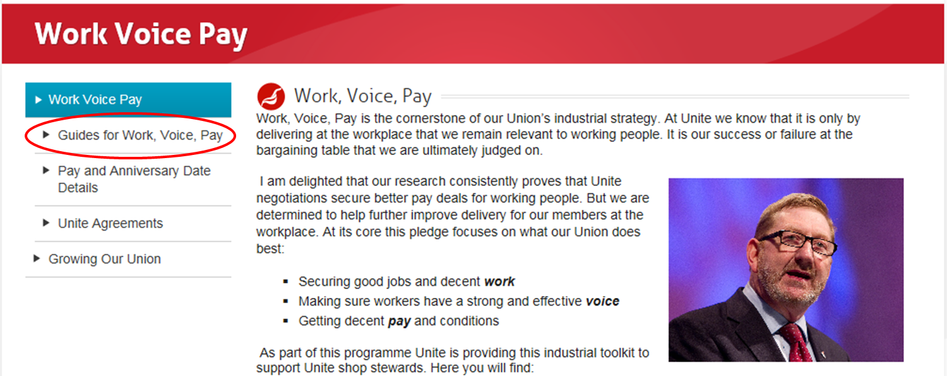
Access the data

Slide 14
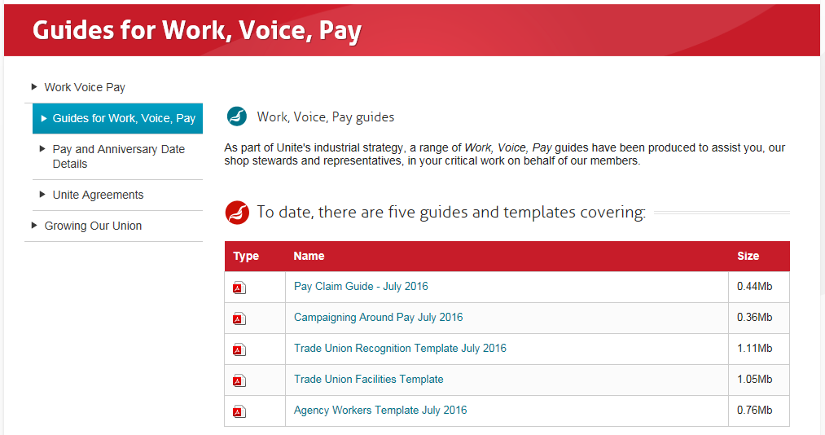
Access the data

Slide 15
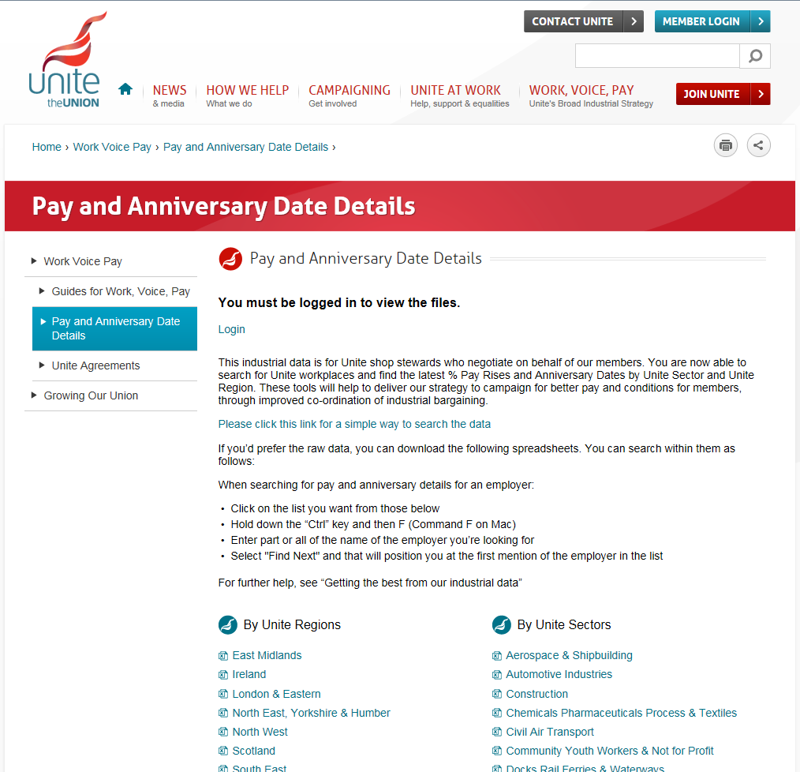
Access the data

Slide 16
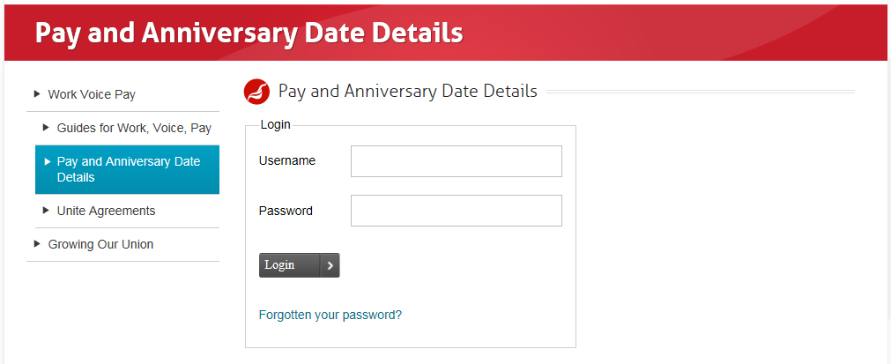
Access the data

Slide 17
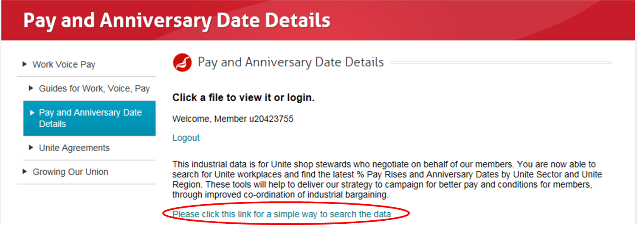
Access the data

Slide 18
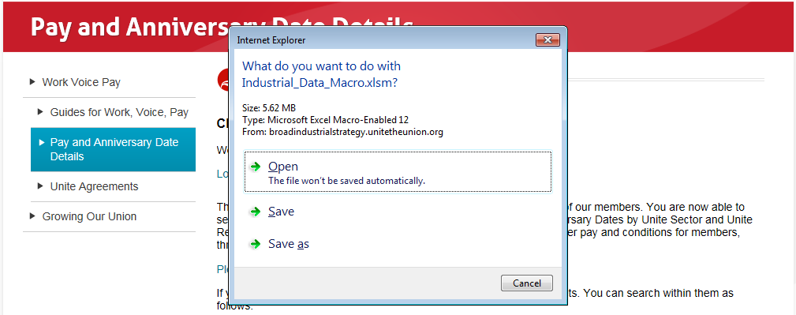
Access the data

Slide 19
Use the data: Standard Search

Slide 20
Use the data: Standard Search
2 Sisters

Slide 21
Use the data: Further search for Excel users

Slide 22
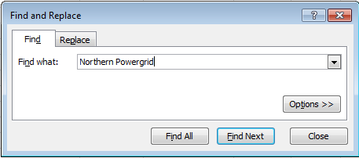
Use the data: Further search for Excel users
Vauxhall

Slide 23
More to be done: Further searches added/increased use of data
We are developing our data and information
Further ways to search our bargaining data will be available
Collective agreements will be collected and made accessible
But we don’t just want information, we need to build our Union!
Using the data to develop combines and coordinate bargaining across companies and sectors
To increase power and deliver at the bargaining table
A fighting Union dedicated to working people

