Slide 1

Unite Structure

Slide 2
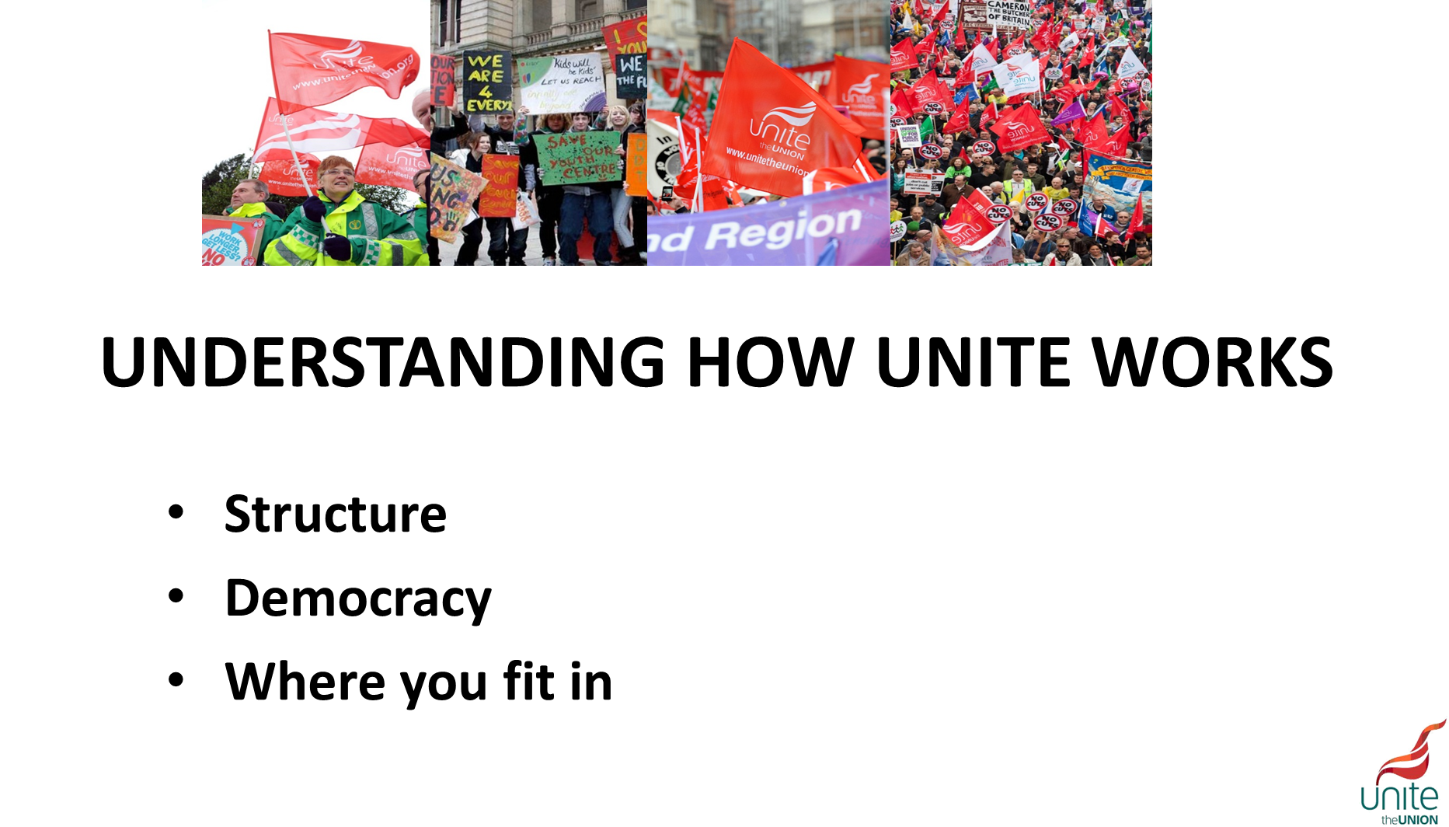

Slide 3
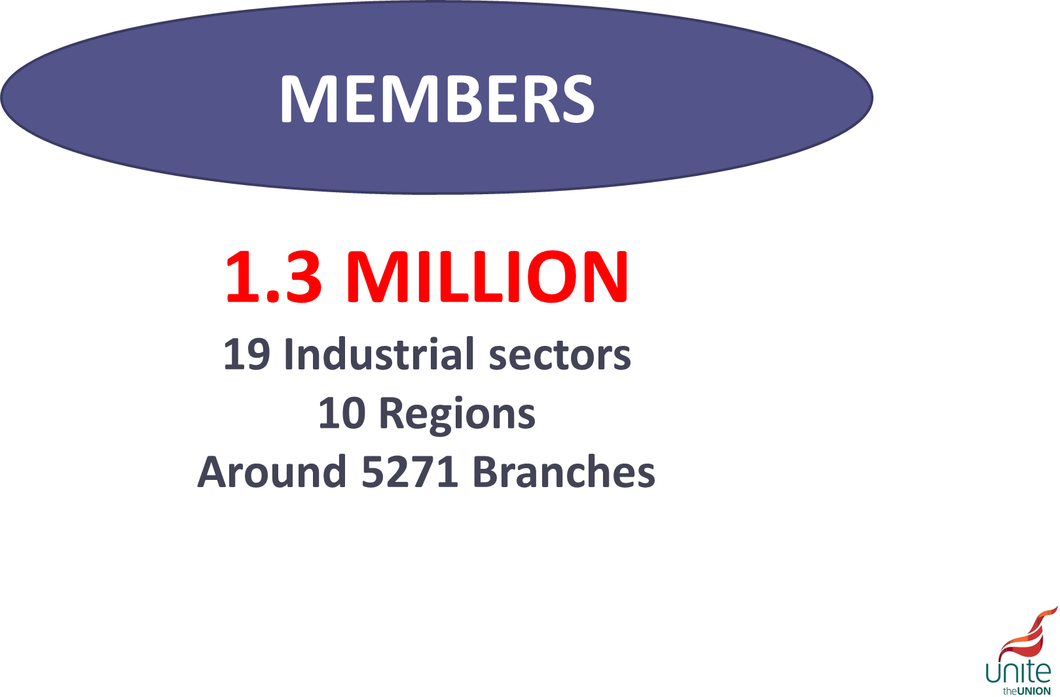

Slide 4
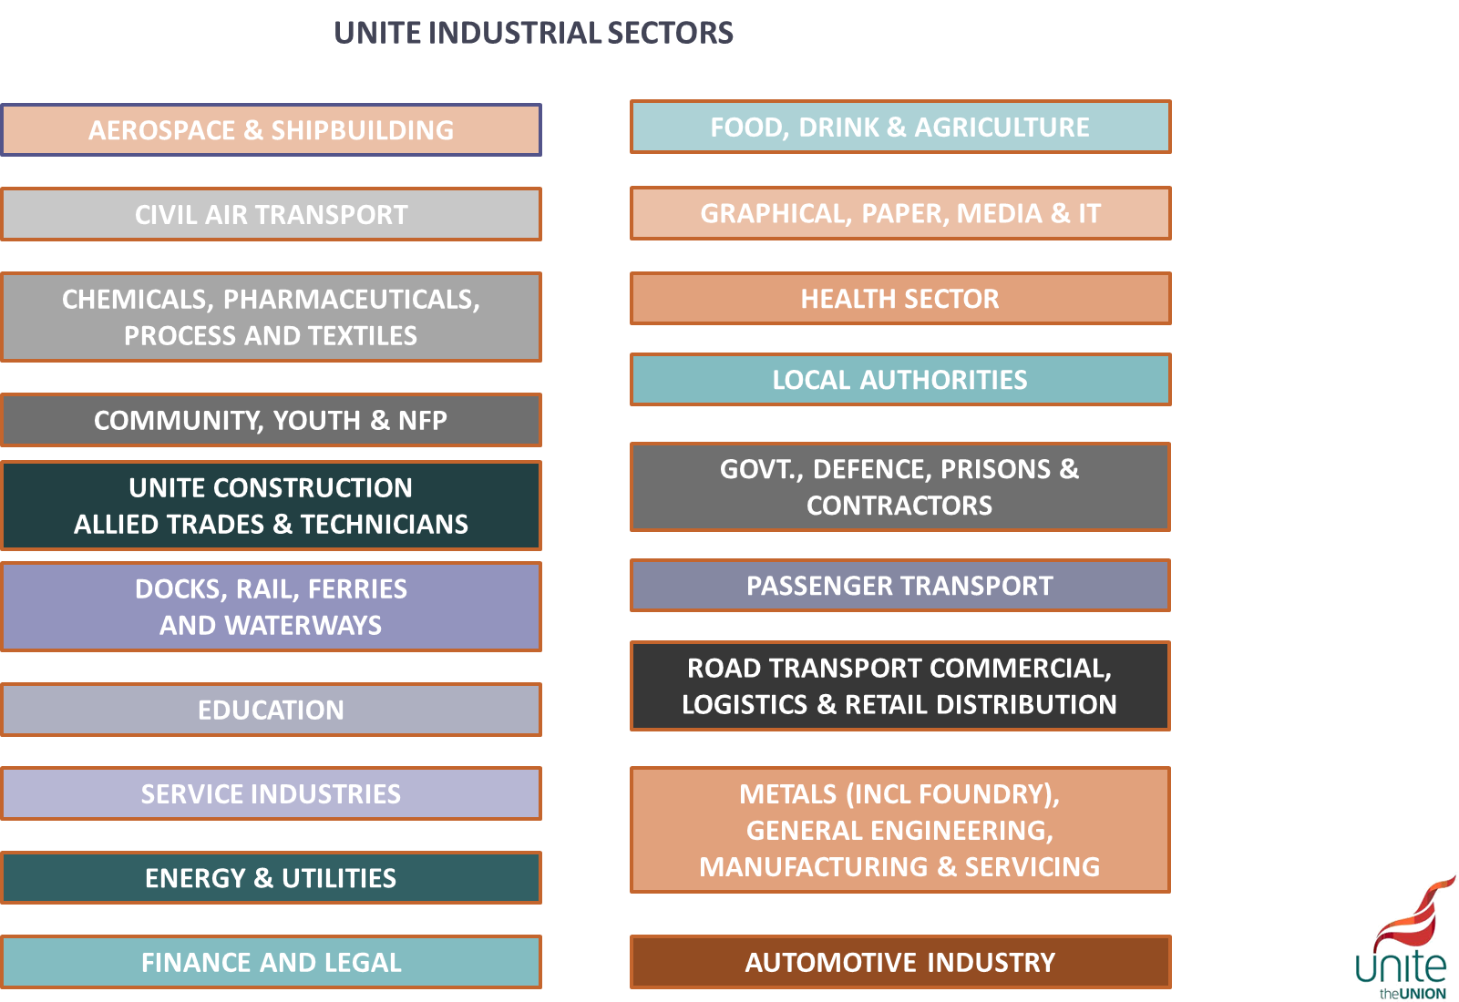
Notes:
On joining the union you will be asked where you work, this is so we can allocate you to the correct sector, based on what you do and who you work for.

Slide 5
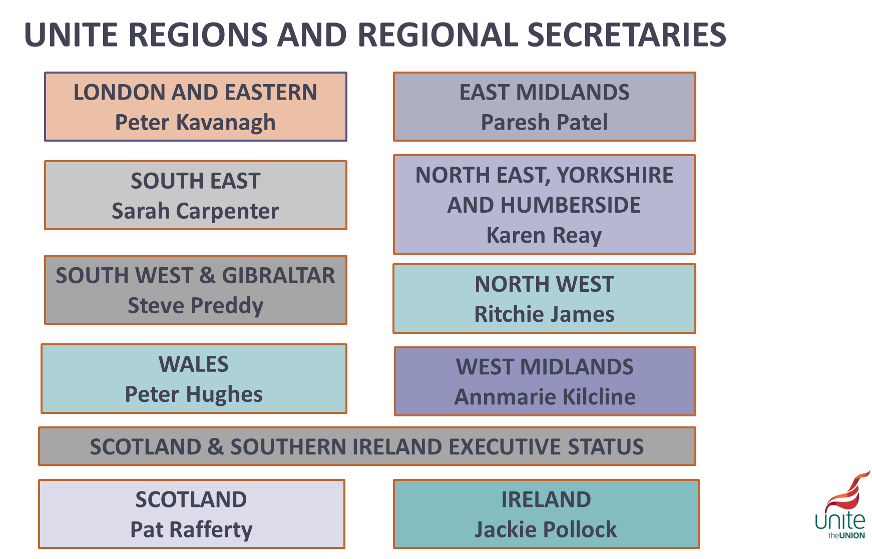
Notes:
You will also be allocated to a region based on where you live

Slide 6
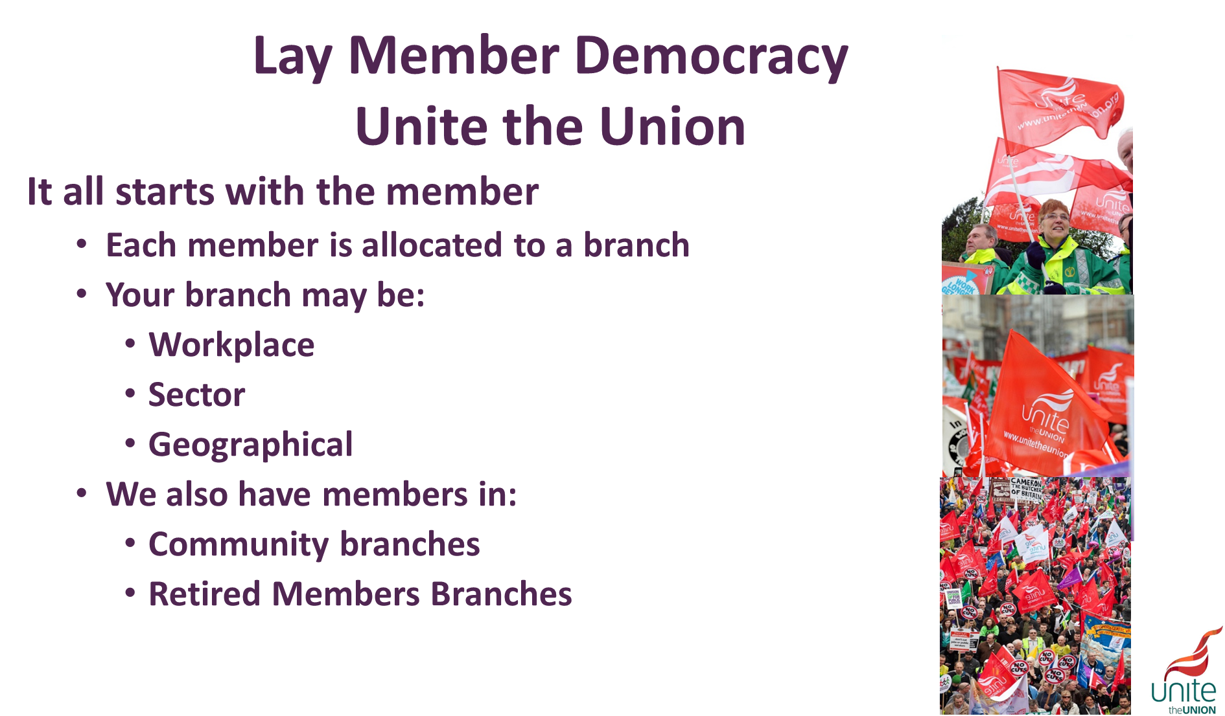
Notes:
Unite is a lay member democracy, its run by the members for the members. When you join the union you will be allocated to a sector and region as we have just covered, you will then be allocated to a branch.
A branch is simply a group of members situated either in the same workplace, sector or geographical area. There are also branches for retired members and our community members who are not in work.

Slide 7
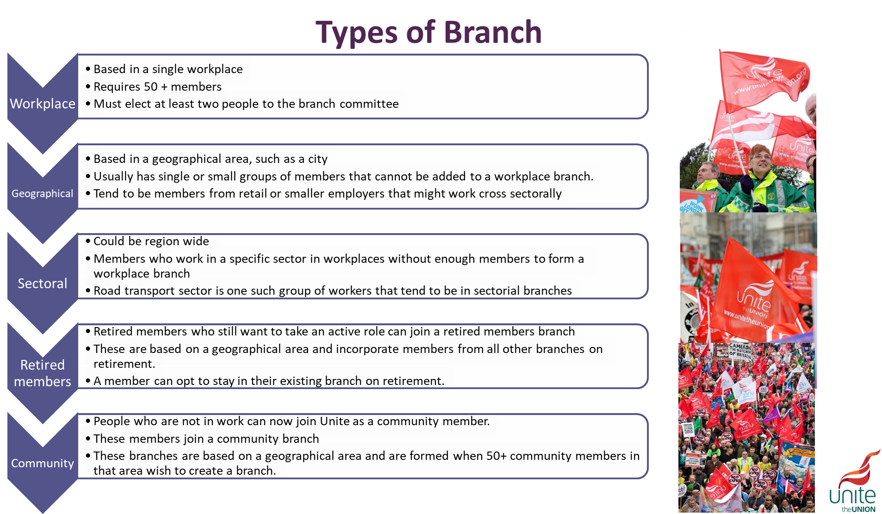
Notes:
There are five types of branch that members are allocated to.

Slide 8
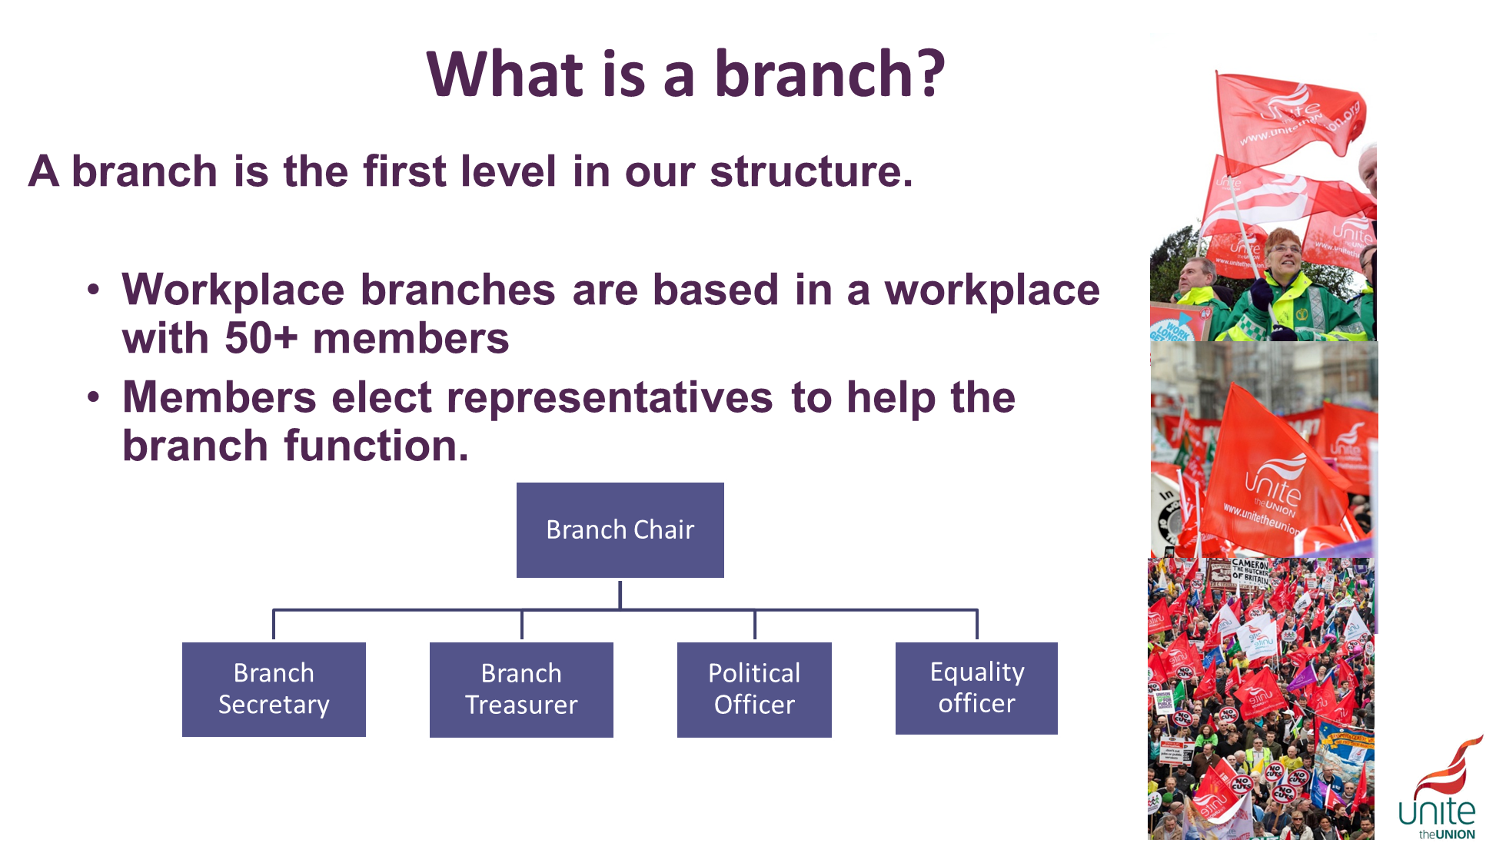
Notes:
Not every branch elects all the positions identified, most simply elect a chair and secretary who also act as treasurer and equality officer. A branch has access to funds from the union to support members or campaign on issues in their workplace, local area or sector. It is the members within the branch that decide how to spend these funds (within the rules of the branch).

Slide 9
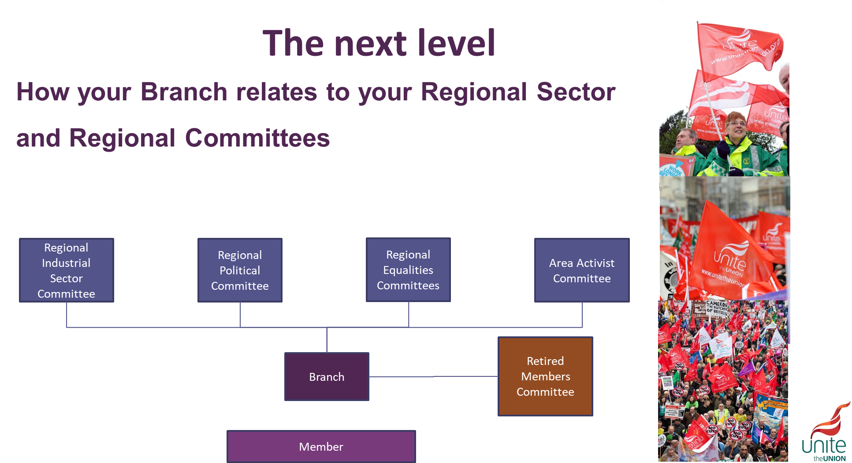
Notes:
The next level of our structure above the various branches is at a regional level. The first of these are the Regional Industrial Sector Committees (RISC). Each of the sectors represented by Unite has a RISC. It is made up of delegates elected onto the committee who work within that particular sector. RISC elections take place once every three years, at a Regional Industrial Sector Conference. All lay representatives who Comply with Rule 6 of the unite rule book (6.3 “accountable representative of workers) in accordance with Rules 17 and 18 (Branch or Workplace Representative) are entitled to attend the conference and stand for election to the Regional Industrial Sector Committee. Each RISC then elects representatives to sit on the regional committee.
The next element of the regional Structure is the Area Activist Committee. AAC’s are geographically based and are made up of activists within that area and are not subject to particular workplaces or sectors. The number and size of the committees is determined by the Regional Committee to represent the geographic make up of the region. Area Activist Committees are elected in the same way as RISC’s. Every three years an Area Activist Meeting is convened for all activists in that geographic area. Delegates then elect members onto the ACC. Each AAC then elects representatives to sit on the regional committee.
The final committees at this level of our structure are the Equalities committees these consist of the Womens committee, LGBT committee, Young Members Committee, Disabled Members Committee and the BAEM Committee. Like the other two committees these committees are elected via conferences every three years. The equalities committees then elect representatives onto seats allocated the the equalities committees on each of the other two committees (RISC & AAC) along with electing members to sit on the Regional Committee.
Retired members unlike other equalities groups do not have a committee, instead they have a forum which is open to all members to attend. An observer delegate is then elected to attend the Regional Committee.

Slide 10
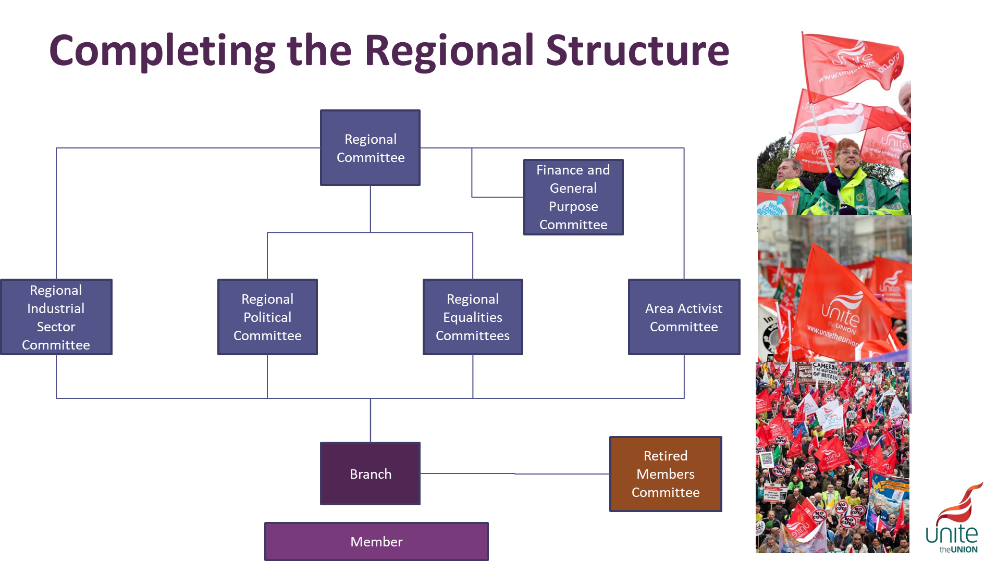
Notes:
Each region is then run by a Regional Committee, again elected every three years and made up from elected delegates from RISC’s, ACC, Equalities committees and with an observer delegate from the Retired Members Forum. This committee then elects a sub committee known as the Finance and General Purpose Committee. This committee oversees the day to day financial management of the Region.

Slide 11
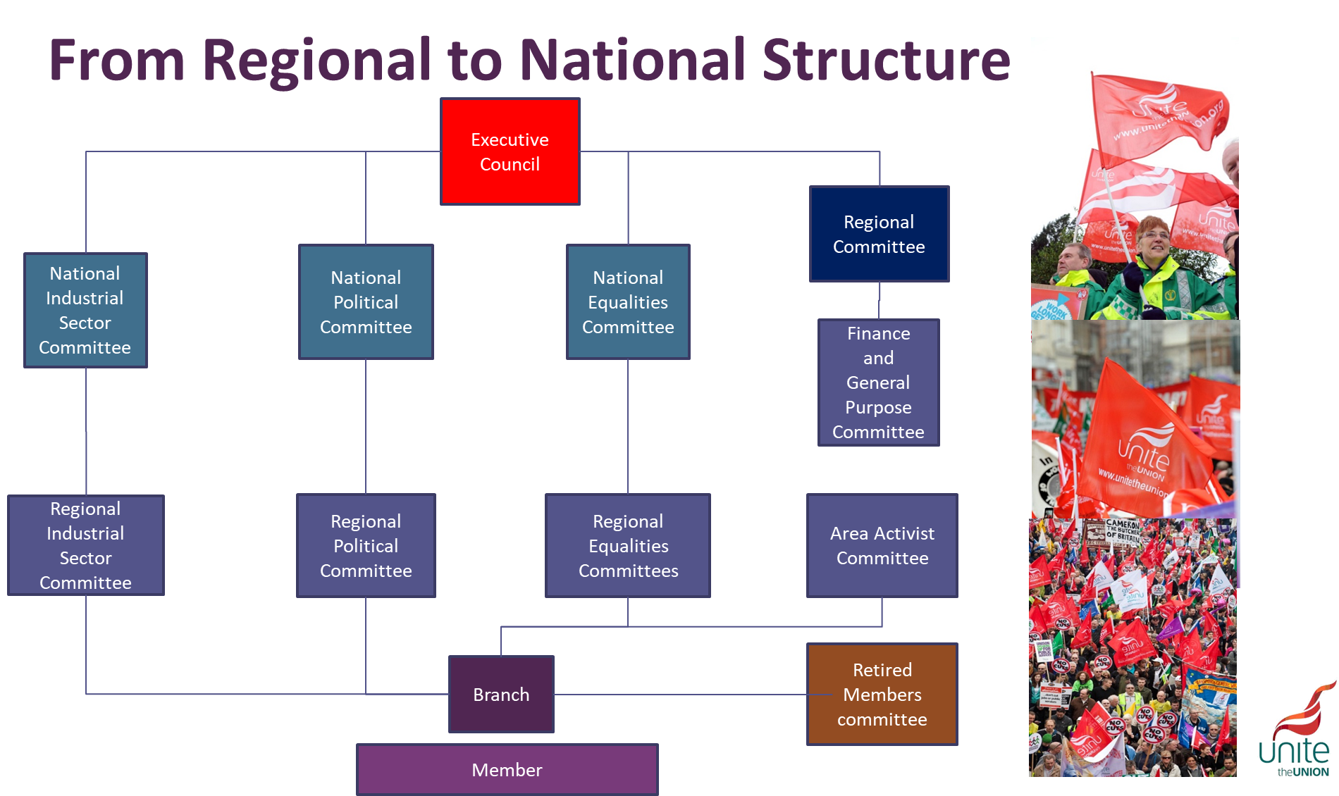
Rules Conference
Policy Conference
Notes:
The National Structure consists of our National Industrial Sector Committees, made up of delegates elected from each regions RISC for that particular sector. The Equalities committees are also elected in the same way, with delegates elected from regional equalities committees to seats on the national committees.
The overall governing body of the Union is the Executive Council. The Executive Council or EC is made up of elected representatives from the Regional Structure, NISC’s and the National Equalities committees. Regional places are elected based on the membership figures. For example regions with 150,000 members but fewer than 200,000 will have three seats available. Rule 14 of the Union Rule book outlines how the EC is elected and who is eligible to be elected.

Slide 12
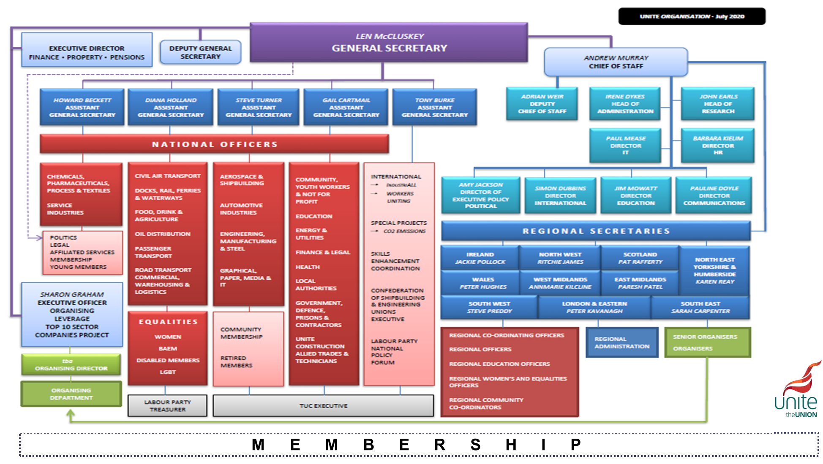
Sharon Graham
General Secretary

Slide 13
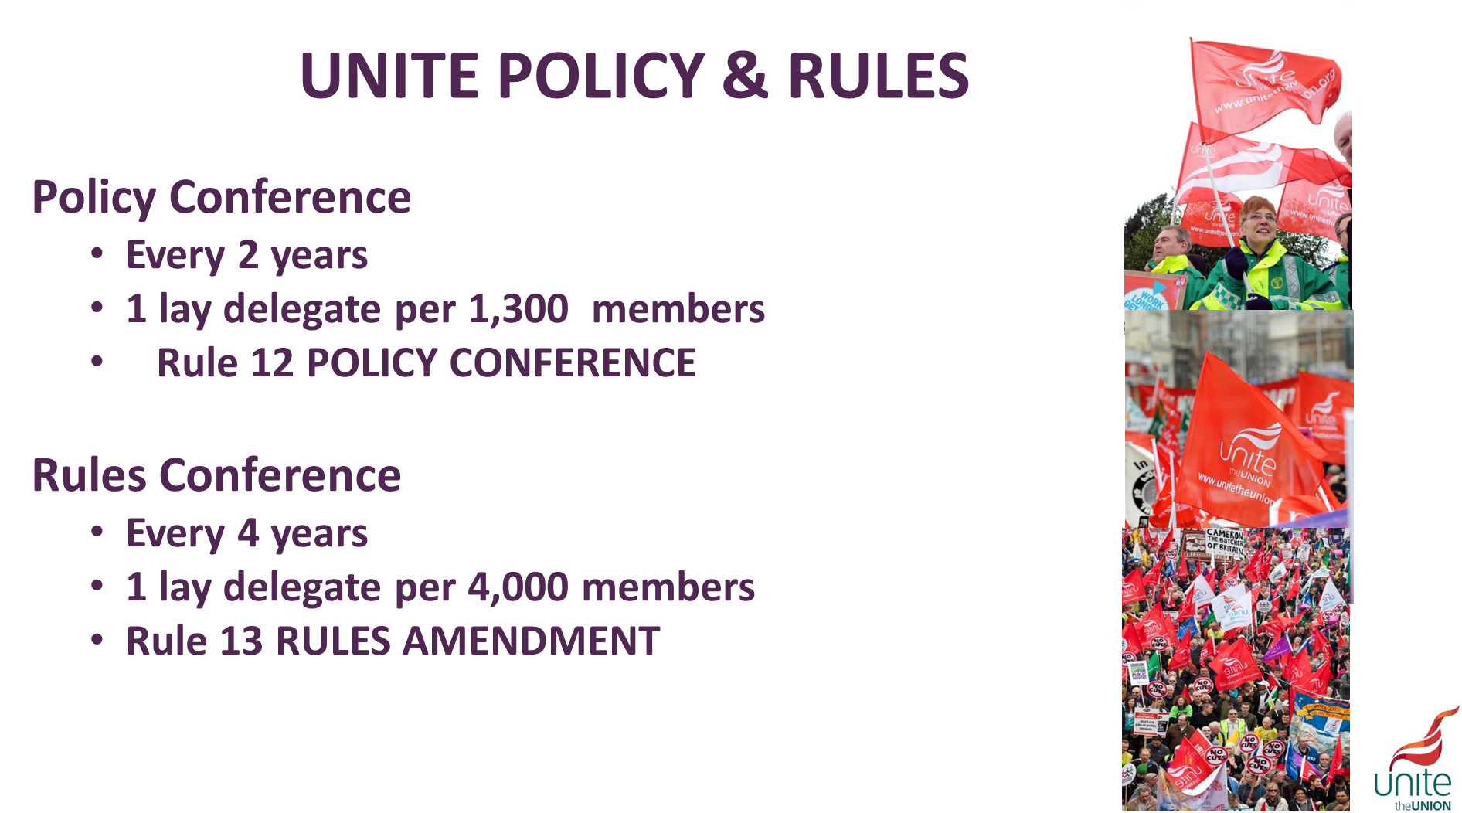
Notes:
The policy conference chooses the direction the union will go in. Whether that is campaigning on industrial or political issues. The members choose our strategy.
The Rules conference ensures our union has rules fit to govern itself. It is at the rules conference that changes to the rule book and how we govern ourselves are made.

