Slide 1
Unite the Union ENVIRONMENT Conference/webinar September 16, 2021
Sue Longley IUF

Slide 2
The International Union of Food, Agricultural, Hotel, Restaurant, Catering, Tobacco and Allied Workers' Associations (IUF) - international federation of trade unions representing workers employed in
agriculture and plantations; the preparation and manufacture of food and beverages; hotels, restaurants and catering services; tobacco
423 affiliated trade unions in 125 countries
www.iuf.org

Slide 3
HOSPITALITY – FAKE CLAIMS
Many (all?) hotel chains claiming you will help them to save the planet by:
Not changing your towels everyday
Not changing sheets
Not having room cleaning in exchange for a coffee voucher
NOT ABOUT SAVING THE PLANET BUT ABOUT SAVING MONEY FOR THE HOTEL
CONSEQUENCES FOR WORKERS INCREASINGLY PRECARIOUS WORK MUCH MORE EFFORT TO CLEAN A ROOM AFTER SEVERAL DAYS AND USES MORE CHEMICALS/CLEANING PRODUCTS

Slide 4
UNITE HERE
https://unitehere.org/campaign/hotel-rooms-should-be-cleaned-every-day/

Slide 5
AGRICULTURE GLOBALLY
GLOBAL FOOD SYSTEM IS BROKEN
BIGGEST SINGLE SECTOR - 1 BILLION WORKERS
BIGGEST SINGLE EMPLOYER OF CHILD LABOUR = 70%
ONE OF 3 MOST DANGEROUS INDUSTRIES
DEPENDENT ON VULNERABLE, HIGHLY EXPLOITED MIGRANT WORKERS
AGRICULTURAL WORKERS DENIED THEIR FUNDAMENTAL RIGHTS TO ORGANISE AND BARGAIN

Slide 6
AGRICULTURE & FOOD

Slide 7
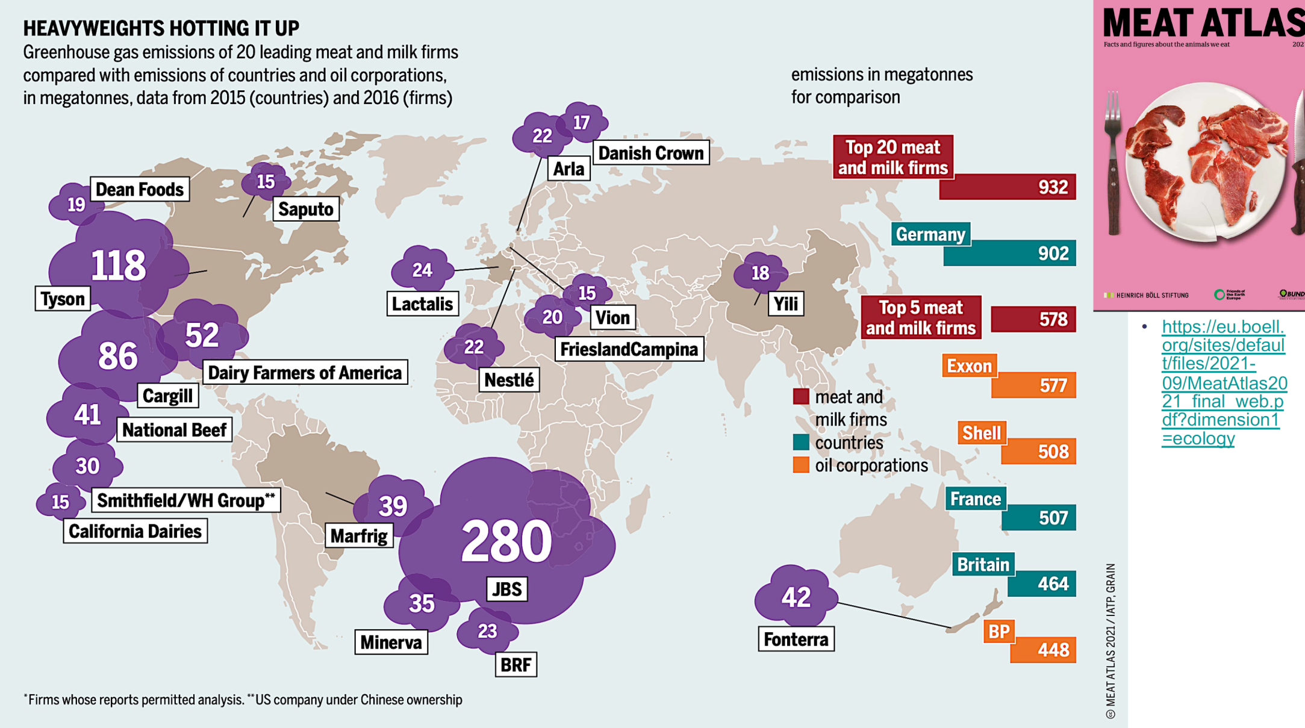
AGRICULTURE & FOOD

Slide 8
HOW DO WE DRIVE THE CHANGE?

Slide 9
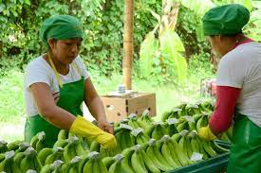
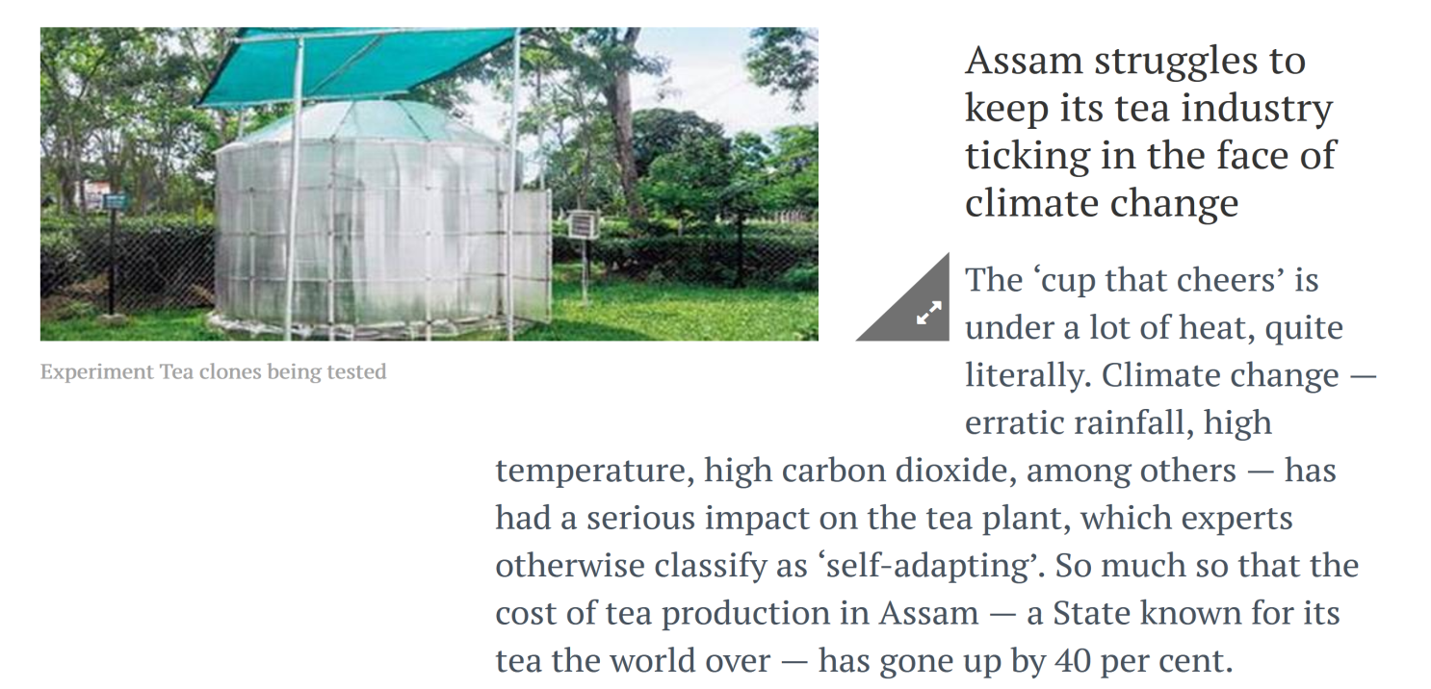
GENDER PROOF OUR RESPONSES
TWO EXAMPLES: WOMEN BANANA WORKERS LAID-OFF WHEN PLANTATIONS DEVASTATED BY STORMS
MOST TEA PICKERS ARE WOMEN – ALREADY LOSING INCOME BECAUSE OF THE DROP IN YIELDS

Slide 10
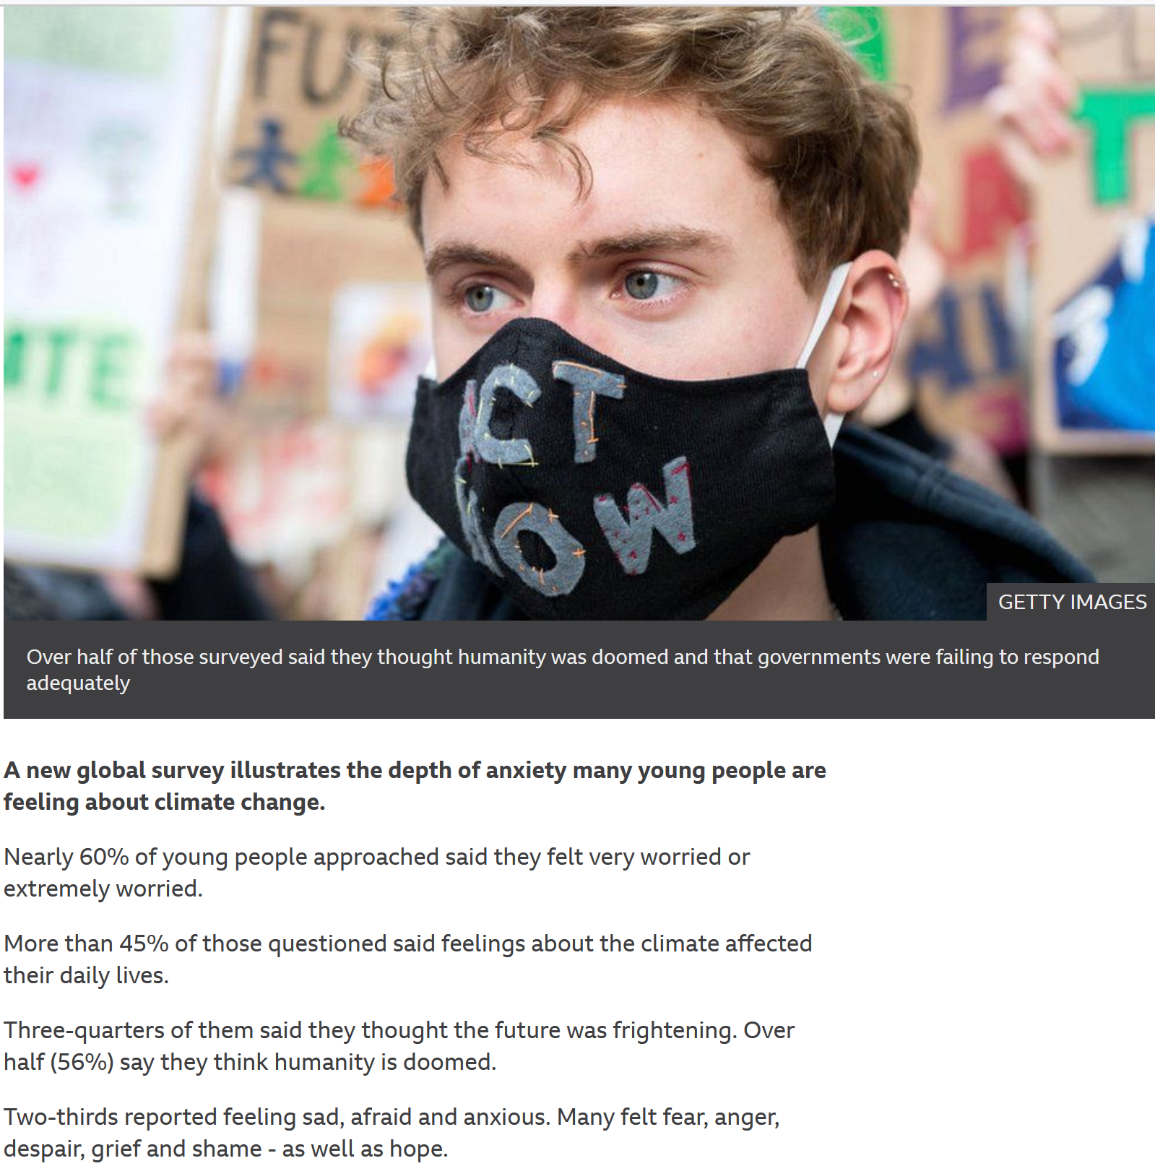
YOUNG PEOPLE AND THE CLIMATE CRISIS
Survey across 10 countries led by Bath University
Many of those questioned perceive that they have no future, that humanity is doomed, and that governments are failing to respond adequately.
Many feel betrayed, ignored and abandoned by politicians and adults.

Slide 11
ORGANISE, ORGANISE, ORGANISE
No longer “male, pale & stale” - but maybe a bit aged
Effective, real work on the climate should help us recruit young workers
Build knowledge and capacity in workplaces
Challenge company fake claims
Do not defend the indefensible - work for a just transition that has decent work and the planet at its centre

Slide 12
Thank you
I look forward to working with Unite on the critical issues that have been discussed today

