Slide 1
Presentation Skills
Public Speaking – Unite National Education Department

Slide 2
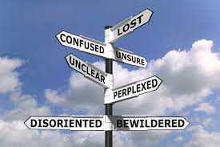
Laws of Effective Communication
Simple and clear
Avoid jargon and technical terms
create messages that are clear to people

Slide 3
Albert Mehrabian & Communication

Slide 4
Communication skills
Active Listening
Body language
Perceptions and attitude
Words we use
Tone of voice
Notes:
4

Slide 5
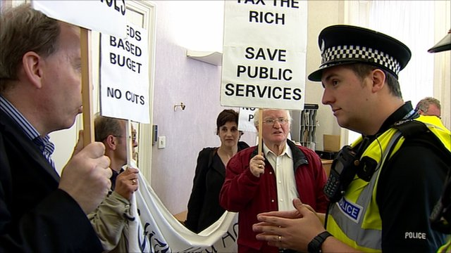
Six Es of Listening
Ears
Eyes
Experience
Emotions
Expectation
Ego
Notes:
5
Ears – The actual words we hard and the tone in which they are expressed
Eyes – The body language we observe – smiling, standing upright and looking enthusiastic – mentoring examples
Experience – What has happened in the past
Emotions – How we are feeling
Pre-emotional state – at start of communication
Post-emotional State – how we feel during the message (e.g. if a particular word is used that upsets us then that emotion will affect the rest of what we hear)
Expectation – What we think will happen/we will hear
if we have a particular opinion about the speaker
Egos Wanting to feel good about ourselves
We listen more if we hear our name first
subconsciously listening for those things that either reinforce our self-esteem or in some way demean it.

Slide 6
Presentation Skills
What do you want to present (content)?
Why do you want to present (purpose)?
Where will you be presenting (place)?
How do you want to present (words to be used or not, slides to be used)
Who is your audience?

Slide 7
Presentation Skills
Preparation: Audience Analysis
What are they interested in
What do they want?
What do they already know
How will they benefit from this presentation

Slide 8
Presentation Skills
Structure the content
What is your objective?
Keep in mind the time allotted
Anticipate questions
Research well
Put points logically

Slide 9
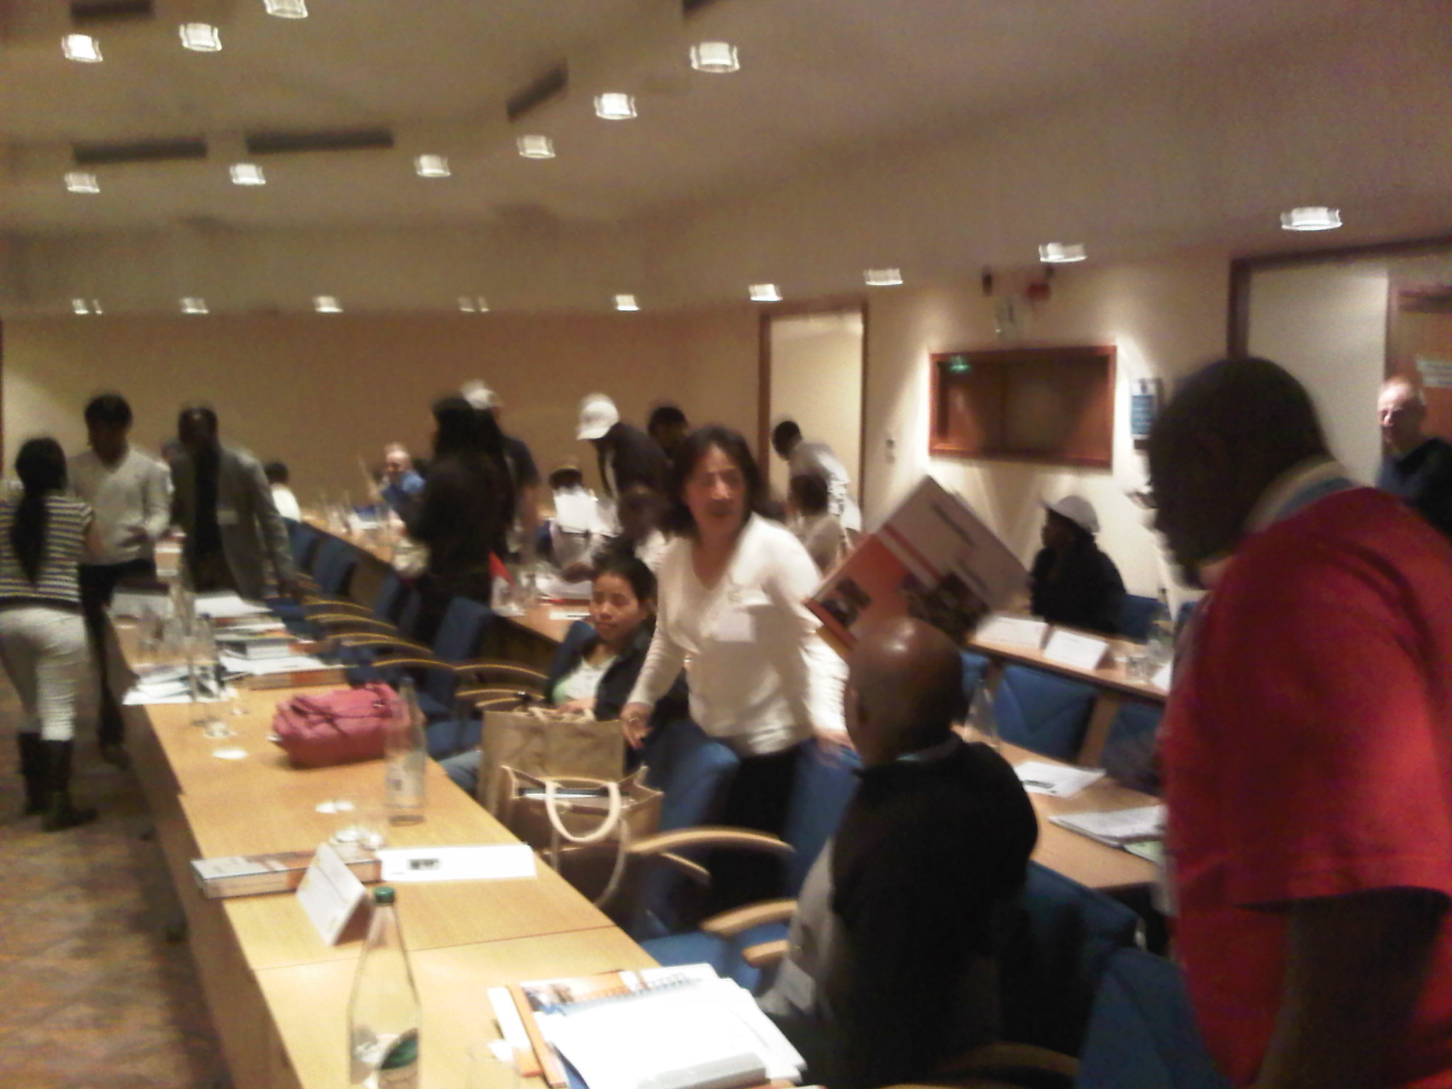
Presentation Skills
Preparation: Audience Analysis
What are they interested in
What do they want?
What do they already know
How will they benefit from this presentation

Slide 10
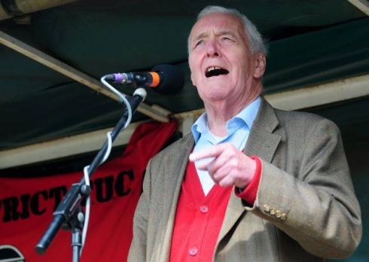
Presentation Skills
Structuring the 5 minute speech
30 seconds--- opening/beginning
4 minutes--- middle section
30 seconds --- closing/end
Time for --- questions

Slide 11
Presentation Skills
The Beginning
Should create a “bang”

Slide 12
Presentation Skills
Sequence should be logical & understandable
Interim summaries- Recaps
Visual aids-flip charts, handouts etc.

Slide 13
Presentation Skills
Prepare Closing
Last few seconds are critical
Summarise- highlight important points
Suggest action

Slide 14
Stage Fright
Everyone has it to some degree
Can be used constructively
Channel the energy fear generates

Slide 15
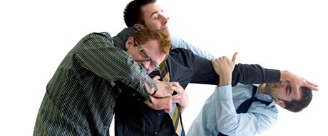
Effective Delivery
Be active - move
Be purposeful - controlled gestures
Variations – vocal (pitch, volume, rate)
Be natural
Get stuck in!

Slide 16
Ideal Message
Use simple language
Be consistent
Three topics
Potential membership losses
Chance of losses over specific time period
Ways to cut losses

Slide 17
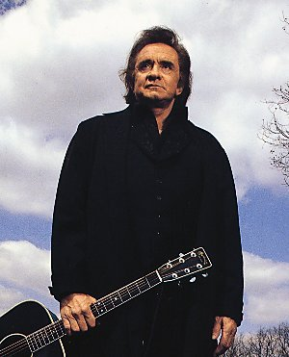
Stories and examples
Stories and examples
These are really useful as they are often remembered longer if they relate to common experiences
Johnny Cash used stories to identify with his audience

Slide 18
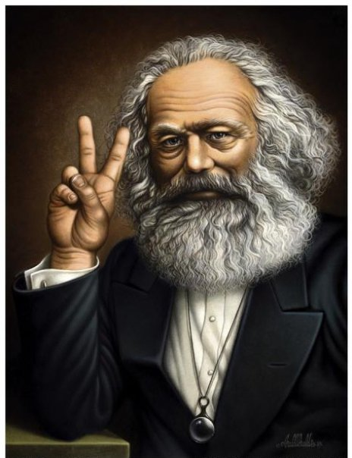
Papa Don’t preach
People don’t like being told
what to do, they need to figure out the answer

Slide 19
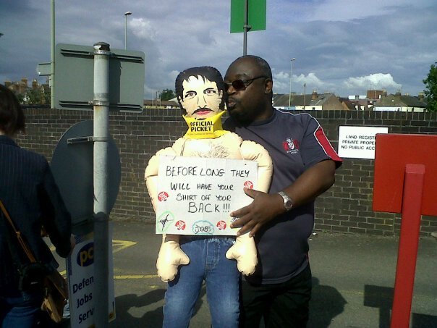
Ask for commitment
People who make a commitment to take an action are more likely to do so.
They need to understand why and agree that it is worth doing.

Slide 20
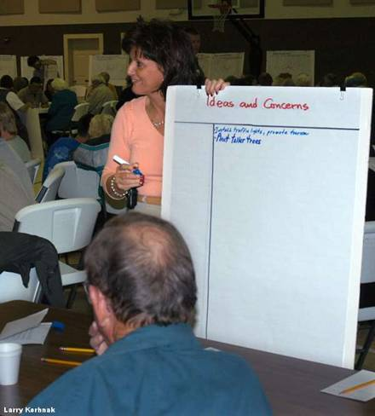
If people aren’t listening!
Explore their understanding
Ask about constraints and barriers
Explore their attitudes and opinions
Win their trust
Use their interests to win their attention

Slide 21
Good communicators
Trustworthy
Engaging
Care about what the audience cares about

Slide 22
Face
Connect to the audience
Good eye contact
Light-housing
Smile
Contact shows confidence

Slide 23
Body
Use the whole space
Look upwards
Gesture to emphasise may seem over the top
Use hands to signal direction, shape, size etc

Slide 24
Voice
Work on projection, best speech no use if not heard
Use power of voice but don’t strain, speak slowly and clearly
A lift at the end may question a drop may suggest confidence control and authority
Emphasise with pace, silent pauses let them think
Avoid fillers eg erm, um
Allow space for applause

Slide 25
Interaction
Audiences have limited attention spans so try to interact, Q&A,
If using questions group 3-4 together in response this speeds responses and allows concentration on positive aspects, the negativity can be buried easier

Slide 26
Practice and preparation
As with anything, success stems from good planning and preparation, you will devise the best method
Consider video, friends, mirror, audio
Time your efforts

Slide 27
Structure
Logos – logical order, structuring needs to be logical A – B –C
Ethos – build trust, do I sound believable
Pathos – Emotion, tell them why it matters, tie them in emotionally

Slide 28
Think what you want
What do you want people to feel as a result of your speech
What do you want people to do as a result of your speech
What do you want people to know as a result of your speech

Slide 29
Paint a picture
Ensure you paint a picture with your words
Make sure that picture is one the audience recognises and touches their lives
Evoke powerful images, ideas and memories
Often use of military, biblical or political quotes and references will connect

Slide 30
Not all rhetoric
Try to sound natural, important to put yourself into a speech
Rhymes and half rhymes can be powerful
A good speech has a rhythm of its own almost poetic
Remember repetition, rule of 3 and use of metaphor
Anaphora – repeat phrases for effect

Slide 31
ELEMENTS THAT CAN HELP WITH OVERCOMING COMMUNICATION BARRIERS
REPETITION
EMPATHY
UNDERSTANDING
FEEDBACK
LISTENING

Slide 32
Verbal Communication- barriers
Speaking too fast
Using jargon
Tone and content
Complicated language
Not questioning
Physical State of the audience

Slide 33
Finish
“With a bang”

