Slide 1
Social media workshop

Slide 2
objectives
To ensure participants have an adequate knowledge of Social Media.
To have an awareness of how the various social media sites can be used.
To know how to access and navigate your way around some key social media sites.
To be able to use social media as communications and campaigning tools.

Slide 3
What is social media?
Websites and applications that enable users to create
and share content or to participate in social networking’.

Slide 4
Social media is two (or more) way communication
You Should:
Ask questions which provoke and answer
Post trivia and ways of involving people
Plan regular themes or events
Post videos and photos

Slide 5
What are the main sources of social media?
Facebook
Twitter
Google Plus
You Tube
Tumblr
Instagram
Pintrest
Wikis
This list is not exhaustive and is ever growing

Slide 6
Group activity
In your groups discuss:
What types of social media sites do you need to use?
How can they be accessed and where from?
How do you want to use them?
Please put your thoughts on flipchart and be prepared to discuss.

Slide 7
facebook
Facebook is a social networking website that makes it easy for you to connect and share with your family, friends and work colleagues online

Slide 8
Getting started on facebook
Type Facebook on search engine an follow link to log in
Follow instructions to Sign Up
You will be asked to insert a cover photo and a profile photo
over photo should be 851x315 pixels
Profile photo should be 180x180 pixels

Slide 9
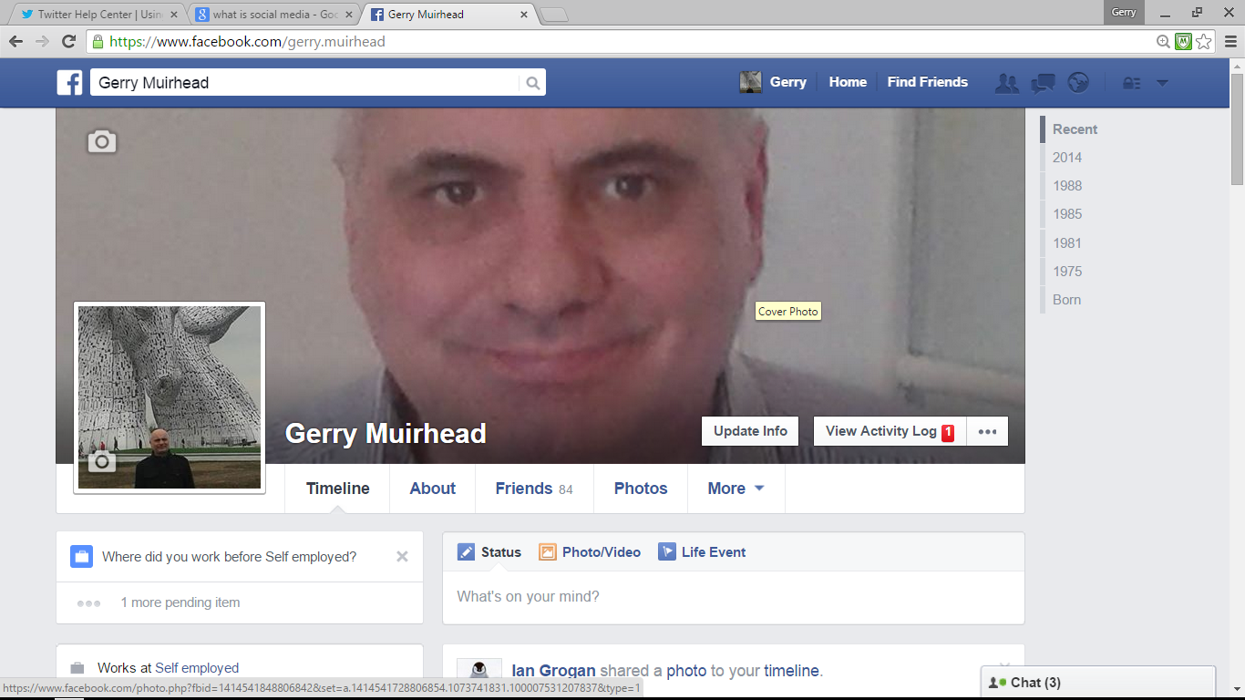

Slide 10
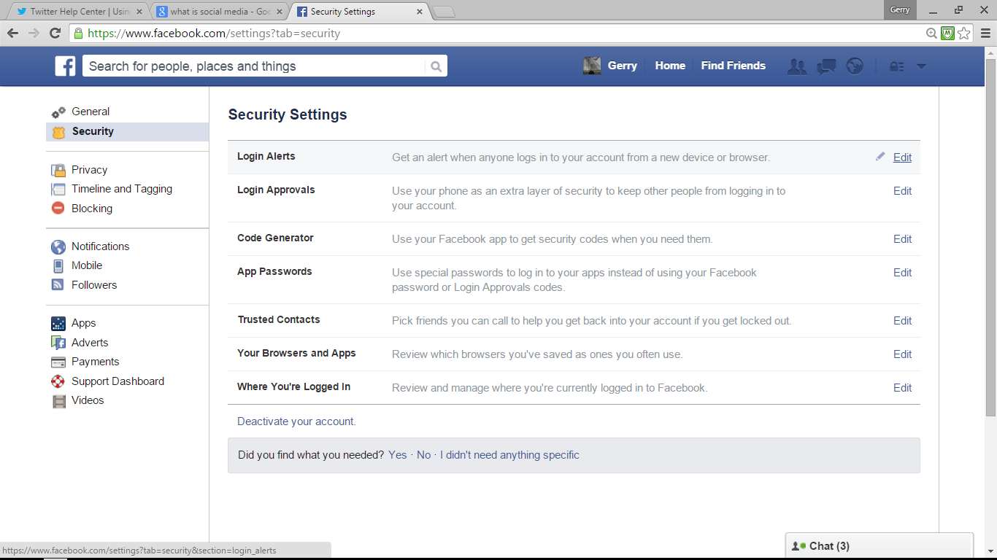

Slide 11
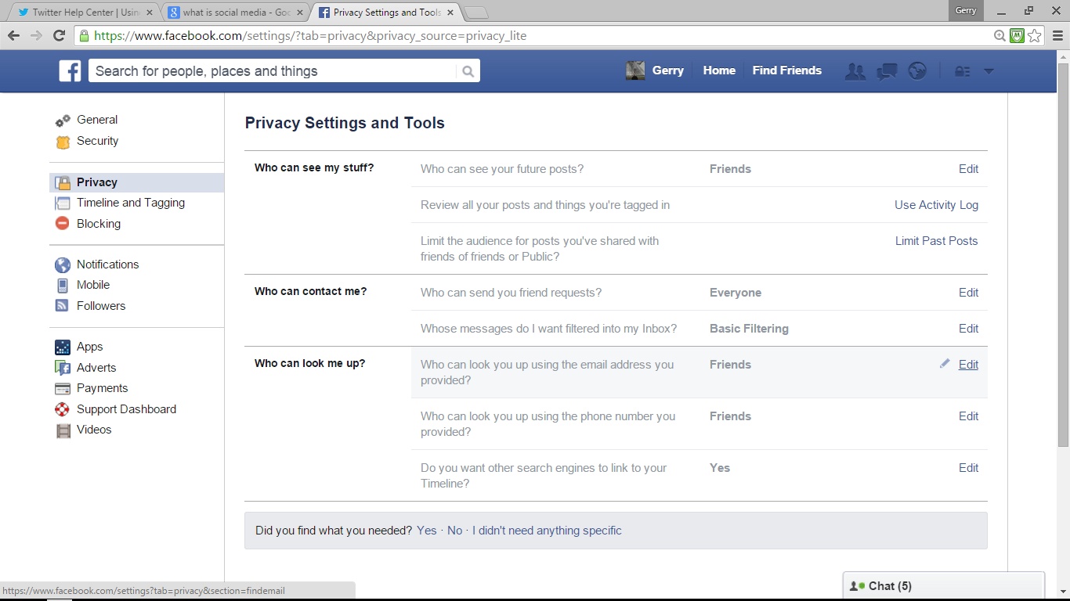

Slide 12
When posting on facebook you should always think visually
Should use photos/videos a lot on facebook
Like and/or comment on videos
Briefly describe photos

Slide 13
Be careful what you put on facebook
You can block keywords and turn on profanity filter.
Click edit page
Select edit settings
Click page moderation, type keywords, save changes
Click profanity filter, select medium, strong, click save changes

Slide 14
You can create groups and pages on facebook
A page could be your local branch or your workplace
A group could be a sector or a campaign group

Slide 15
Using facebook for campaigning
Develop your campaign objective
Decide on content and relevant call to action
Keep it up to date with relevant information, photos videos
Monitor
Regularly adapt and evolve
Try to be original
You can ‘check in’ to places you are at.

Slide 16
What is twitter?
Twitter is an information network made up of 140-character messages called Tweets.
It's designed to help you discover the latest news related to subjects you care about.

Slide 17
When in twitter
Enter your full name, email address, and a password.
Click Sign up for Twitter.
On the next page, you can select a username
Double-check your name, email address, password, and username.
Click Create my account.
You will get a confirmation email to the email address you entered. Click the link in that email to confirm your email address and account.
You will be asked to type some personal information including a bio which will
be a maximum of 160 character

Slide 18
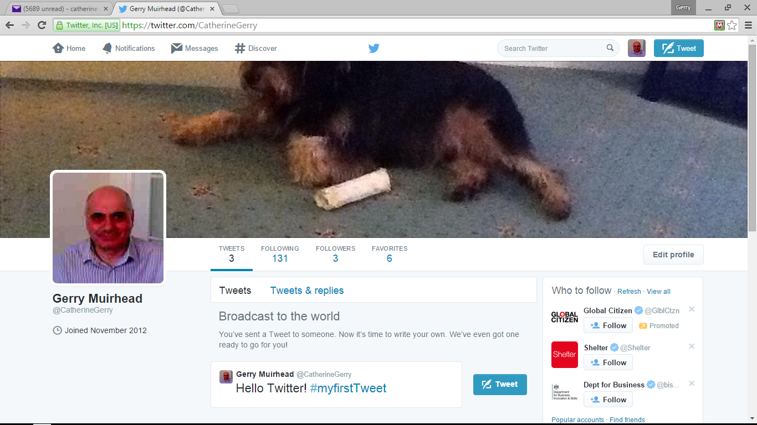

Slide 19
What are hashtags # ?
The # symbol, called a hashtag, is used to mark keywords or topics in a Tweet.
People use the hashtag symbol # before a relevant keyword or phrase (no spaces) in their Tweet to categorize those Tweets and help them show more easily in Twitter Search.
Clicking on a hashtagged word in any message shows you all other Tweets marked with that keyword.
Hashtags can occur anywhere in the Tweet – at the beginning, middle, or end.
Hashtagged words that become very popular are often Trending Topics.

Slide 20
To post a tweet via the web:
Sign in to your Twitter account.
Type your Tweet into the box at the top of your Home timeline, or click the Tweet button in the top navigation bar.
Make sure your update is fewer than 140 characters. Remaining characters show up as a number below the box.
Insert photos
Click the Tweet button to post the Tweet to your profile.
You will immediately see your Tweet in the timeline on your homepage.

Slide 21
Protecting tweets
From the web:
Go to your Security and privacy settings.
Scroll down to the Tweet privacy section and check the box next to Protect my Tweets.
Click the blue Save button at the bottom of the page.
You will be prompted to enter your password to confirm the change.

Slide 22
@mentions and replys
What is an @reply?
An @reply is any update posted by clicking the Reply button on a Tweet.
Any Tweet that is an @reply to you begins with your username and will show up in your Mentions tab on the Notifications page.
What is a mention?
A mention is any Twitter update that contains "@username" anywhere in the body of the Tweet. (Yes, this means that @replies are also considered mentions.)
If you include more than one person's name in your Tweet and you use the @username format, all of those people will see the Tweet in their Mentions tab.

Slide 23
Using twitter for campaigning
Can use hashtags to raise awareness of issues
Can use @replies and mentions to target people
Can follow appropriate people and organisations to
raise awareness of issues and keep up to date with developments.

Slide 24
Using social media for campaigning
In groups discuss How we can use all social media as
individuals
In the workplace
In Branches and committees
For organising and campaigning

