Slide 1
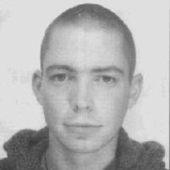
Simon Jones

Slide 2
Euromin
Simon Jones was killed on 24th April 1998, aged 24, on his first day as a casual worker at Shoreham dock, working for a company called Euromin

Slide 3
No Training
He was sent to work unloading cargo inside a ship - one of the most dangerous jobs in the country - with only a few minutes training

Slide 4
The Grab
Within hours of starting work his head was almost completely severed by the clam grab of a crane.
Within hours of starting work his head was almost completely severed by the clam grab of a crane.

Slide 5
Cheap Fix
The grab had been adapted with four chains to lift bags of aggregate out of the hold

Slide 6
The Manager
The adaptation had been carried out on the direction of Euromin’s manager James Martell

Slide 7
The Police
Two beat constables were called to the incident
The majority of police officers are not trained in Health and Safety legislation

Slide 8
The Police Action
Scene preservation
Unloading the vessel
Records
Statements
Audit and Control of scene

Slide 9
The Police
Scene of crimes input
What are the and HSE police supposed to do?
Work related death protocol

Slide 10
The HSE
The Police had attended the scene fairly Several hours were now to elapse before the HSE Inspector arrived.
In the meantime Simon’s lifeless body remained in situ in the hold while work carried on

Slide 11
The HSE
The HSE Inspector arrived alone
She was left on her own to record the scene and obtain evidence.
She asked for HSE back up and was told-there was none available
Her HSE line manager was unobtainable

Slide 12
Failure
No trained forensic investigators attended the scene
The unloading caused the remaining cargo to shift making it difficult to recover Simon’s body

Slide 13
No facilities
James Martell was absent and was not seen for several days
No facilities were arranged on the site for the HSE when they returned to examine the crane

Slide 14
Slow Progress
An initial HSE enquiry followed
Problems and communication
issues

Slide 15
Things begin to move
Finally, six weeks after the event the HSE called in the CID to assist with the enquiry

Slide 16
Simon’s Parents
Simon’s parents were only ever advised verbally about the progress of the investigation
Telephone calls
Family Liaison Officer

Slide 17
The CPS
After the joint HSE/CID investigation the possibility of corporate manslaughter was finally identified.
Unfortunately the Crown Prosecution Service did not agree and decided not to take any further action

Slide 18
The Campaign
Campaigning by Simon’s friends and family resulted in a judicial review

Slide 19
The Verdict
On the 29th November 2001 a jury cleared general manager Martell and Euromin of manslaughter

Slide 20
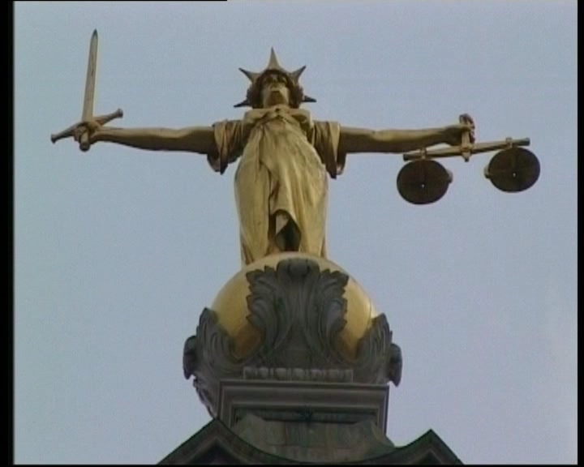
The Verdict
They found the company guilty of two crimes relating to Health and Safety breaches which they considered had led directly to Simons’ death

Slide 21
The Verdict
Failing to ensure their employees health, safety and welfare and failing to conduct a risk assessment on the grab

Slide 22
The Fine
The company was fined
Just £50,000.

Slide 23
The Outcome
Workers Memorial Day
28th April

Slide 24
Simon Jones September 1973-April 1998

Slide 25
Suppose it was one of your members
What should you do if one of your members is killed at work?
Who do you speak to?
What steps should you take?
What is not within your remit?

