Slide 1
Safety At Work
We are proud to present you the winners of our contest

Slide 2
17th place
The delivery man

Slide 3
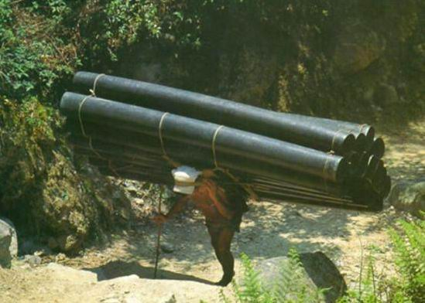

Slide 4
16th place
The grinder

Slide 5
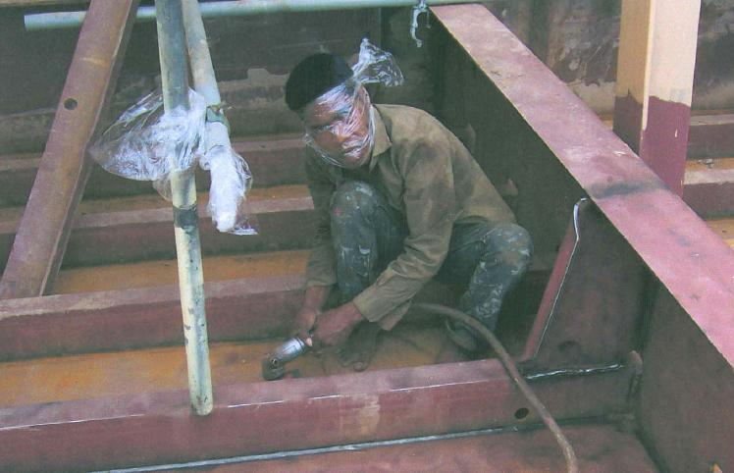

Slide 6
15th place
The mason

Slide 7
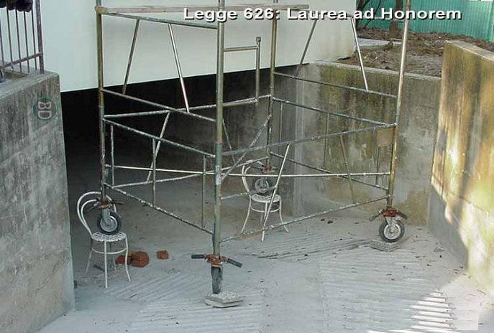

Slide 8
14th place
The welder

Slide 9
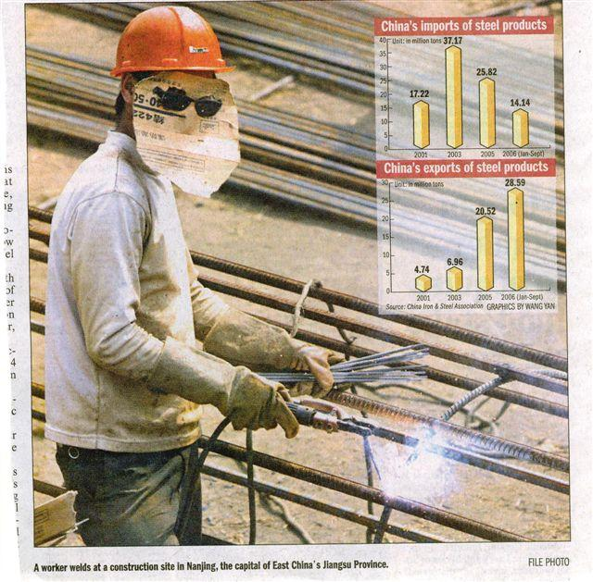

Slide 10
13th place
The luggage handlers

Slide 11
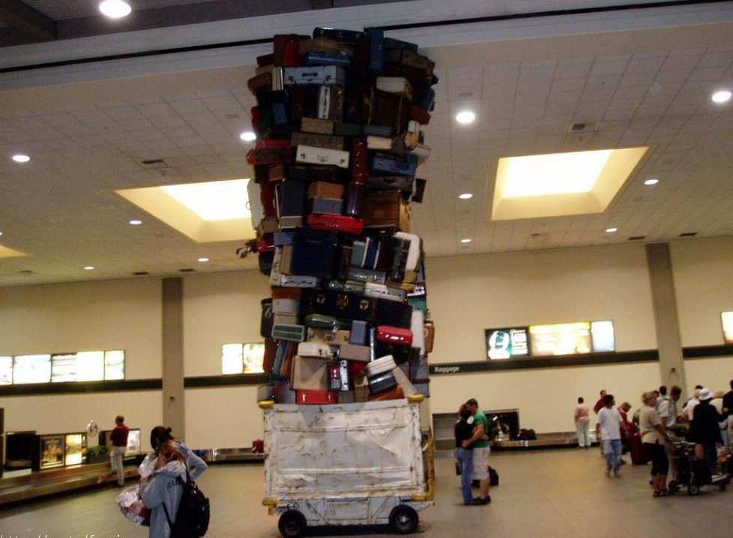

Slide 12
12th place
The painters

Slide 13
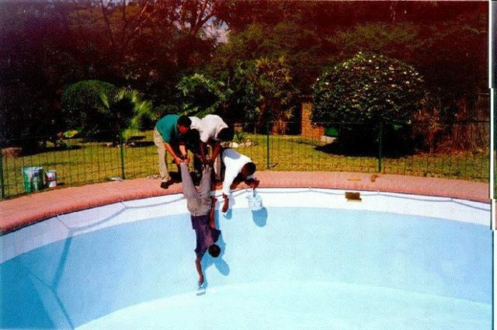

Slide 14
11th place
The shipyard mechanics

Slide 15
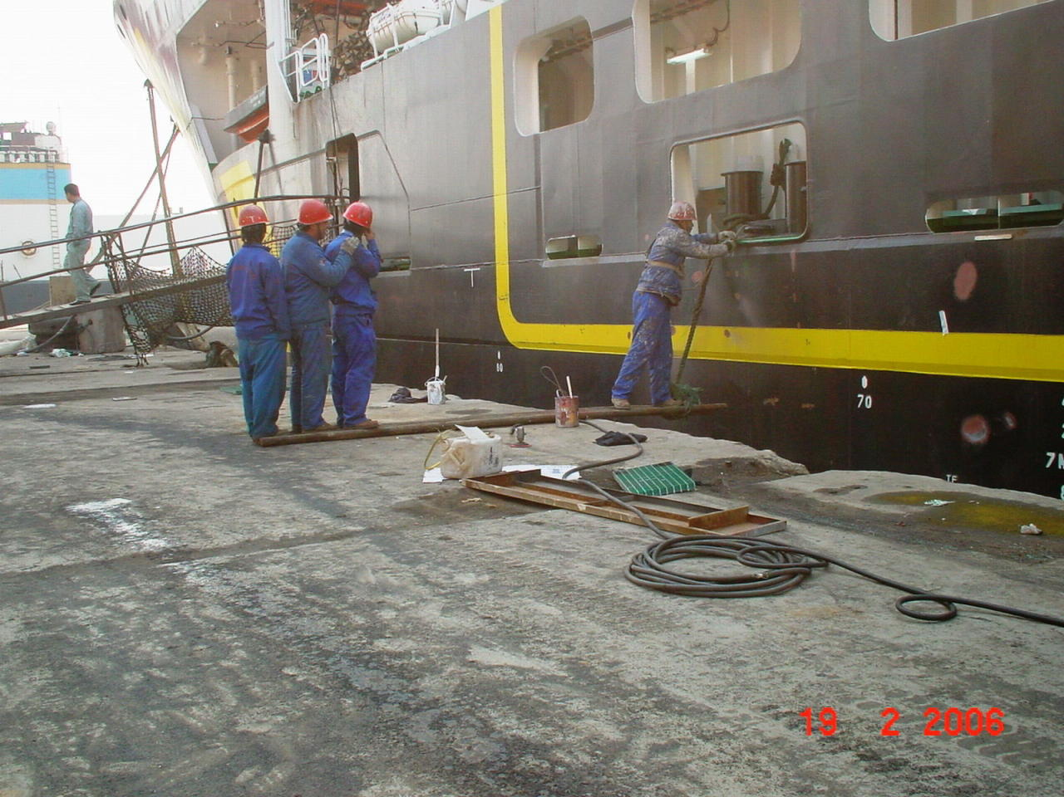

Slide 16
10th place
The air conditioner installer

Slide 17
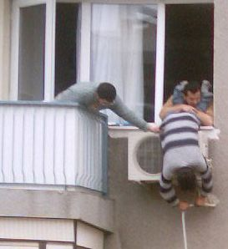

Slide 18
9th place
The construction site worker

Slide 19
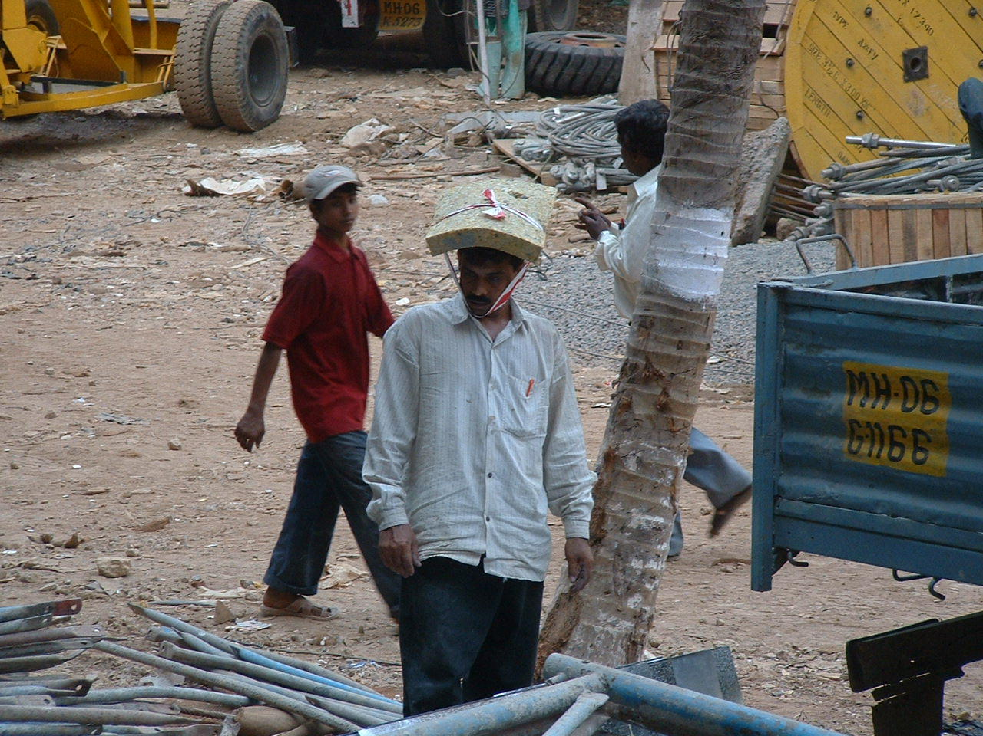

Slide 20
8th place
The expert in biological weapons

Slide 21
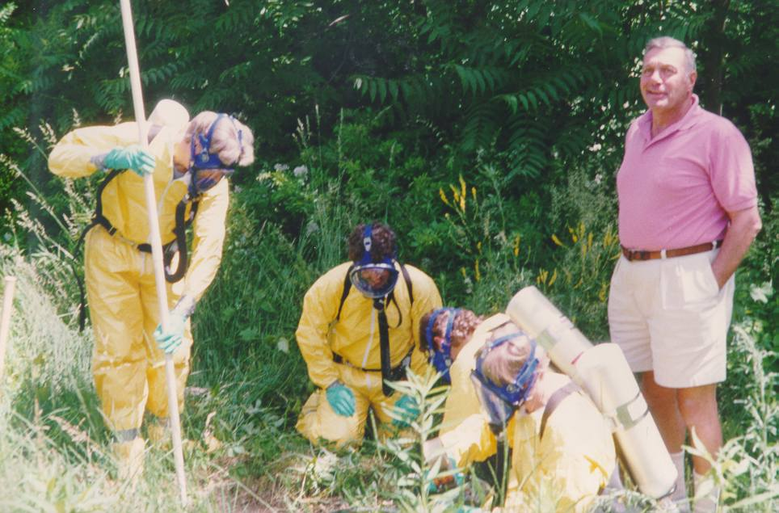
Notes:
21

Slide 22
7th place
The WMD warehouse manager

Slide 23
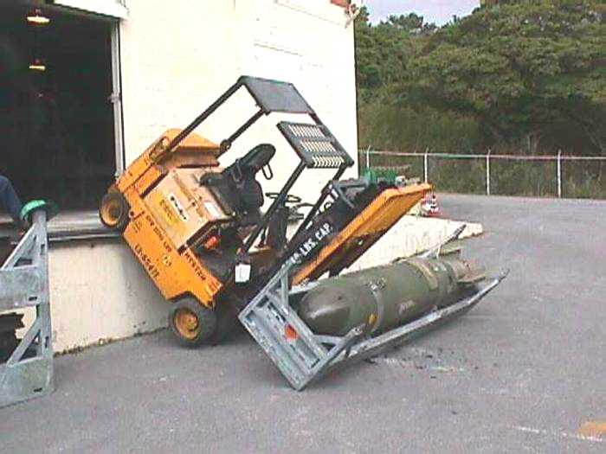

Slide 24
6th place
The car mechanics

Slide 25
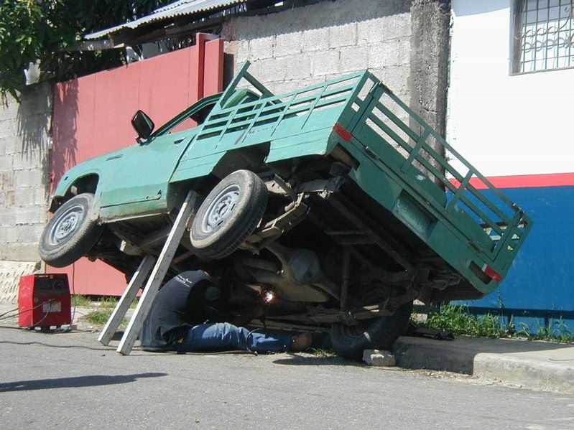

Slide 26
5th place
The electrician

Slide 27
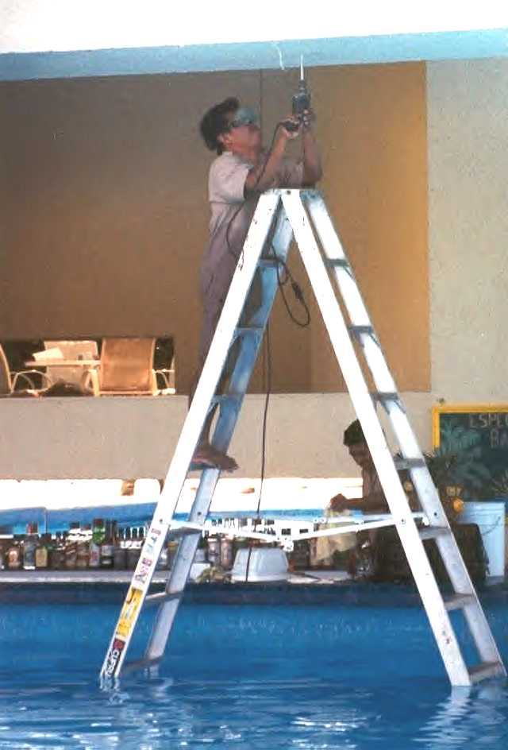
Notes:
27

Slide 28
4th place
The erection team
Notes:
28

Slide 29
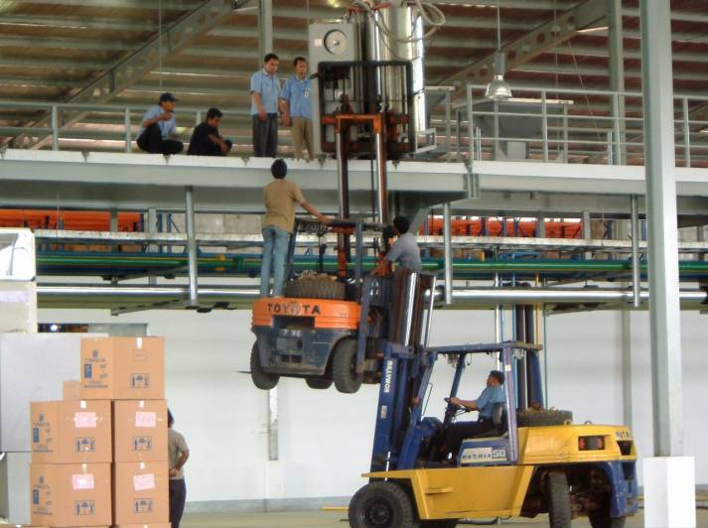

Slide 30
3rd place
The power cable installers
Notes:
30

Slide 31
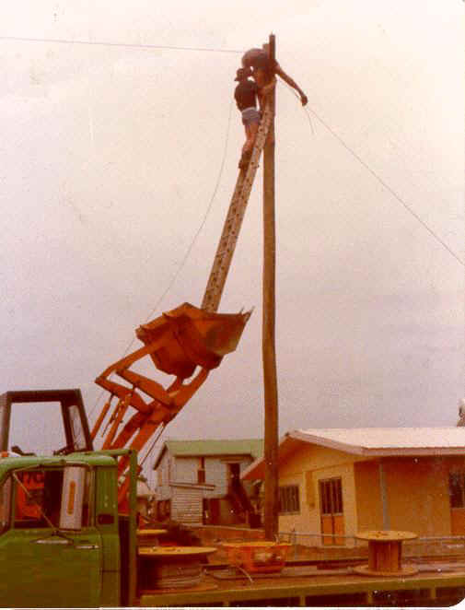
Notes:
31

Slide 32
2nd place
The aircraft mechanic
Notes:
32

Slide 33
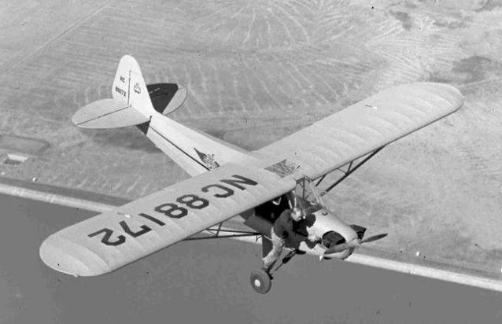
Notes:
33

Slide 34
…
And the winner is …
The city council maintenance team !
Notes:
34

Slide 35
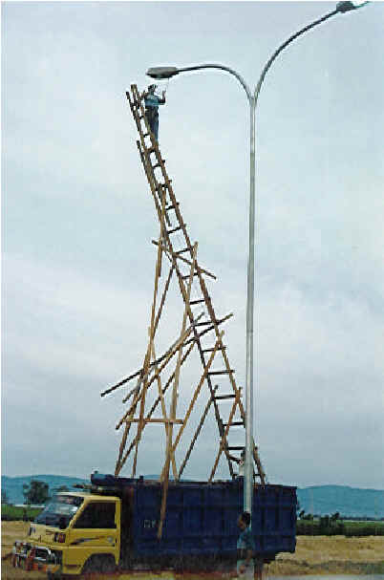
Notes:
35

Slide 36
And finally, a special prize to :
The shooting gallery assistant

Slide 37
