Slide 1
Risk Assessments

Slide 2
Management of Health and Safety at Work Regulations 1999
The law states that a risk assessment must be 'suitable and sufficient', it should show that: -
a proper check was made
you asked who might be affected
you dealt with all the obvious significant risks, taking into account the number of people who could be involved
the precautions are reasonable, and the remaining risk is low
you involved your workers or their representatives in the process

Slide 3
Management of Health and Safety at Work Regulations 1999
The level of detail in a risk assessment should be proportionate to the risk and appropriate to the nature of the work.
Insignificant risks can usually be ignored, as can risks arising from routine activities associated with life in general, unless the work activity compounds or significantly alters those risks.
The risk assessment should only include what could reasonably be expected to know - you are not expected to anticipate unforeseeable risks.

Slide 4
Risk Assessment Objectives
Purpose of risk assessment is so that the employer can identify the measures which need to be taken to comply with the Law
Risk assessment is a means of showing that the employer has done all that was reasonably practicable
Three objectives:
To identify all factors that may cause harm to employees and others (i.e., hazards)
To consider the chances of that harm occurring and the possible consequences (i.e., risks)
To enable the planning, introduction and monitoring of preventative and protective measures to ensure that risks are adequately controlled at all times.
Notes:
4
Reasonable Practicability is the balance between: -
The risk of something going wrong
HAZARD SEVERITY X LIKELIHOOD OF OCCURRENCE
And the
TIME, COST, TROUBLE, DIFFICULTY of putting in control measures

Slide 5
What Is The Difference Between Safety And Health Issues?
RISK
SAFETY HEALTH
FATAL Disabling Major Acute Chronic FATAL
ACCIDENT injury injury illness disease DISEASE
- practical solutions
- transparent danger
no technical challenge
known business loss
200 deaths + road (I,000?)
30,000 major injuries
- insidious danger
- few effective solutions
unquantifiable “loss”
knowledge lags behind
3,500 - 50,000 deaths
2,000,000 ill-health cases
Notes:
5

Slide 6
Definitions
HAZARDS
Anything that has the potential to cause harm
RISK The likelihood of the hazard actually causing harm
RESIDUAL RISK
Risk remaining when control measures are in place (This will either be acceptable or unacceptable)
Notes:
6

Slide 7
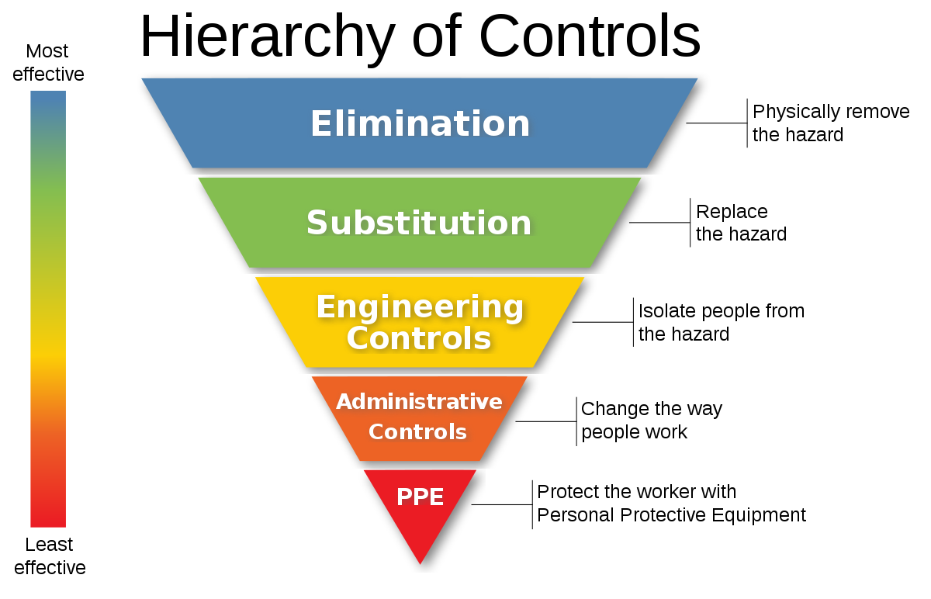

Slide 8
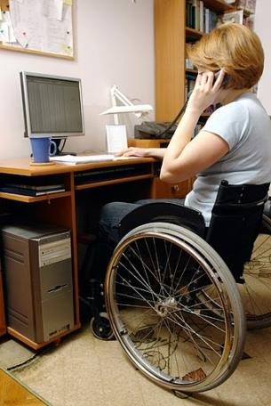
People at Special Risk
Young people
New or expectant mothers
Disabled workers
Lone workers
Notes:
8

Slide 9
People involved in the risk assessment process
Employers/directors
Safety managers/competent persons
Line managers/supervisors
Safety representatives/employees
Contractors
Specialists

Slide 10
Competence of Risk Assessors
What makes a person competent?
Knowledge and experience
Familiarity with:- workplace, work activities/methods, organization, other issues and information
Training and qualifications, Risk assessment skills
Personal qualities
The Ability to recognise our own limitations and when to obtain advice, information and guidance

Slide 11
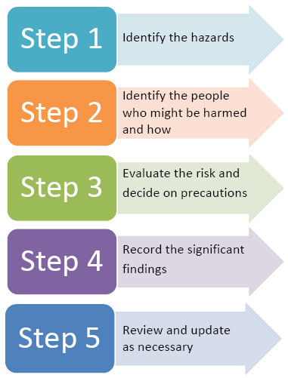
The 5 Steps to Risk Assessment
Notes:
11

Slide 12
Step 1 Hazard Identification
Risk assessment should be task based. You cannot adequately risk assess without watching the tasks
Analyse all parts of the tasks, for example: - operational, cleaning, maintenance, inspection
Look for what could foreseeably go wrong
Consider: -
People (all persons that could be harmed), Equipment, Environment in which persons are working, Materials and Substances
Look for Safety and Health Hazards
Report immediately major hazards
Notes:
12

Slide 13
Sources of Information
Observation Watch the completion of tasks
Discussion
With relevant persons – operators, maintenance engineers, etc.
These people will be able to provide essential information that would otherwise be missed
Notes:
13

Slide 14
INTERNAL Sources of Information
Documentation. Internal and external including:-
Results of inspections, Audit reports
unsafe acts / unsafe conditions.
Previous risk assessments.
Maintenance records
Internal accident and ill health data relating specifically to this task.
lack of incidents does not in itself mean low risk
Notes:
14

Slide 15
EXTERNAL Sources of Information
Relevant legislation
purpose of RA is to ensure compliance – MHSW Reg 3
ACOPs, guidance, standards, industry codes, etc.
External accident and ill health data relating specifically to the job / process, your industry and nationally
Notes:
15

Slide 16
Step 2: Identify the People at Risk
Employees
Maintenance staff
Cleaners
Contractors
Visitors
Members of the public (also trespassers)
Notes:
16

Slide 17
Step 3: Evaluate the Risk - SEVERITY
Insignificant, no injuries / no ill health, negligible property damage.
Minor first aid cases, damage with a potential repair cost of less than £10,000.
Moderate injuries, resulting in up to 3 days absence from normal duties, damage with a potential cost >£10,000 and <£150,000.
Major injuries, resulting in more than 3 days absence from normal duties (includes all RIDDOR reportable injuries), damage with a potential cost >£150,000 and <£1,000,000.
Catastrophic injuries, resulting in fatality / exposure likely to result in fatality or serious chronic condition damage with a potential cost >£1,000,000.

Slide 18
Step 3: Evaluate the Risk - Likelihood
Very unlikely, all best practice controls are in place, are effective and are monitored and maintained to prevent deterioration.
Unlikely, all good practice controls are in place, are effective and are monitored and maintained to prevent deterioration.
Fairly likely, reasonably practicable controls have not all been fully implemented, those that have may not be fully effective or they are not properly monitored and may deteriorate.
Likely, controls are poorly designed, are not effective (demonstrated by previous incidents), monitoring and maintenance systems are absent.
Very likely controls to all intents and purposes are absent.
Notes:
Show an example of a risk assessments

Slide 19
Risk Rating Chart
Acceptable No further action, but ensure controls are maintained | Adequate Look to improve at the next risk assessment review | Tolerable Look to improve within a specified timescale (before the next risk assessment review) | Unacceptable Stop the activity and make immediate improvements
Severity | 1 | 2 | 3 | 4 | 5
Likelihood
1 | 1 | 2 | 3 | 4 | 5
2 | 2 | 4 | 6 | 8 | 10
3 | 3 | 6 | 9 | 12 | 15
4 | 4 | 8 | 12 | 16 | 20
5 | 5 | 10 | 15 | 20 | 25

Slide 20
Step 4 – Record Significant Findings
Typical content: -
Activity/area assessed and hazards
Groups at risk
Risks and adequacy of existing control measures
Further precautions needed
Date and name of competent person
Review date
Notes:
20

Slide 21
Step 5 - Review
Significant change in : -
Process, Substances, Equipment, Workplace environment, Personnel
If it is no longer valid : -
Accident. Near miss, Ill-health, Change to legal standards,
Periodically
Notes:
21

Slide 22
Risk Perception
Perception is the way a person interprets information detected by their senses: -
Sight
Hearing
Smell
Taste
Touch
Any Sensory impairment may reduce the perception of the risks present
Notes:
22

Slide 23
Risk Perception
Other Factors which can affect perception include: -
Illness, Stress, Fatigue, Drugs and Alcohol
Training and education, Experience/ Inexperience
Known/ Unknown
Age
Acuity of senses
Proximity
Notes:
Ask the students which circle is the largest
They are in fact the same size
23

