Slide 1

noise
Can you hear what I’m saying

Slide 2
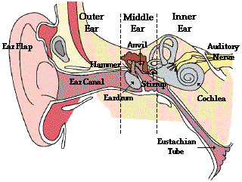
How we hear
Sound waves cause the eardrum to vibrate
Bones in middle ear transmit vibrations to cochlea
Receptors (hair cells) in cochlea convert vibrations to electrical energy
Brain interprets these electrical impulses as sound
Notes:
This picture is a graphic that when clicked with the mouse produces a short clip on how the ear accepts the noise and transmits it through the ear system.
Click the Graphic
Discuss the text on the slide as the graphic works.

Slide 3
Logarithmic scale
If the noise source is doubled
83 dB
The noise level only goes up 3 dB
86 dB
Small increases in decibel level
89 dB
Represent enormous increases in noise level and risk
92 dB
Notes:
The decibel scale means that when the noise is doubled the number only increases by 3 dB.
This in most cases may not be distinguishable by the human ear as it is only a slight change audibly but a big change in the power being given out.

Slide 4

Some activities and their noise levels
Normal conversation 50-60 db(a)
A loud radio 65-75 db(a)
A busy street / general process noise 78-85 db(a)
Power tools e.G.. Grinders & saws 95-100 db(a)
Cold cut saws MSM 110 db(a)
Un-silenced sinter plant fans 115-120 db(a)
A jet aircraft taking off 25m away 140 db(a)
Notes:
These are generic sounds listed in the Guidance document of the Noise regulations

Slide 5
How do I know its loud ?
If you must SHOUT to be understood over the background noise when standing about 1 meter away from somebody,
That background noise is 85 db(a)
Notes:
Unless you have a noise meter you cannot accurately tell how loud it is in the area you are.
A general rule of thumb is that if you need to shout to be understood above the background noise at 1 metre away the noise is generally above 85 dB(A)

Slide 6
How do I know I may have hearing loss ?
If you cannot here someone from 2 metres away and they have to shout for you to hear them it may be an indication that you have damaged hearing

Slide 7
Noise induced hearing loss
Noise >80db(a) can damage your hearing
Causes no pain
Causes no visible trauma
Leaves no visible scars
Is unnoticeable in its earliest stages
Accumulates with each over-exposure
Takes years to diagnose
Is permanent and 100% preventable
Notes:
The HSE states that noise exposure above >80 dB(A) could damage your hearing. In certain circumstances e.g.. Medical conditions people can get damaged hearing from below 80 dB(A).
Please note that this is prolonged exposure over considerable periods of time.
The problem with Noise induced hearing loss (NIHL) is that is sneaks up on you unnoticed
Doesn’t cause any initial pain or trauma
With good management and participation from everyone it is preventable
But be warned once you have it you can’t get rid of it.

Slide 8
Going going gone
Old age = presbycusis
Speech freq.. Lost, can’t communicate
Th / sh / f / s / h / ch / k / p / t
3 types: Acute (Temporary threshold shift)
Tinnitus
Chronic (Permanent threshold shift)
HSE estimate >2 million exposed to >80db(a)
WHO estimate 120 million worldwide have disabled hearing
Notes:
NIHL accelerates old age
Lose the higher freq.. such as the consonants
There are three main types of loss or damage:
Temporary threshold shift - this is when your threshold of hearing reduces for a period of time and then returns back to its normal level. An example of this would be after a night club or even after work after exposure to high noise levels when you turn on the radio, in the morning you turn it back on and think that its loud. Its just your ears becoming tiered after a busy day at work. It may take up to 2 to 3 days to fully recover.
Tinnitus - is a ringing or tone in your ear, in some cases its constant. Can be very annoying and mentally debilitating. Some people have to sleep with the TV on or Radio to go to bed to drown out the ringing. Can be temporary also such as after working in high noise levels or after leaving a night club (or other noisy environments)
Permanent threshold shift - when your threshold of hearing is reduces and never returns to normal, the damage has been done and its too late. This occurs over years of exposure but all depends on the individual.
Discuss the statistics and emphasise the fact that people don’t die from noise at work but many more people suffer than other health hazards.

Slide 9
Control of noise at work regs (2005)
Reduce the risk of damage to employees hearing
Reduce the noise at source by:
        Elimination
        Engineering controls
Work on a daily exposure over 8 hours
Use hearing protection as a last resort to reduce exposure, this is not a control measure
Notes:
There were some slight changes from the old regs but in general they required similar things.
Reduce the risk
One big change was the emphasis on reducing noise at source
When we talk about noise levels and how much people can be exposed to we need to set it against a daily does which is known as the LEPD of the employee which is their dose over an 8-hour period.

Slide 10
Exposure levels / limits
87 db ~ exposure limit
    Maximum allowable noise level in the ear with protection
85 db ~ upper action level
    Hearing protectors required
    Audiometric evaluation made available to exposed workers
    Warning signs posted in noisy areas
80 db ~ lower action level
    Hearing protectors made available if requested
    Training program for noise-exposed workers
    Audiometric screening made available to exposed workers
Notes:
The other major changes to the regs were the introduction of the two new upper and lower action values and the totally new Exposure limit value.
The action value have actions for the employer and the employee to carry out. (as stated above)
The Exposure limit value should never be broken - this is an 8-hour exposure dose to above 87.0 dB(A) with the attenuation of hearing protection taken into account.

Slide 11
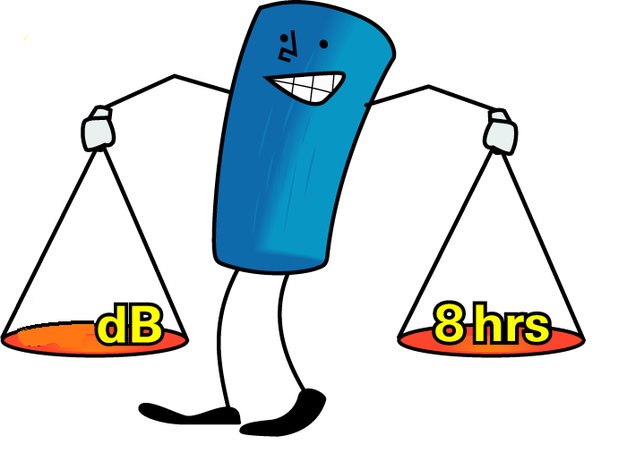
Daily exposure level
85
Notes:
Because of the logarithmic scale we can use the next two slides as an example of exposure time

Slide 12
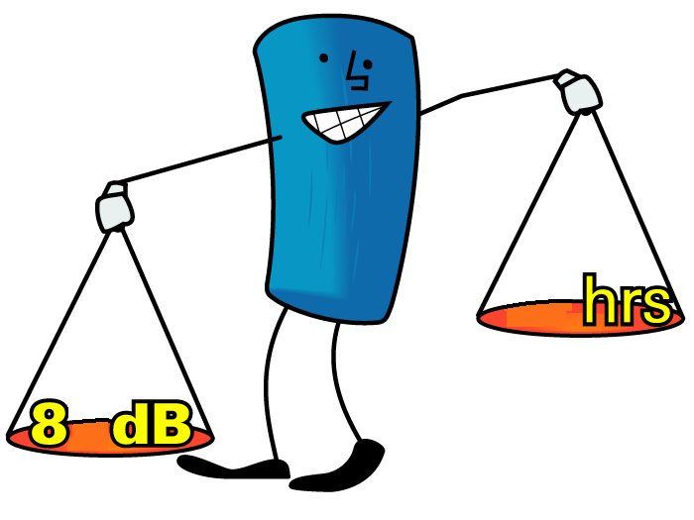
Daily exposure level
4
8
Notes:
Because of the logarithmic scale we can use the next two slides as an example of exposure time

Slide 13
Management of noise
Assess the risk of excessive noise exposure
If potential of exposure is >80.0 db(a)
  Noise assessment of the workplace is required
Workplace monitoring and personal dosimetry
Results of survey will help establish a noise management plan
Detail and prioritise risks, the areas, the controls and actions to achieve the controls
Notes:
The Control of Noise at Work Regulations (2005) require the management of noise exposure in the workplace if an initial assessment shows to be a risk to excessive noise exposure.
Surveys and personal dosimetry will be carried out to establish high noise risk areas. This is done by the Occupational Environment Team..
Help establish noise hazard areas - blue and white signs
The results will go towards creating a noise management plan which will detail the risks, the areas, the controls and the actions on how to achieve the controls.

Slide 14
Eliminating / reducing noise exposure
Eliminate or reduce noise at source
Apply engineering controls: (Noise barriers, Acoustic enclosures / absorbers, Silencers)
    Maintenance of equipment
    Anti-vibration devices
Apply procedural controls:
    Provide information instruction and training
    Reduce exposure time / restrict access (Job rotation within team working)
Denote noise hazard areas with signs
Notes:
The Control of Noise at Work Regulations (2005) require us to eliminate or reduce noise at source. By applying the above techniques.
If you have any noise controls in your areas you may wish to discuss these now.
Make a note that noise hazard areas should be denoted with the relevant signs. This would be the mandatory hearing protection signs which are blue and white in colour, yellow and black signs inform of a potential noise hazard.

Slide 15

PPE hearing protection
Last resort / temporary measure
Compulsory in hearing protection zones
Must know what type to use
Best or most adequate attenuation
Notes:
Hearing Protection can be used to reduce noise exposure.
But it should only be used as a last resort or a temporary measure until other controls can be put in place.
Some people use hearing protection as the only noise control but this is seen by the HSE as bad control practice.
Hearing protection should always be worn in accordance with manufacturers directions in a noise hazard area. - it is illegal not to under the regs.
Employees can be fined up to £5000 if prosecuted
There are many types: plugs, muffs, personal plugs
These should all be made available if they are shown to provide adequate attenuation of noise.
There can be a problem with over protection where high quality hearing protection is used in areas of low noise levels. This could cause other problems in the workplace such as communication failure and the inability to distinguish alarms and sirens and the vulnerability of feeling isolated.
Try and emphasise that plugs and muffs do the same job and there isn’t one that is better than the other, it all comes down to personal preference and the attenuation provided by the plug or muff.

Slide 16
Excuses for not wearing hearing protection
I don’t need to wear hearing protection i’m already deaf!
It’s a free country i can do what i want!
I can’t hear people speak when i’m wearing hearing protection!
I need to remove my protection to listen to sounds of machines!
I’ll only be in this area for a short time!
Wearing hearing protection can harm your ears!
My personal stereo blocks out the factory noise!
I’m not the one using the noisy tools!
Notes:
Below is the feedback to the above statements
1 - Very few people with hearing problems are completely deaf. The hearing loss will get worse if exposure to loud noise is not stopped. It is even more important that people who already have some damage to their hearing protect what they have left. A person who had lost one eye would not be careless with the other!
2 - Employees have a legal duty under the Control Noise at Work Regulations 2005 to wear the hearing protection they are provided with in ear protection zones. If an employer has complied with the law, but the employee still refuses to wear hearing protection, then HSE could take the employee to court. If they are found guilty, they could be fined up to £5000.
3 - It is actually easier to distinguish speech in a noisy environment while wearing hearing protection because much of the background noise is screened out. Some hearing protectors are specially designed to make it easier to hear speech, such as level-dependent protectors (show an example if possible).
4 - Removing hearing protection, even for a short time, greatly reduces the protection provided. If this damaged their hearing, it would be even harder to hear the machine. Diagnosing faults on machines can still be done wearing hearing protection, but people need to re-learn what the
machines sound like with hearing protection in place.
5 - Everyone should put on hearing protection before they enter an ear protection zone, no matter how long they intend to stay there. This applies to managers, people who work in the office, visitors and fork-lift truck drivers, who may be in and out of the
area regularly.
6 - • Earplugs are soft and not long enough to reach far into the ear canal so it is virtually impossible to do any harm. • Earplugs cannot cause ear infections, although people with existing ear infections should not wear them - they should wear earmuffs instead. Ear infections are never a reason why hearing protection should not be worn. If employees report ear problems such as infections or a build-up of wax, they should go to their GP (or, the company's medical advisor).
7 - Personal stereos simply add to the total factory noise exposure, they can't protect against it.
8 - Sound is transmitted through the air and affects everyone, not just the person nearest to it. So even if you are not the one using the noisy tool, or working at a noisy machine, you still need to protect your hearing.

