Slide 1

Manual handling

Slide 2
What is Manual Handling?
‘Involves both the transporting and supporting of a load’ and includes:-
Lifting, Lowering
Holding
Carrying
Pushing, Pulling
Throwing
Moving
Notes:
The movement of a load by human effort – as opposed to using a forklift truck or equivalent.
Either directly or indirectly – using the hands or body to move something is direct and tying a rope round something and pulling it is indirectly
A load is a discrete moveable object such as a box or bag of compost. It does not include implements tools or machines when used for their intended purpose. If you are moving a sack truck for the purpose of taking it to a different location it is a load – if it has a load on it that is being moved it is not a load in itself.

Slide 3
Manual Handling Regulations
The regulations require employers to make a suitable and sufficient assessment of the risks to the health & safety of their employees while at work
Where this general assessment indicates the possibility of risks to employees from the manual handling of loads, the requirements of manual handling operations regulations must be complied with_

Slide 4
Employers Responsibilities
Avoid handling where possible
Conduct assessment
Take steps to reduce risks
Provide information, instruction and training_

Slide 5
Hierarchy of Measures
The regulations set out a hierarchy of measures which should be followed to reduce the risks from manual handling
Avoid hazardous manual handling operations so far as is reasonably practicable
Assess any hazardous manual handling operation that cannot be avoided
Reduce the risk of injury so far as is reasonably practicable_

Slide 6
Injuries
Musculoskeletal Disorders (MSD)
Parts of the body that can be injured during handling activities include:
Lower back (lumbar spine)
Neck (cervical spine)
Arm, wrists, shoulders
Knees
The back is the main area of concern forming a high proportion of injuries, and with potentially devastating and costly effects_

Slide 7
Types of Handling Injuries
Insidious, Cumulative effects over time
Over time, constant wear and tear on the spine damages the discs putting more pressure on the facet joints. Other tissues adapt causing reduced range of movement, and the back becomes gradually more prone to injury
Pain can result, particularly when there is also inflammation. Sometimes this pain is referred, that it is felt elsewhere e.g., in the buttocks or down the legs
Static activity and positions causes pain as the blood flow becomes restricted so muscles tire very quickly making the area prone to injury
Over - exertion

Slide 8
Types of Handling Injuries
Traumatic events
The “one – off” accident
Acute
Short term – reversible
Chronic –
Long term through bad lifting techniques

Slide 9
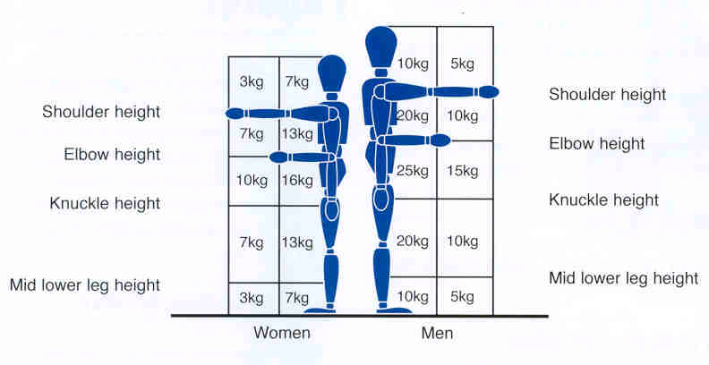
Guidelines for Lifting and Lowering

Slide 10
Lifting and Handling
The three p’s to successful lifting and handling
  Planning
  Preparation
  Performance

Slide 11
Plan
Consider the location and destination of the load to be moved?
Who needs to be involved?
Are there resting places on the journey?
Are there ramps / staircases / confined spaces?
Mechanical / automated assistance available?
Is a full risk assessment required?
Notes:
Stop and think – plan what your going to lift – can you use a trolley instead? Where are you going to put the load? Will you need to get someone to help you? Are there any obstructions in your way, if so move them before you try to lift. If you are carrying a long way, find somewhere to have a rest part way through.

Slide 12
PREPARATION
Is the gross load weight marked and within guidelines?
What is the load and does the label reflect the contents?
Is there a heavy end?
Is the load bulky or unwieldy?
Is the load hot / cold / sharp / dirty?
Is it a single / two / three man job?

Slide 13
PERFORMANCE
Where is the centre of gravity?
Can I use the six steps to correct lifting?

Slide 14
Reduce the Risk
Ergonomics
Mechanical assistance
Work routine
Changing the load
Workplace layout
Information, instruction and training

Slide 15
Those at Particular Risk
Young
Pregnant
Disabilities
Health problems
Accident records
Previous injuries
Notes:
All subject to significant debate and variation
As a general rule males have a greater lifting capacity than females, but a degree of overlap exists and this is influenced by health, strength, fitness, training and experience.
Pregnancy has a significant influence on a females capacity to lift and move objects safely.
People are at their peak in terms of lifting in their 20s and start to decline in their 40s. This should be viewed in parallel with the benefits of experience and maturity, which are often lacking in younger operatives.

Slide 16
Assess the Risk (TILE)
If manual handling cannot be avoided
T = Tasks
I = Individual
L = Loads
E = Environment

Slide 17
Task
Does it involve:
Holding loads away from the trunk, Twisting
Reaching upwards, Large vertical movement
Long carrying distances
Strenuous pulling or pushing
Unpredictable movement of loads, Repetitive handling
Insufficient resting or recovery, A work rate imposed by a process

Slide 18
Individual
Does the job
Require unusual capability
Call for special training
Other factors
Hazardous to those with a health problem
Hazardous to those who are pregnant
Is movement or posture hindered by PPE

Slide 19
Load
Is it:
Heavy (how heavy?)
Bulky / unwieldy
Difficult to grasp
Unstable or unpredictable
Harmful e.g. sharp or hot

Slide 20
Environment
Are there:
Constraints on posture
Poor floors
Variations in levels
Hot / Cold humid conditions
Strong air movements

