Slide 1
Health and Safety at Work Act 1974
A brief introduction
Notes:
Mention that there will be handouts at the end of the session, but that they are welcome to take notes if they so wish. Give very brief info’ on what the situation was like prior to the Act, Health and Safety law started in 1802 and had over 400 pieces of legislation. Mention Lord Robens report of 1972. Legislation included MINES AND QUARRIES ACT 1954,AGRICULTURE ACT1956, FACTORIES ACT 1961,and OFFICE SHOP AND RAILWAY PREMISES ACT 1963.

Slide 2
Health and Safety at Work Act 1974
Initiated in 1969 by the Labour Government under Harold Wilson
Introduced in 1975 following the Robens report

Slide 3
Health and Safety at Work Act 1974
An Enabling Act
Empowers more detailed Health and Safety Regulations to be issued by the Government of the day which focus on specific areas
Notes:
Like all Acts it allows more detailed legislation to be enacted in the form of Regulations
These are Management of Health and Safety at Work Regs, Manual Handling Regs, Display Screen Equipment Regs, Workplace (Health, Safety and Welfare) Regs, Provision and Use of Work Equipment Regs and Personal Protective Equipment Regs. All 1992 commonly known as the European 6 Pack

Slide 4
The Act created:-
The Health and Safety Executive (HSE)
The main enforcing agency
The Health and Safety Commission (HSC)
The HSC can propose new Health and Safety Regulations and approved Codes of Practice to support the requirements of the general duties.

Slide 5
The Act Established:-
Duties on the employer for non-employees
Duties on employees and the self-employed
Notes:
Point 1 is specifically aimed at Agency staff and the self employed but also includes people that come into contact with employees at a place of work, i.e. visitors to a site or members of the public.
Point 2 is that we as employees also have a duty of care to anyone who may come into contact with us and to use all equipment provided to us as it was designed. ( Not to misuse equipment provided by law in the interest of Health and Safety)

Slide 6
Old and new safety law posters

Slide 7
Section 2
The act covers all materials and substances, artificial, solid or liquid, gas or vapour…
IN OTHER WORDS - EVERYTHING YOU USE AT WORK AND EVERY TASK YOU HAVE TO UNDERTAKE!

Slide 8
Section 2 (1)
It shall be the duty of every employer to ensure,
so far as is reasonably practicable,
the health, safety and welfare of all his employees.
Notes:
2 General duties of employers to their employees
(1) It shall be the duty of every employer to ensure, so far as is reasonably practicable, the health, safety and welfare at work of all his employees.

Slide 9
So far as is reasonably practicable
BALANCE
COST
Time
Trouble
Money
RISK
Likelihood
Severity

Slide 10
Section 2 (2) (a)
The provision of plant and systems of work that are safe and without risk to health
In general terms, this includes machinery, equipment and appliances used at work
Notes:
(2) Without prejudice to the generality of an employer's duty under the
preceding subsection, the matters to which that duty extends include in particular--
(a) the provision and maintenance of plant and systems of work that are, so far as is reasonably practicable, safe and without risks to health;

Slide 11
Section 2 (2) (b)
Arrangements for ensuring :-
Safety and absence of risk to health in connection with the use, handling, storage and transport of materials and substances
Notes:
(b) arrangements for ensuring, so far as is reasonably practicable, safety and absence of risks to health in connection with the use, handling, storage and transport of articles and substances;

Slide 12
Section 2 (2) (c)
The provision of such information, instruction, training and supervision as is necessary to ensure the health and safety at work of his employees.
Notes:
(c) the provision of such information, instruction, training and supervision as is necessary to ensure, so far as is reasonably practicable, the health and safety at work of his employees;

Slide 13
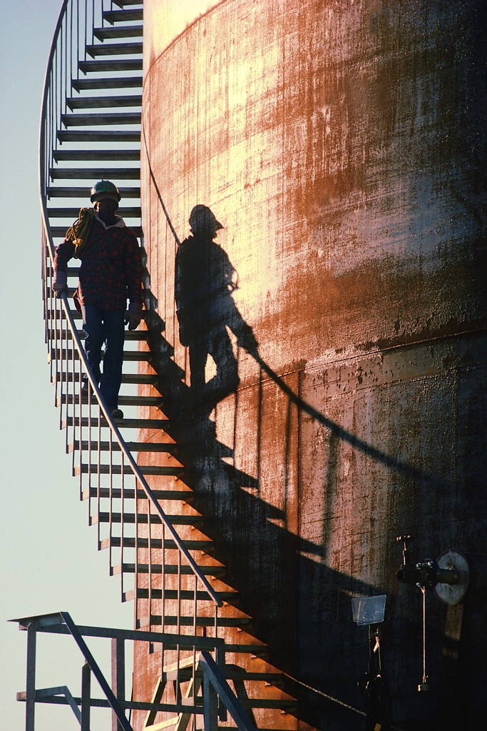
Section 2 (2) (d)
Any place of work under the employers control must be maintained in a condition that is safe and without risks to health.
The provision and maintenance of means of access and egress are safe and without risks
Notes:
(d) so far as is reasonably practicable as regards any place of work under the employer's control, the maintenance of it in a condition that is safe and without risks to health and the provision and maintenance of means of access to and egress from it that are safe and without such risks;

Slide 14
Section 2 (2) (e)
A working environment that is safe without risks to health and adequate as regards facilities and welfare.
Notes:
(e) the provision and maintenance of a working environment for his employees that is, so far as is reasonably practicable, safe, without risks to health, and adequate as regards facilities and arrangements for their welfare at work.

Slide 15
Section 2 (3)
Employers with five or more people must produce a written safety policy clearly stating the address of the site to which it refers
It must be signed by a senior manager and give details of other managers who have responsibility for safety within the company

Slide 16
Section 2 (3)
It must be openly displayed for all employees to see or they should receive a personal copy
It should be an informative document which details the specific arrangements for that workplace and promotes a safer working environment, with involvement from all

Slide 17
Section 2 (3)
Refer to the employers obligation to provide adequate safety training to all employees, especially new ones
Recognise the right of trade union safety representatives to attend union organised training courses

Slide 18
Section 2 (3)
It should also outline the responsibility of supervisors, foremen and works engineers
Employees have a responsibility by law to observe safety rules and procedures in place and pursue safety matters through their elected Trade Union representatives where they have been appointed

Slide 19
Section 2 (3)
Refer to common and known hazards in the particular workplace
Indicate how employees will be given access to full information about all potential hazards and the safe operation of plant and equipment, including provision of copies of all relevant health and safety legislation

Slide 20
Section 2 (4 – 7)
(4) To recognised trade union appointed safety representatives
(6) To consult and co-operate effectively in promoting and developing measures to ensure the health and safety
(7) To form a safety committee if requests to do so by safety representatives.
Notes:
(4) Regulations made by the Secretary of State may provide for the appointment in prescribed cases by recognised trade unions (within the meaning of the regulations) of safety representatives from amongst the employees, and those representatives shall represent the employees in consultations with the employers under subsection (6) below and shall have such other functions as may be prescribed. Note point 2. It does not include management appointed safety reps.
(6) It shall be the duty of every employer to consult any such representatives with a view to the making and maintenance of arrangements which will enable him and his employees to co-operate effectively in promoting and developing measures to ensure the health and safety at work of the employees, and in checking the effectiveness of such measures.
(7) In such cases as may be prescribed it shall be the duty of every employer, if requested to do so by the safety representatives mentioned in section (4)] above, to establish, in accordance with regulations made by the Secretary of State, a safety committee having the function of keeping under review the measures taken to ensure the health and safety at work of his employees and such other functions as may be prescribed.

Slide 21
Section 3
Employers/self employed duties to other persons
To conduct undertaking to ensure SFAIRP that non employees who may be affected by the work activities are not exposed to risks to their health and safety.
To provide to non employees who may be affected by work activities information about the way in which he conducts his undertaking as might affect their health and safety
Notes:
3 General duties of employers and self-employed to persons other than their Employees
(1) It shall be the duty of every employer to conduct his undertaking in such a way as to ensure, so far as is reasonably practicable, that persons not in his employment who may be affected thereby are not thereby exposed to risks to their health or safety.
(2) It shall be the duty of every self-employed person to conduct his undertaking in such a way as to ensure, so far as is reasonably practicable, that he and other persons (not being his employees) who may be affected thereby are not thereby exposed to risks to their health or safety.
(3) In such cases as may be prescribed, it shall be the duty of every employer and every self-employed person, in the prescribed circumstances and in the prescribed manner, to give to persons (not being his employees) who may be affected by the way in which he conducts his undertaking the prescribed information about such aspects of the way in which he conducts his undertaking as might affect their health or safety.

Slide 22
Section 4
General duties of controllers of premises to non- employees
To ensure SFAIRP safe access to and egress from premises and provision of safe plant and substances provided for use.
Notes:
4 General duties of persons concerned with premises to persons other than their employees
(1) This section has effect for imposing on persons duties in relation to those who--
(a) are not their employees; but
(b) use non-domestic premises made available to them as a place of work or as a place where they may use plant or substances provided for their use there, and applies to premises so made available and other non-domestic premises used in connection with them.
(2) It shall be the duty of each person who has, to any extent, control of premises to which this section applies or of the means of access thereto or egress there from or of any plant or substance in such premises to take such measures as it is reasonable for a person in his position to take to ensure, so far as is reasonably practicable, that the premises, all means of access thereto or egress there from available for use by persons using the premises, and any plant or substance in the premises or, as the case may be, provided for use there, is or are safe and without risks to health.
(3) Where a person has, by virtue of any contract or tenancy, an obligation of any extent in relation to--
(a) the maintenance or repair of any premises to which this section applies or any means of access thereto or egress there from; or
(b) the safety of or the absence of risks to health arising from plant or substances in any such premises; that person shall be treated, for the purposes of subsection (2) above, as being
a person who has control of the matters to which his obligation extends.
(4) Any reference in this section to a person having control of any premises
or matter is a reference to a person having control of the premises or matter in connection with the carrying on by him of a trade, business or other undertaking (whether for profit or not).

Slide 23
Section 6
Manufactures are required to :-
Ensure that plant and equipment is safe and without risks to health at all times when it is being set, used, cleaned or maintained
Carry out testing, and research
To providing adequate information about any conditions necessary to ensure that it will be safe and without risks to health when used properly.
Notes:
6 General duties of manufacturers etc as regards articles and substances for use at work
[(1) It shall be the duty of any person who designs, manufactures, imports or supplies any article for use at work or any article of fairground equipment--
(a) to ensure, so far as is reasonably practicable, that the article is so designed and constructed that it will be safe and without risks to health at all times when it is being set, used, cleaned or maintained by a person at work;
(b) to carry out or arrange for the carrying out of such testing and examination as may be necessary for the performance of the duty imposed on him by the preceding paragraph;
(c) to take such steps as are necessary to secure that persons supplied by that person with the article are provided with adequate information about the use for which the article is designed or has been tested and about any conditions necessary to ensure that it will be safe and without risks to health at all such times as are mentioned in paragraph (a) above and when it is being dismantled or disposed of; and
(d) to take such steps as are necessary to secure, so far as is reasonably practicable, that persons so supplied are provided with all such revisions of information provided to them by virtue of the preceding paragraph as are necessary by reason of its becoming known that anything gives rise to a serious risk to health or safety.
(1A) It shall be the duty of any person who designs, manufactures, imports or supplies any article of fairground equipment--
(a) to ensure, so far as is reasonably practicable, that the article is so designed and constructed that it will be safe and without risks to health at all times when it is being used for or in connection with the entertainment of members of the public;
(b) to carry out or arrange for the carrying out of such testing and examination as may be necessary for the performance of the duty imposed on him by the preceding paragraph;
(c) to take such steps as are necessary to secure that persons supplied by that person with the article are provided with adequate information about the use for which the article is designed or has been tested and about any conditions necessary to ensure that it will be safe and without risks to health at all times when it is being used for or in connection with the entertainment of members of the public; and
(d) to take such steps as are necessary to secure, so far as is reasonably practicable, that persons so supplied are provided with all such revisions of information provided to them by virtue of the preceding paragraph as are necessary by reason of its becoming known that anything gives rise to a serious risk to health or safety.]
(2) It shall be the duty of any person who undertakes the design or manufacture of any article for use at work [or of any article of fairground equipment]to carry out or arrange for the carrying out of any necessary research with a view to the discovery and, so far as is reasonably practicable, the elimination or minimisation of any risks to health or safety to which the design or article may give rise.
(3) It shall be the duty of any person who erects or installs any article for use at work in any premises where that article is to be used by persons at work [or who erects or installs any article of fairground equipment] to ensure, so far as is reasonably practicable, that nothing about the way in which [the article is erected or installed makes it unsafe or a risk to health at any such time as is mentioned in paragraph (a) of subsection (1) or, as the case may be, in paragraph (a) of subsection (1) or (1A) above].
[(4) It shall be the duty of any person who manufactures, imports or supplies any substance--
(a) to ensure, so far as is reasonably practicable, that the substance will be safe and without risks to health at all times when it is being used, handled, processed, stored or transported by a person at work or in premises to which section 4 above applies;
(b) to carry out or arrange for the carrying out of such testing and examination as may be necessary for the performance of the duty imposed on him
by the preceding paragraph;
(c) to take such steps as are necessary to secure that persons supplied by that person with the substance are provided with adequate information about any risks to health or safety to which the inherent properties of the substance may give rise, about the results of any relevant tests which have been carried out on or in connection with the substance and about any conditions necessary to ensure that the substance will be safe and without risks to health at all such times as are mentioned in paragraph (a) above and when the substance is being disposed of; and
(d) to take such steps as are necessary to secure, so far as is reasonably practicable, that persons so supplied are provided with all such revisions of information provided to them by virtue of the preceding paragraph as are necessary by reason of its becoming known that anything gives rise to a serious risk to health or safety.]
(5) It shall be the duty of any person who undertakes the manufacture of any [substance] to carry out or arrange for the carrying out of any necessary research with a view to the discovery and, so far as is reasonably practicable, the elimination or minimisation of any risks to health or safety to which the substance may give rise [at all such times as are mentioned in paragraph
(a) of subsection (4) above].
(6) Nothing in the preceding provisions of this section shall be taken to require a person to repeat any testing, examination or research which has been carried out otherwise than by him or at his instance, in so far as it is reasonable for him to rely on the results thereof for the purposes of those provisions.
(7) Any duty imposed on any person by any of the preceding provisions of this section shall extend only to things done in the course of a trade, business
or other undertaking carried on by him (whether for profit or not) and to matters within his control.
(8) Where a person designs, manufactures, imports or supplies an article [for use at work or an article of fairground equipment and does so for or to another] on the basis of a written undertaking by that other to take specified steps sufficient to ensure, so far as is reasonably practicable, that the article will be safe and without risks to health [at all such times as are mentioned in paragraph (a) of subsection (1) or, as the case may be, in paragraph
(a) of subsection (1) or (1A) above], the undertaking shall have the effect of relieving the first-mentioned person from the duty imposed [by virtue of that paragraph] to such extent as is reasonable having regard to the terms of the undertaking.
[(8A) Nothing in subsection (7) or (8) above shall relieve any person who imports any article or substance from any duty in respect of anything which--
(a) in the case of an article designed outside the United Kingdom, was done by and in the course of any trade, profession or other undertaking carried
on by, or was within the control of, the person who designed the article; or
(b) in the case of an article or substance manufactured outside the United Kingdom, was done by and in the course of any trade, profession or other undertaking carried on by, or was within the control of, the person who manufactured the article or substance.]
(9) Where a person ("the ostensible supplier") supplies any [article or substance] to another ("the customer") under a hire-purchase agreement, conditional sale agreement or credit-sale agreement, and the ostensible supplier--
(a) carries on the business of financing the acquisition of goods by others by means of such agreements; and
(b) in the course of that business acquired his interest in the article or substance supplied to the customer as a means of financing its acquisition by the customer from a third person ("the effective supplier"), the effective supplier and not the ostensible supplier shall be treated for the purposes of this section as supplying the article or substance to the customer, and any duty imposed by the preceding provisions of this section on suppliers shall accordingly fall on the effective supplier and not on the ostensible supplier.
[(10) For the purposes of this section an absence of safety or a risk to health shall be disregarded in so far as the case in or in relation to which it would arise is shown to be one the occurrence of which could not reasonably be foreseen; and in determining whether any duty imposed by virtue of paragraph (a) of subsection (1), (1A) or (4) above has been performed regard shall be had to any relevant information or advice which has been provided to any person by the person by whom the article has been designed, manufactured, imported or supplied or, as the case may be, by the person by whom the substance has been manufactured, imported or supplied.]

Slide 24
Section 7
Employees must ensure they work safely and in a manner which does not endanger the health, safety and welfare of others who might be affected by what they do, Or do not do!
If the employer must comply with the law then the employee must co-operate!
Notes:
7 General duties of employees at work
It shall be the duty of every employee while at work--
(a) to take reasonable care for the health and safety of himself and of other persons who may be affected by his acts or omissions at work; and
(b) as regards any duty or requirement imposed on his employer or any other person by or under any of the relevant statutory provisions, to cooperate with him so far as is necessary to enable that duty or requirement to be performed or complied with.

Slide 25
Section 8
No-one shall intentionally or recklessly interfere with, or misuse, anything provided in the interests of health and safety this includes:-
Machine Guards
Personal Protection Equipment
Fire Extinguishers
Fire Alarms
First Aid Equipment
Notes:
8 Duty not to interfere with or misuse things provided pursuant to certain provisions
No person shall intentionally or recklessly interfere with or misuse anything provided in the interests of health, safety or welfare in pursuance of any of the relevant statutory provisions.

Slide 26
Section 9
Imposes a duty on employers not to charge employees for provision of anything done or provided in pursuance of any specific requirements of the relevant statutory provisions
Notes:
9 Duty not to charge employees for things done or provided pursuant to certain specific requirements
No employer shall levy or permit to be levied on any employee of his any charge in respect of anything done or provided in pursuance of any specific requirement of the relevant statutory provisions.
For example you should not be expected to pay for your PPE etc or any such equipment that you may require.

Slide 27
Section 10 - 16
Section 10 established HSC/HSE
Section 14 powers of investigation
Section 15 regulations
Section 16 approvals of codes of practice
Notes:
10 Establishment of the Commission and the Executive
11 General functions of the Commission and the Executive
12 Control of the Commission by the Secretary of State
13 Other powers of the Commission
14 Power of the Commission to direct investigations and inquiries
15 Health and safety regulations
16 Approval of codes of practice by the Commission

Slide 28
A SMILES
Employers duties under Section 2 (1 – 3) of the HASAWA 1974
Section 2 (1) A As far as reasonably practicable
Section 2 (2) (a) S Safe system of work & plant (provision and maintenance of)
Section 2 (2) (b) M (Materials) safe use, handling, storage and transport of
Section 2 (2) (c) I Information, Instruction, Training & Supervision
Section 2 (2) (d) L (Location) safe place of work & access / egress
Section 2 (2) (e) E Environment and adequate welfare facilities
Section 2 (3) S Safety Policy (written if more than 5 employees)
Notes:
10 Establishment of the Commission and the Executive
11 General functions of the Commission and the Executive
12 Control of the Commission by the Secretary of State
13 Other powers of the Commission
14 Power of the Commission to direct investigations and inquiries
15 Health and safety regulations
16 Approval of codes of practice by the Commission

