Slide 1
Decarbonisation and the need for a
“workers’ transition”
24^{h} February 2021
Jess Whelligan // Global Labour Institute (GLI)
Notes:
Purpose of presentation is to introduce broader context of decarbonisation and the concept of a ‘workers’ transition’
And to then pose a set of questions to structure our discussion today

Slide 2
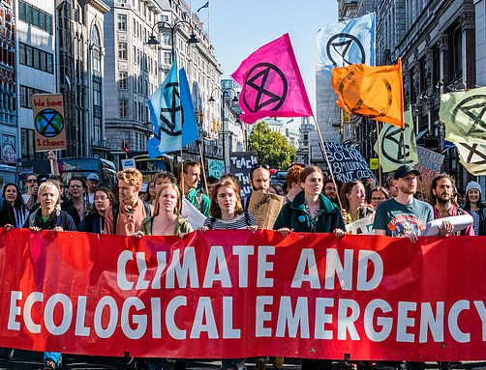
Context…
Notes:
Brief introduction to context: unequivocally living in climate emergency [declared by UK gov in 2019– though not binding]
The world is on track for at least 3 degrees of warming above pre-industrial levels by the end of century - the consequences of which will have a catastrophic impact on life on earth as we know it
Impacts are already being felt

Slide 3
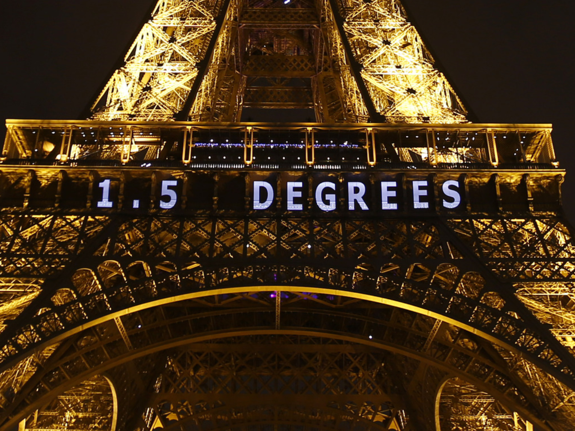
Notes:
Yet climate catastrophe is not inevitable – the scientific consensus limiting the increase to 1.5 degree (or well below 2 degrees) will significantly reduce the risks and impacts of climate change.
However achieving this target will require a radical change, in across the world, in our economy, the sectors that we work in. For many people this transformation will change how we work and what we do, and certainly it will change how we live.
This need to change is not a bad thing – it is clear that we can’t go on like this. In fact what is at the heart of the idea of a workers transition is these necessary changes provides an opportunity to build not only a green economy but a better economy characterized by decent work and respect of trade union rights etc

Slide 4
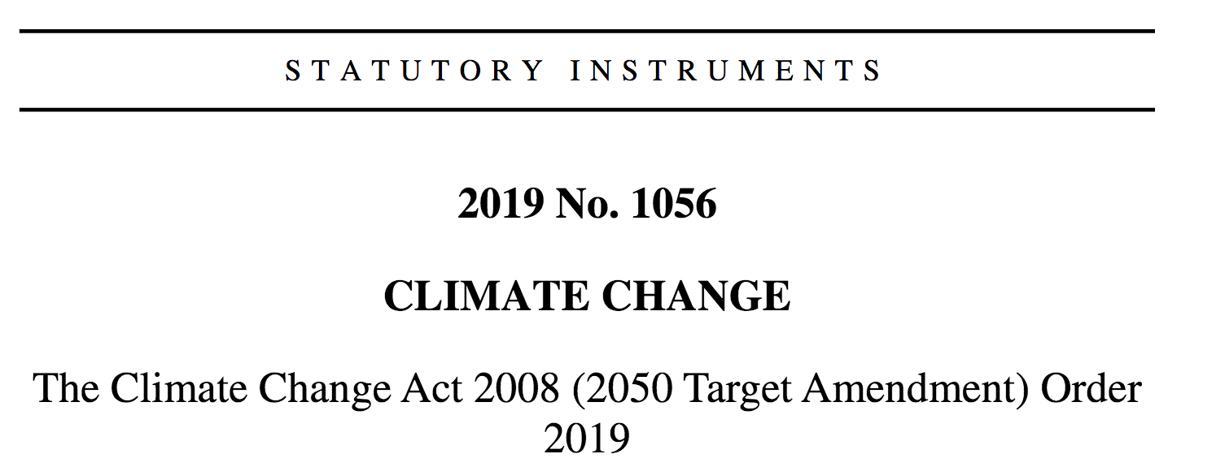
Global/UK commitments:
Net-zero emissions by 2050

Slide 5
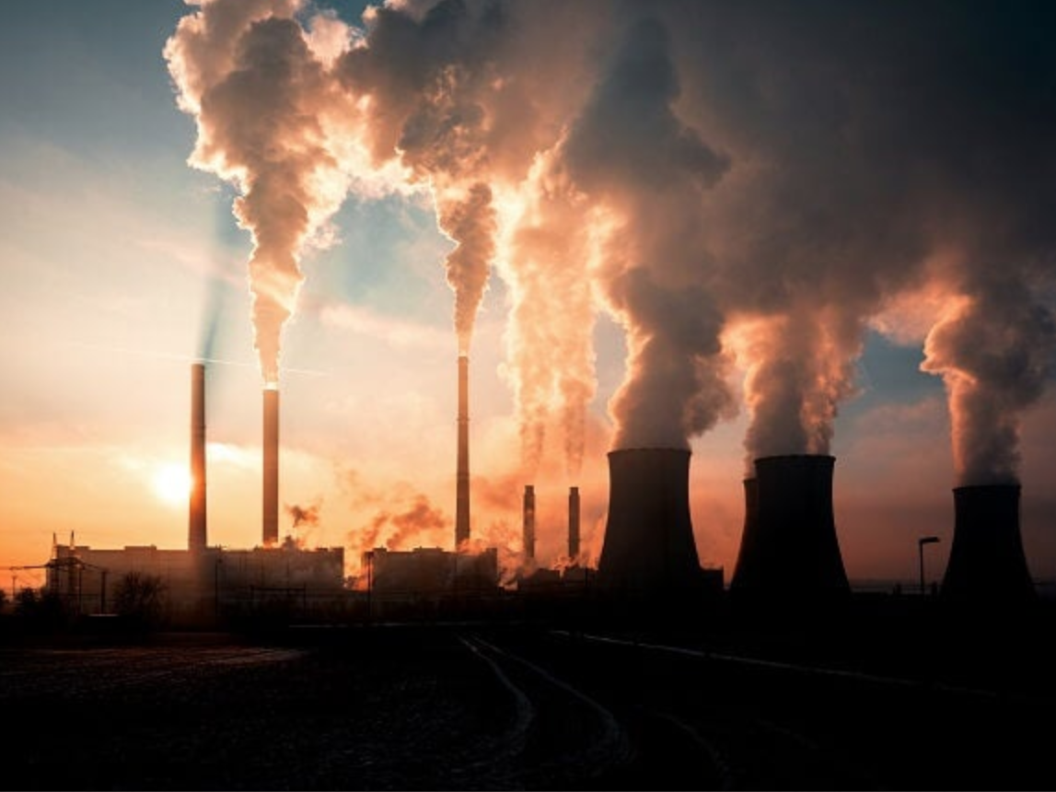
Decarbonisation
Notes:
Impact on/relevance to Unite members: Achieving these targets will transform our economy and touch all Unite sectors/members – from CPPT/energy/automobiles/metal to care

Slide 6
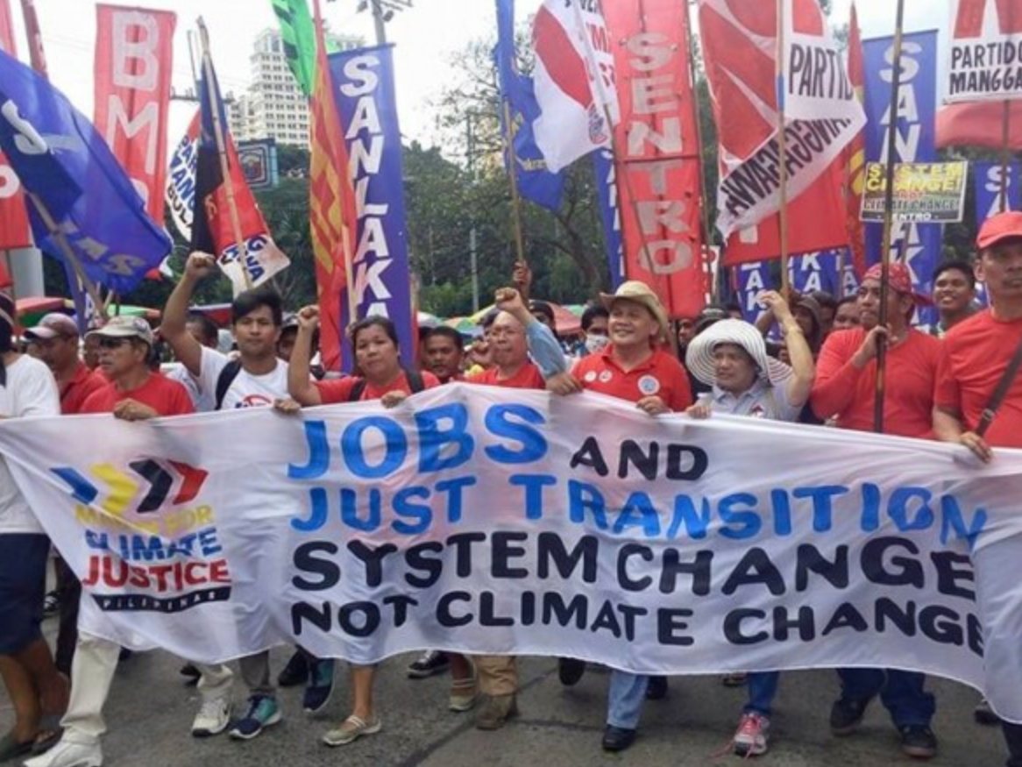
Just transition

Slide 7
ITUC/social dialogue
“Just Transition is the name of a comprehensive and broad strategy put forward by the global trade union movement to protect those whose jobs, incomes and livelihoods are at risk because of climate policies…
Effective Just Transition policies need a social dialogue process between governments, employers, workers and their unions to develop plans and measures that will build trust and drive effective transformation. It’s about workers and their unions having a seat at the table to negotiate their future. .” (ITUC, 2018)

Slide 8
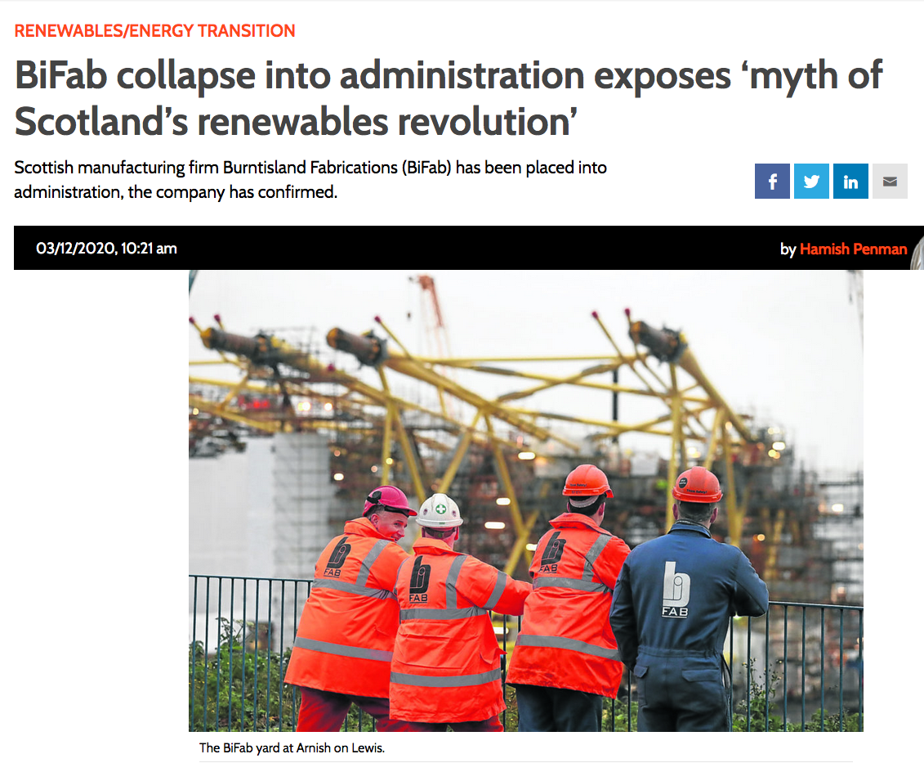
Just transition…where are you?

Slide 9
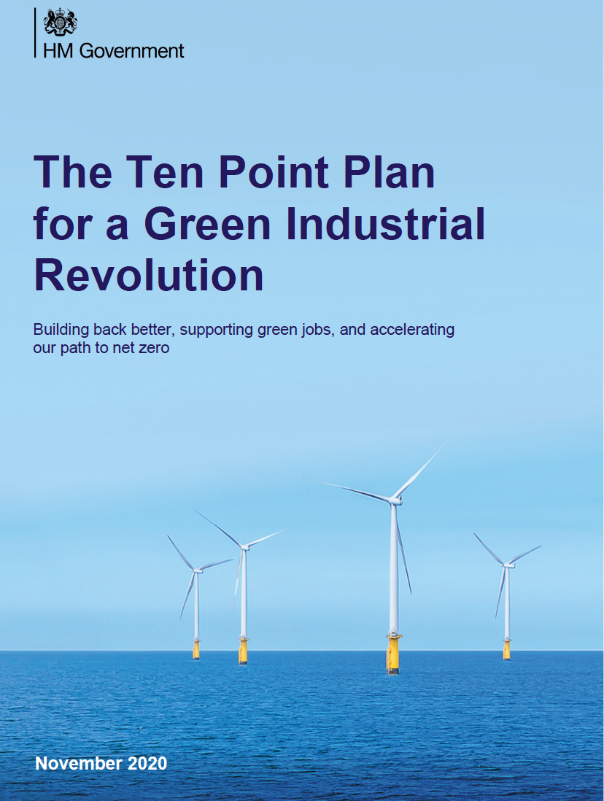

Slide 10
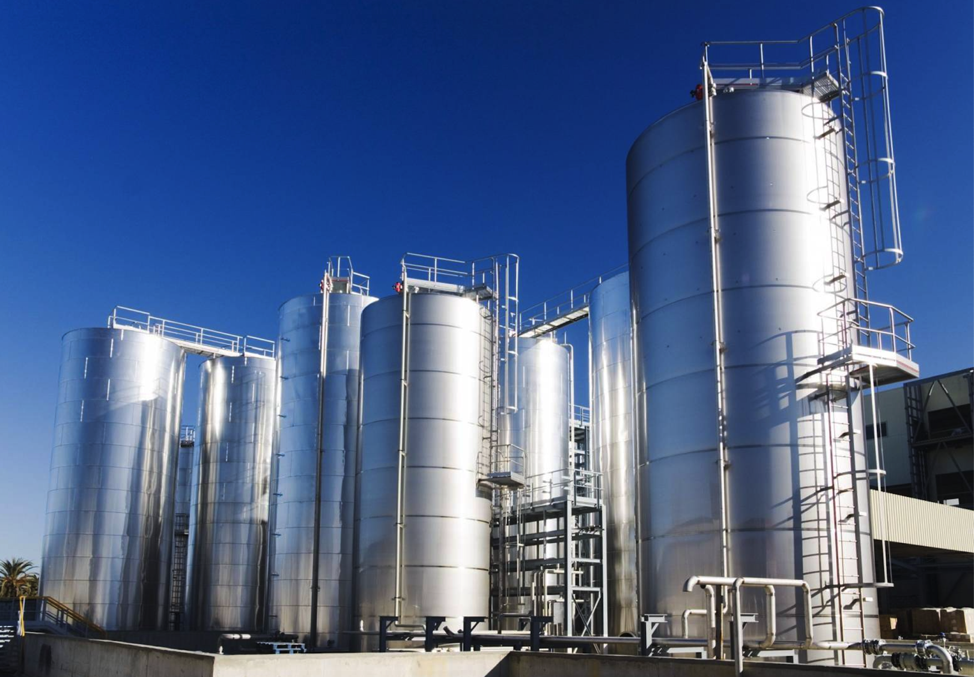
Challenges?
A lack of government commitment to even the most basic principles of a just transition
Current government policy/action is inadequate

Slide 11
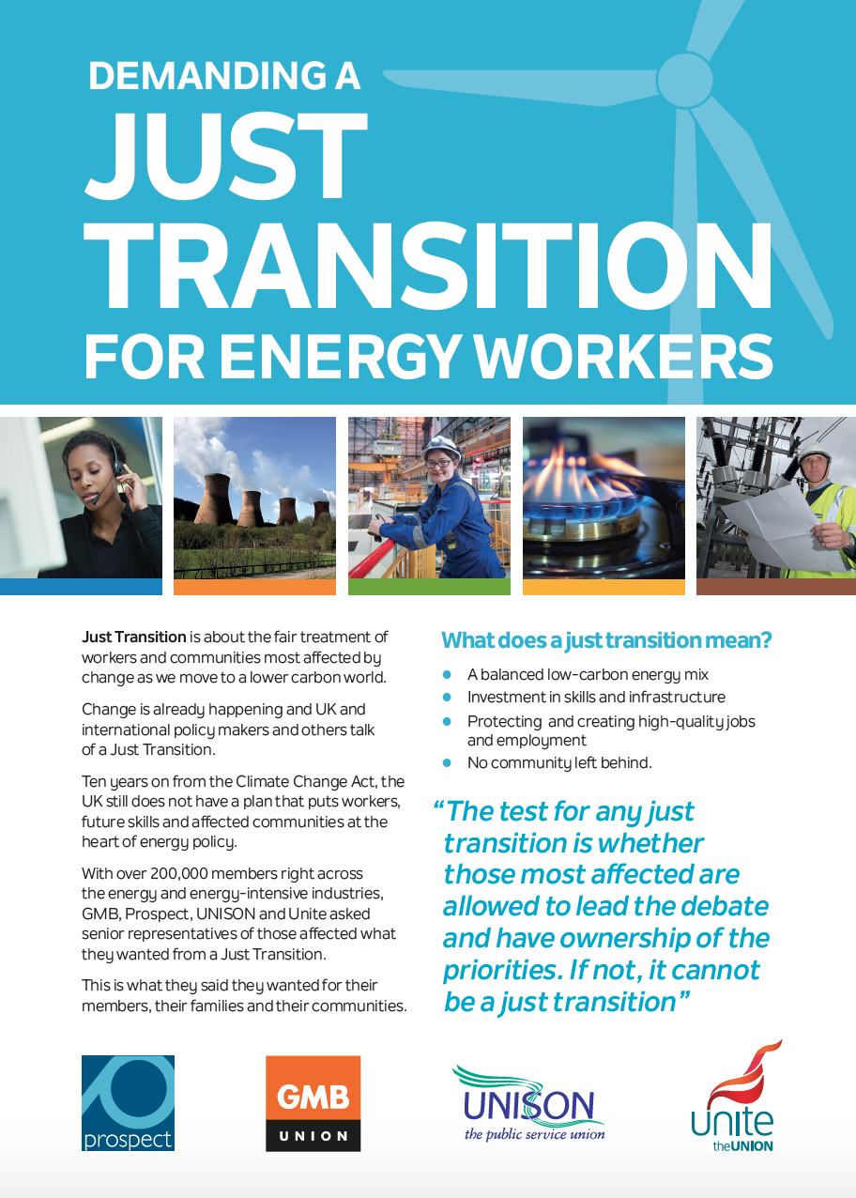
Work is already underway

Slide 12
Notes:
See ‘magnificent seven’ including:
Housing Retrofit – a programme to increase energy efficiency and reduce carbon emissions in people’s homes that would create thousands of jobs a year for decades to come, including manufacturing more of the products needed to make it happen, here in the UK.
Offshore Wind – Doubling the number of UK wind turbines by 2024 would create 13,000 jobs by 2024. By 2030, 27,000 jobs could be created, rising to 80,000 by 2054, while pushing on with hydro, solar and nuclear plans for a balanced green energy policy.

Slide 13
What does UNITE want to happen ?
(vision/programme)
2) How do we make it happen?
(strategy)
3) Who will make it happen?
(responsibilities/ownership)

