Slide 1

FIRE SAFETY AT WORK

Slide 2
Death and Destruction
What is it that kills people in the event of a fire?
SMOKE kills
Burns
Heat

Slide 3
Death and Destruction
In the UK 2019 / 20;
153,957 fires attended by Fire Service. (36% less than 10 years ago)
243 fire-related deaths
68,677 primary fires (14,308 in non domestic properties

Slide 4
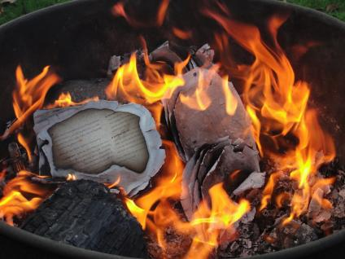
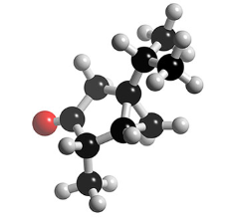
The rapid oxidation of fuel evolving heat, particles, gases and non-ionising radiation
A self sustaining chemical reaction involving the bonding of oxygen with carbon and other fuels
Q. What is fire?

Slide 5
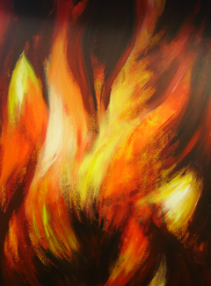
Red Flame
Between 525⁰ C < 1000⁰ C
Orange Flame
1100⁰ C < 1200⁰ C
White Flame
1500⁰ C
Fire Facts

Slide 6
Nature of Fire
Three Basic Ingredients Necessary For Fire:
Oxygen
Heat
Fuel

Slide 7
Heat
Created by a source of ignition
Naked Flames
External Sparks – Welding etc
Internal Sparks – Lighting etc

Slide 8
Heat
A critical temperature must be reached for ignition to take place.
Once a fire has started, it will generally maintain its own heat supply.
Flash Point
Lowest temperature at which vapour is released in sufficient quantity for combustion, if ignited.
Auto ignition
Temperature at which it will catch fire without ignition

Slide 9
Fuel
Any combustible substance, whether solid, liquid or gas.

Slide 10
Oxygen
Oxygen is present in the air, approximately 21% at sea level
A level of only 16% is needed to support a fire

Slide 11
Fire Spread
Conduction
Convection
Radiation

Slide 12


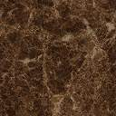



Conduction
Heat is transferred through solid material such as a metal beam

Slide 13
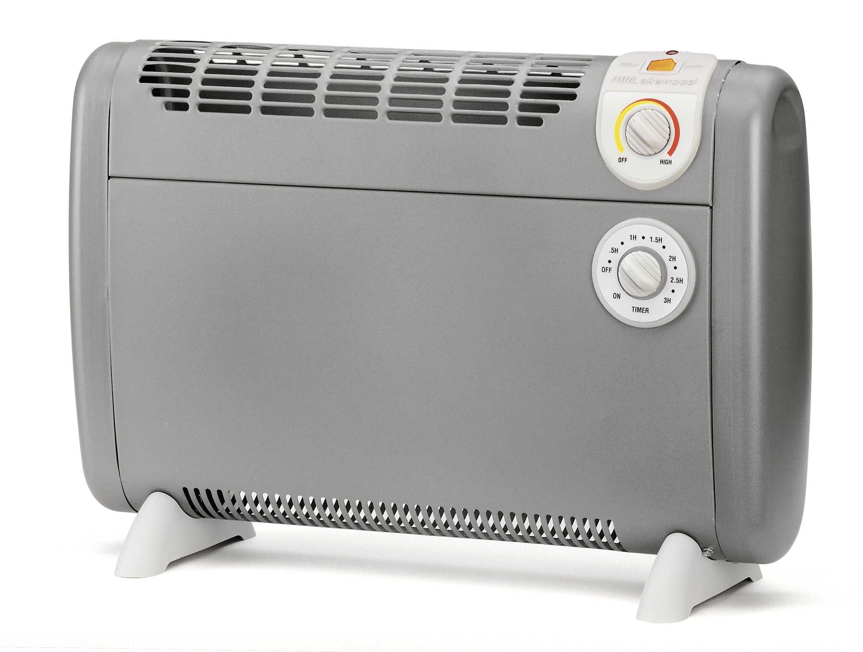
Convection
Hot air and smoke rises upwards into the atmosphere. Why?
Hot air less dense, drawing in cold air and oxygen
e.g. bonfire or convector heater

Slide 14


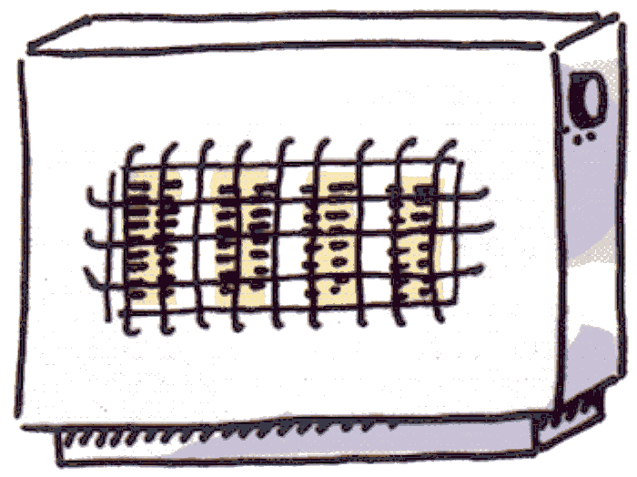
Radiation
Direct heat travels through emission of heat waves from a source such as the sun or the bars of an electrical fire

Slide 15
Three States of Matter
Solid Liquid Gaseous

Slide 16

Classification of Fires
Solid Materials: Water, Foam, Powder
Wood, paper, textiles, fabric
Liquid/liquifiable solids: Foam, Powder, CO2
Petrol, Diesel Oils
Fires involving Gases: Powder
Butane, Methane, Propane
Fires involving Metals: Pyromet Powder
Lithium, magnesium, sodium or aluminium
Electrical Risk CO2
Computers, Switchgear, Fax
Cooking Oil (3+litres) Wet Chemical
D

Slide 17
Three Methods of Extinction
Cooling
Smothering
Oxygen
Heat
Fuel
Starvation

Slide 18
Smothering
Removal or limitation of oxygen
  Snuffing out a candle, covering a chip pan fire
  Liquid fires will extinguish if oxygen level is reduced below 16%
  Solid materials may continue to burn until a drop to 6%.
  Some substances carry enough oxygen to maintain combustion

Slide 19
Cooling
Removal of heat
  Water is most commonly used, as it has great heat absorbing properties.
  If rate of heat lower than rate of heat absorbed, the fire will go out.

Slide 20
Starving
Removing a fire’s fuel supply will extinguish a fire
  Turning off gas supplies
  Removal of Fuel

Slide 21
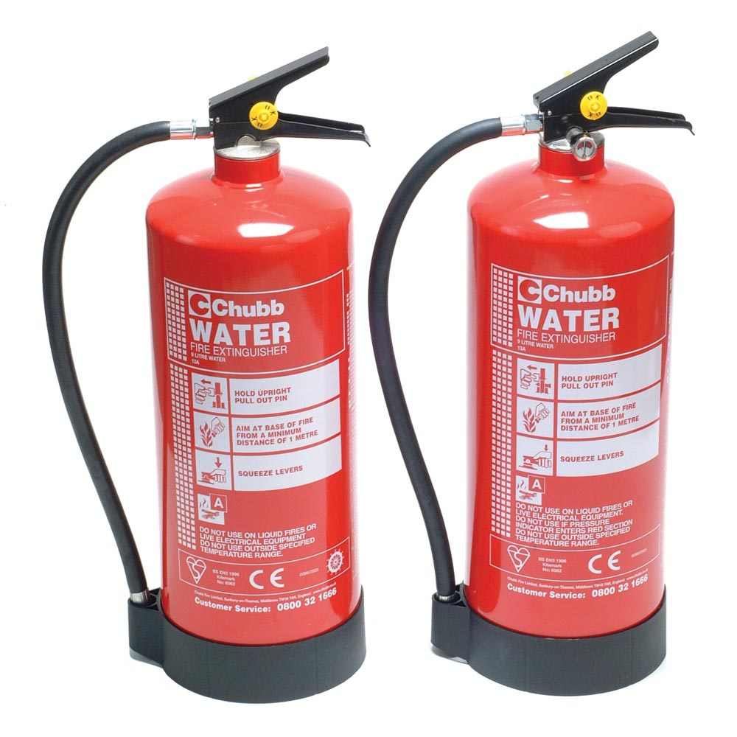
Portable Fire Extinguishers
Water
WARNING: Do not use on ‘Class B’ Flammable Liquid fires
WARNING: Do not use on Electrical Hazards!

Slide 22
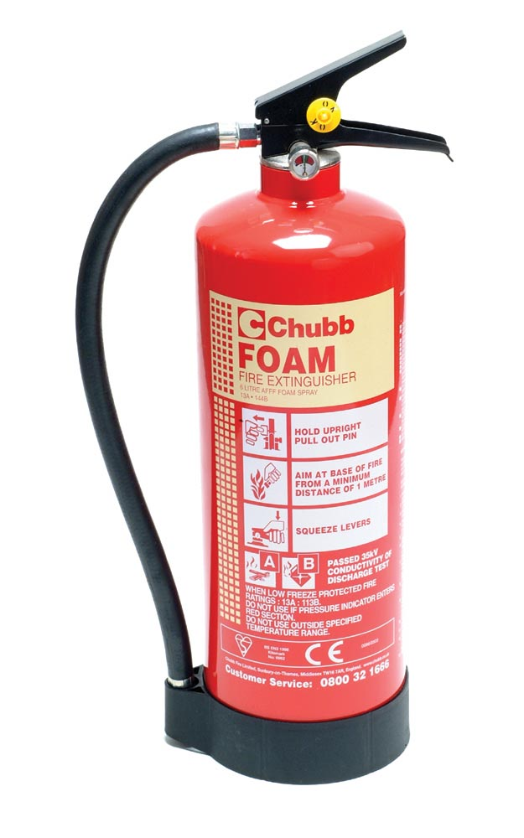
Portable Fire Extinguishers
FOAM
2, 6 and 9 litre
Stored Pressure & Cartridge Operated
Some have added Operator Safety of 35kv test

Slide 23
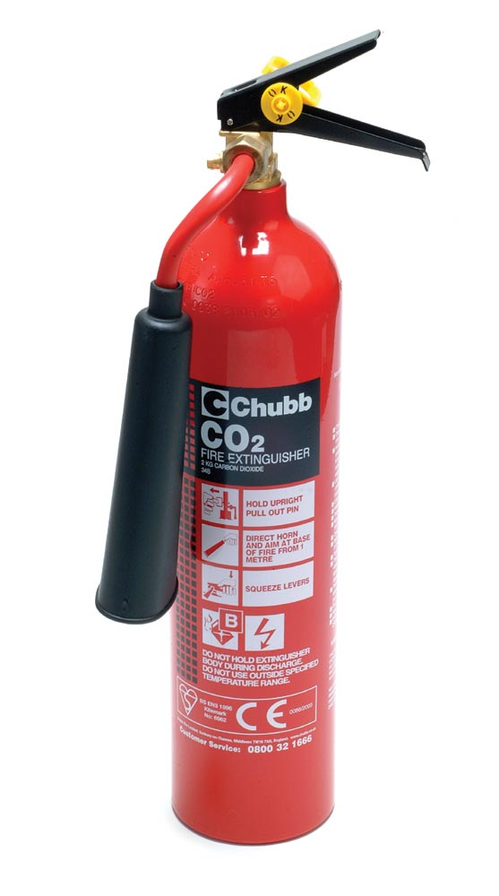
Portable Fire Extinguishers
CO₂
2 and 5kg
Clean medium
WARNING: Nozzle gets very cold during use!
Thickened horn can be fitted to protect against frost burns

Slide 24
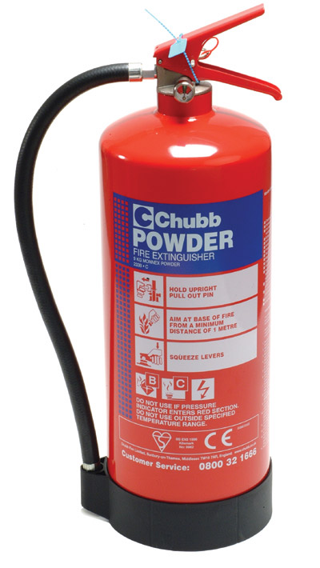
Portable Fire Extinguishers
Dry Powder
1, 2, 3, 6 and 9kg
All round safety

Slide 25
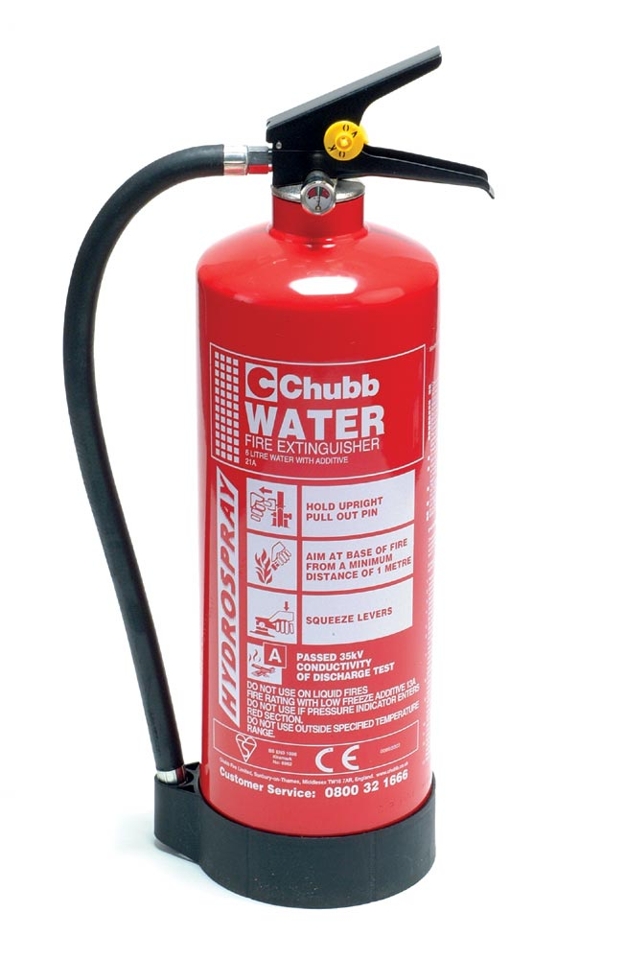
Portable Fire Extinguishers
Water with Additive
6 and 3 litre
Stored Pressure
User-friendly
Often same fire fighting capacity as 9 litre water

Slide 26
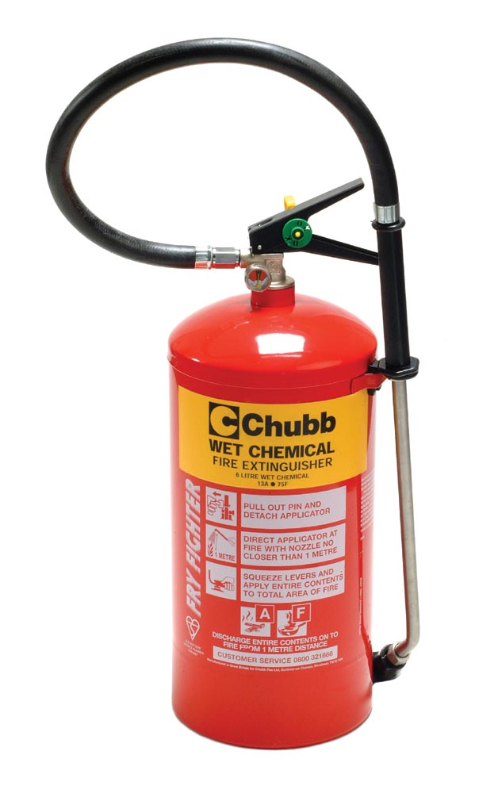
Portable Fire Extinguishers
Wet Chemical

Slide 27
Fighting a Fire
Do not fight the fire if:-
  It is bigger than a waste paper bin
  One extinguisher is not enough
  Smoke is affecting your breathing
  You cannot see the way out
  Gas cylinders or chemicals are involved
  Your efforts are not reducing the size of the fire
  Always keep an exit available when tackling a fire
  Generally, fight the fire to ensure successful evacuation

Slide 28
Remember - If tackling a fire!
IRE BRIGADE?
S IT SAFE TO TACKLE THE FIRE?
IGHT TYPE OF FIRE EXTINGUISHER?
XIT ROUTE CLEAR

