Slide 1
Dignity and Equality at Work

Slide 2
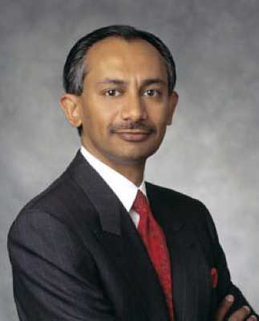
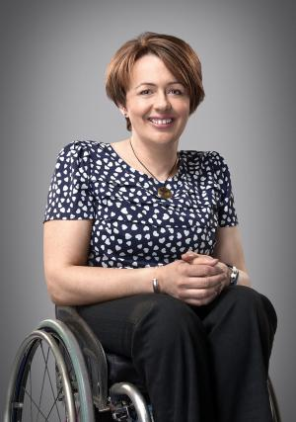
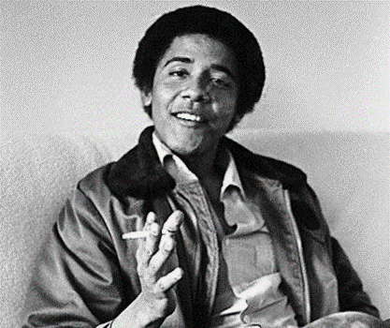
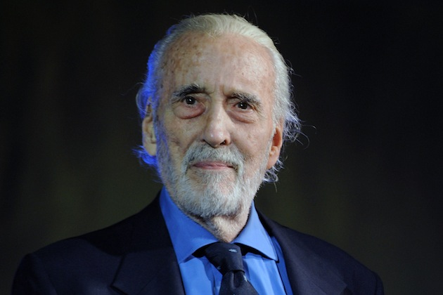
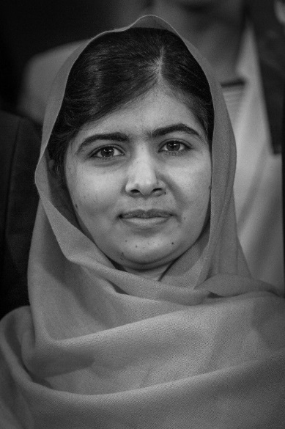
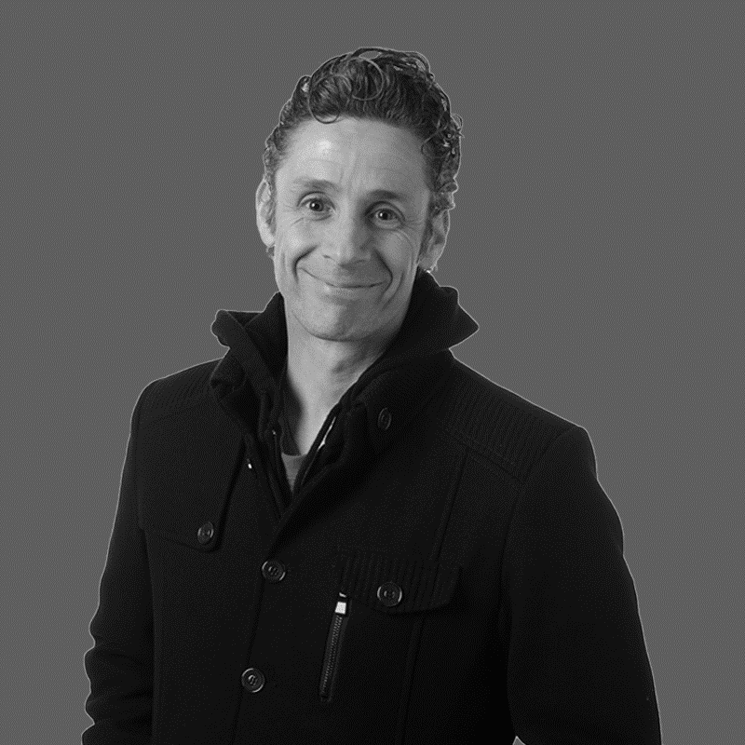
One is a criminal with a conviction

Slide 3
General principle of the equality act 2010
Equality legislation is about securing equal treatment for particular groups who might otherwise be disadvantaged in the workplace, when compared with others who do not share the same characteristic.

Slide 4
General principle of the equality act 2010
It aims to address this through legislating against:
Direct Discrimination
Indirect Discrimination
Discrimination by Association
Discrimination by Perception
Victimisation and Harassment
It legislates for taking positive action
It does not ensure social justice

Slide 5
Everyone gets exactly
the same support
Different support to
give equal access
and opportunity
No support or accommodations
needed because all the systemic
barriers have been removed

Slide 6
General principle of the equality act 2010
The Equality Act aims at providing a legal framework to protect the rights of individuals and advance equality of opportunity for all.
Social Justice aims for fairness between the individual and the society they live in e.g. through wealth distribution, healthcare, education, privileges etc.

Slide 7
Equality Act 2010 and Protected Characteristics
The Equality Act 2010 identifies nine protected characteristics:
Age
Disability
Gender reassignment
Marriage and civil partnership
pregnancy or maternity
Race
Religion or belief
Sex or gender
Sexual orientation

Slide 8
Equality Act 2010 and Protected Characteristics
Discriminatory treatment in any category is prohibited by the act.
Public Sector services are subjected to additional requirements

Slide 9
Section 149: Public Sector Equality Duty – 3 aims
Those subject to the equality duty must, in the exercise of their functions, aim to:
Eliminate unlawful discrimination, harassment and victimisation and other conduct prohibited by the Act.
Advance equality of opportunity between people who share a protected characteristic and those who do not.
Foster good relations between people who share a protected characteristic and those who do not.

Slide 10
Section 149: Public Sector Equality Duty – due regard
The Act explains that having due regard for advancing equality involves:
Removing or minimising disadvantages suffered by people due to their protected characteristics.
Taking steps to meet the needs of people from protected groups where these are different from the needs of other people.
Encouraging people from protected groups to participate in public life or in other activities where their participation is disproportionately low.

Slide 11
In Summary
The Equality Act 2010 represents the culmination of years of debate about how to improve British equality law.
It offers individuals stronger protection against discrimination.
It gives employers and businesses greater clarity about their responsibilities.
It sets a new expectation that public services must treat everyone – staff and the people being served - with dignity and respect.

Slide 12
Activity 24 - Equality Terminology
Working in your groups, come to an agreement on the following:
What do you understand by the word ‘prejudice’?
What is ‘discrimination’?
Who can be affected by prejudice and discrimination?
What do you understand by the term ‘diversity’?
How would you define ‘inclusion’?
What do you understand by the terms ‘equality’ & ‘equal opportunities’?
elect someone to report back for the group

Slide 13
Equality Terminology
Prejudice – pre-judging, an attitude, often based on stereotypes
Discrimination – being treated less favourably especially in relation to sex, race, age etc.
Who – everyone – usually individuals or minority groups
Diversity – recognising, valuing and respecting peoples differences so that they can contribute and realise their full potential
Inclusion - a sense of belonging: feeling respected, valued for who you are; feeling a level of supportive energy and commitment from others so that you can do your best
Equality and equal opportunities – ensuring all are treated fairly and equitably, no less favourably than any one else

Slide 14
Activity 25: task 1– Workplace Issues
Dignity at Work, Issues in your Workplace
Working in your groups, your task is to discuss what types of equality, dignity and inclusion problems you may be faced with in the workplace
these might have affected you personally
they might be things you have witnessed
they might be at your current or in previous workplaces
they might be simply your thoughts on equality issues.
Elect someone to report back for the group.
Discretion and confidentiality must be used at all times

Slide 15
Activity 25: task 2 – Bullying, harassment and banter
Working in your groups, your task is to discuss how would you define the following terms:
Bullying
Harassment
Banter
Record your findings in your workbooks

Slide 16
Bullying
Some types of behaviours can soon turn into harassment or bullying if not challenged.
ACAS characterises bullying as:
“offensive, intimidating, malicious or insulting behaviour, an abuse or misuse of power through means that undermine, humiliate, denigrate or injure the recipient.”
e.g. - spreading malicious rumours / insulting by word or behaviour
ridiculing someone / setting them up to fail
exclusion or victimisation
Lack of intent does not diminish the impact on the recipient.

Slide 17
Harassment
In general terms it’s unwanted conduct affecting the dignity of people.
When related to a protected characteristic it is unlawful under the Equality Act 2010 (may also fall under the Protection from Harassment Act 1997)
Conduct will only amount to harassment if done for a prohibited reason
It can be: -
direct (the person it is aimed at)
or indirect (others who it is not personally aimed at)
It may be related to any protected characteristic

Slide 18
Banter
What is it like in your workplace?
Is banter good or bad?
What happens when banter goes too far?
Could it become a bullying and harassment issue?
Challenging behaviours

Slide 19
Activity 25: task 3 – Bullying, harassment and banter
Working in your groups, your task is think about the workplace issues you identified earlier and mark up your flip chart whether those issues could be considered:
Bullying
Harassment
Banter

Slide 20
Bullying through Social Media
Bullying of itself is not unlawful, but other laws may be breached:
Malicious Communications Act 1988 (s1) and Communications Act 2003 (s127)
It is an offence to send “indecent or grossly offensive” communications
for the purpose of causing “distress or anxiety” to the recipient
Obscene Publications Act 1959
an article that is classed as one that whose effect is to ‘deprave or corrupt’
publishing includes circulating, showing, playing, projecting or transmitting

Slide 21
Bullying through Social Media
Public Order Act 1986
S5 refers to threatening, abusive or insulting words or behaviour likely to cause harassment alarm or distress within hearing or sight of a person.
Computer Misuse Act 1990
Hacking a victim’s online accounts or computer in order to bully them

Slide 22
Activity - How Bullying & Harassment Affects our Health
Mental/Psychological and Physical Effects
Working in your groups consider the potential effects of bullying and harassment in your workplace:
Group 1 your task is to discuss the effects on physical health.
Group 2 your task is to discuss the effects on psychological health
Elect someone to report back for the group.
Discretion and confidentiality must be used at all times

Slide 23
Activity - How Bullying & Harassment Affects our Health - physical
crying
Skin rashes
FATIGUE
high blood pressure
self harm
headaches
nausea
REDUCED IMMUNITY
Irritable bowel syndrome
ulcers
illnesses of the organs
night ‘sweats’
increased substance intake

Slide 24
Activity - How Bullying & Harassment Affects our Health - mental
Sense of isolation
loss of self-confidence
reduced self esteem
obsessive thoughts
thoughts of suicide
disturbed sleep
Feeling things are
out of your control
tearfulness
feeling helpless
Irritability
DEPRESSION
ANXIETY
Feeling lonely

Slide 25
Who’s responsibility is it?
Union Representatives?
The Manager?
The Employer?
The employee?
The law?

Slide 26
Unite Rulebook
The objects of the Union are given in Rule 2
Section 2.1.6 of Rule 2 states:
“The objects of the Union shall be…
to promote equality and fairness for all, including actively opposing
prejudice and discrimination on grounds of gender, race, ethnic origin,
religion, class, marital status, sexual orientation, gender identity, age,
disability or caring responsibilities”

Slide 27
Activity 26 – Employment Tribunal Case Studies
Working in your groups, your task is to discuss your case.
Decide whether you think the Tribunal upheld or dismissed the claim?
Elect someone to report back for the group giving reasons as to why your group made that decision.

Slide 28
One is a criminal with a conviction

Slide 29
One is a criminal with a conviction
SANJAY KUMAR
Former CEO of
Computer Associates
Defrauded company of
$2.2bn. 12 year jail term
TANNI GREY-THOMPSON
Winner of 16 medals
30 world records
6x winner London marathon
MBE, OBE, DBE
Member in the Lords
BARACK OBAMA
U.S. President
since 2009 - 2017
First African American President
LUBAINA HIMID
Awarded an MBE and is the 2017
Turner Prize winner. One of the
first artists in the Black Art
movement of the 1980’s. Focuses
on black cultural history and
reclaiming identity
ANGELA MERKEL
German Chancellor
since 2005
12 times been named by Forbes
as worlds most powerful woman
CHRISTOPHER LEE
Actor, singer, author
and WW2 veteran
MALALA YOUSAFZAI
survived an assassination
attempt by the Taliban for
advocating human rights
for women and education
JOE SOLO
musician, writer, poet political activist and broadcaster. Co-creator
of “We Shall Overcome”
anti austerity movement

