Slide 1
Pools
Issues to consider when looking at selection at pools:
The extent to which employees are doing similar work
The extent to which employees’ jobs are interchangeable
Is the pool based on current location
Size and definition of the pools
Do the employers numbers match your numbers for each pool?
Notification of pools to members
Appeals process (for members) for their pool allocation
DEALING WITH REDUNDANCY – 3 DAY COURSE

Slide 2
Selection criteria
Issues to consider when being consulted on selection criteria:
Will each pool have different criteria?
Are there criteria that can be applied to all at risk?
Are the criteria objective?
If subjective criteria are being used how will fairness be ensured?
What weighting is being applied?
Will the scoring be made visible?
What is the resource line? – i.e. the cut off between safe/at risk
What is the appeals process?
DEALING WITH REDUNDANCY – 3 DAY COURSE
Notes:
The resource book gives some further detail. Note there is case law regarding an employees right to see their score

Slide 3
Selection criteria and pools
ACAS propose the following criteria:
Work performance
Skills/competence
Experience
Disciplinary record
Attendance record (with disability and pregnancy-related absences ignored)
The criteria are scored out of five, but weighted so that the results for work performance and skills/competence are each given three times the significance of those for disciplinary record and attendance record.
DEALING WITH REDUNDANCY – 3 DAY COURSE

Slide 4
ACTIVITY 6
CASE STUDY
POOLS AND SELECTION CRITERIA
Using your workbooks, work as a group to discuss the tasks
DEALING WITH REDUNDANCY – 3 DAY COURSE
Notes:
TASK:
How would you define a ‘pool’ – does that match with what your employer thinks?
How would you challenge your member’s pool allocation?
What criteria might be used?
Are they objective or subjective?
What are the categories to be scored?
Should they be weighted?
Who will do the scoring?
How would you challenge them?
Look at the case study - consider the proposed pools and draft up criteria which might be used.

Slide 5
Issues when it finally comes to formal notification of dismissal
Things to consider:
Individual Consultation
Time off to look for work
Was it unfair
Remedies
What is notice and counter notice
How much is redundancy pay
DEALING WITH REDUNDANCY – 3 DAY COURSE

Slide 6
Individual Consultation
Employers must offer individual consultation (on-to-one)
No defined or statutory process
It should still follow the principles of Section 188 TULRCA (2) i.e. consultation shall be about ways of:
• avoiding dismissals • reducing the number of employees to be dismissed • mitigating the consequences of the dismissals
It is key that the individual consultation process has been covered in the
formal collective consultation meetings
The process may look like…
DEALING WITH REDUNDANCY – 3 DAY COURSE

Slide 7
Time off to look for work
There is statutory provision under ERA 96 sections 52 & 53:
A right to time off
to look for new employment,
or
b) to make arrangements for training for future employment.
A right to pay for the time taken off
entitlement to be paid at their standard hourly rate
but
b) the employers liability is capped at 40%
c) we can negotiate enhancements to this however!
DEALING WITH REDUNDANCY – 3 DAY COURSE
Notes:
It’s important for us to negotiate the full rate for any time off taken looking for work. We can look to agree this provision early in consultations for anyone that might leave under voluntary redundancy (as they would not have the statutory right)- understanding that in doing so we are not accepting that job losses are inevitable.

Slide 8
Dismissal - Redundancy is a dismissal - is it unfair?
The redundancy may be an unfair dismissal if you can show an employer has:
acted unreasonably in dismissing them on the grounds of redundancy, or
unfairly dismissed an employee for some other reason
Reasons that may form the basis for a claim:
The employer must :
Show there was a genuine reason for the redundancy
Show they have warned the employees and consulted on the redundancy
Show they have identified the pools affected
Show that selection was objective and fairly applied
Show they have made reasonable efforts to offer suitable alternative work if available
DEALING WITH REDUNDANCY – 3 DAY COURSE

Slide 9
Unfair dismissal – tribunals and remedies
To bring a claim to tribunal:
Must be lodged within 3 months less one day from date of termination
Remedies - If a Tribunal finds in favour of the employee it can order:
Reinstatement
getting their job back with no loss of money or security.
Re-engagement
getting another job with the same employer.
Compensation
a basic award calculated similar to a redundancy payment plus a compensatory award to account for financial losses incurred as a result of the dismissal.
DEALING WITH REDUNDANCY – 3 DAY COURSE

Slide 10
Unfair dismissal – tribunals and remedies
Changes after 29 July 2013 mean dismissed employees are subject to a compensatory 'cap‘
which means their award is limited to 52 weeks' gross pay or £93,878 - whichever is lower.
Reinstatement and re-engagement are rarely ordered by Tribunals.
Tribunals can adjust awards up or down by 25 percent if they think that either the employer or employee unreasonably failed to follow the ACAS CoP
DEALING WITH REDUNDANCY – 3 DAY COURSE

Slide 11
Compensation limits 6th April 2022
Payments | From 6th April 2022
Limit on guarantee payments (maximum £150, five days in any three-month period) | £31
Limit on a week's pay for calculating redundancy and unfair dismissal basic award | £571
Maximum basic award for unfair dismissal and statutory redundancy payment (30 weeks' pay subject to the limit on week's pay) | £17,130
Minimum basic award for dismissal on trade union, health and safety, occupational pension scheme trustee, employee representative and on working time grounds only | £6,959
Maximum compensatory award for unfair dismissal (unlimited for certain automatic unfair dismissals e.g H&S or whistleblowing) | A years pay subject to a cap of: £93,878
Contract claims - if a claim for breach of contract (eg wrongful dismissal) is brought in an employment tribunal, compensation is capped at £25,000. (If the claim is for more than £25,000, it can be made in the county court or high court) | £25,000
Additional award for failure to comply with reinstatement or re-engagement order (max 26-52 weeks pay) | £14,846 - 29,692
Minimum compensation for employees excluded/expelled from trade union | £10,628
Maximum award for unlawful inducement relating to trade union membership or activities, or collective bargaining | £4,554
Failure to allow right to be accompanied correctly (two weeks' pay capped at the statutory amount) | £1,142
DEALING WITH REDUNDANCY – 3 DAY COURSE
Notes:
These changed in April 2021
Section 119 ERA 1996 lays out the formula for a basic award

Slide 12
Issues when it finally comes to dismissal
Notice and counter notice:
Employees can be dismissed with statutory or contractual notice
Statutory:
at least one week’s notice if employed between one month and 2 years
one week’s notice for each year if employed between 2 and 12 years
a maximum 12 weeks’ notice – i.e. if employed for 12 years or more
You may have greater notice periods if it’s in your contract
You may receive Payment in Lieu Of Notice instead
DEALING WITH REDUNDANCY – 3 DAY COURSE
Notes:
Counter notice – e.g. you have found an alternative job to commence within the statutory or contractual time. You may lose your PILON (Payment In Lieu Of Notice) however

Slide 13
Issues when it finally comes to dismissal
Notice and counter notice:
Counter notice
If under notice of dismissal you may apply to leave earlier (for example to a new job) by submitting a counter notice.
N.B. if not under notice (but still at risk), leaving early would be considered a resignation therefore no redundancy pay would be received
DEALING WITH REDUNDANCY – 3 DAY COURSE

Slide 14
Issues when it finally comes to dismissal
Redundancy pay - Statutory:
0.5 week’s pay for each full year worked when you’re under 22
1 week’s pay for each full year worked when you’re between 22 and 41
1.5 week’s pay for each full year worked when you’re 41 or older
maximum £571 pw / £17130 pa
capped at 20 years service
Non-contractual redundancy pay is currently tax free up to £30,000
over £30,000 it is subject to taxation
it is not subject to National Insurance Contributions for employees
but is subject to NIC’s payable by the employer from 6th April 2020
DEALING WITH REDUNDANCY – 3 DAY COURSE
Notes:
Statutory redundancy payment
Employees who are made redundant and have two years' continuous employment are entitled to a statutory redundancy payment. The amount of the payment is calculated in the same way as the basic award for unfair dismissal, according to a formula based on the employee's age, length of service and week's pay (section 162, Employment Rights Act 1996). There is no minimum payment.

Slide 15
Issues when it finally comes to dismissal
Enhanced schemes:
Where an enhanced scheme is operated, these must broadly reflect the statutory
provision but may favour older workers with justification:
Encourage and reward loyalty
Offset the vulnerability of older workers in the job market
Encourage VR to leave opportunity for younger employees
Payment In Lieu Of Notice (PILON)
Contractual and non-contractual PILON is liable to tax and NIC

Slide 16
Support – again!
Doesn’t finish at the time of dismissal -
Financial
Education
Interview skills
CV writing
Retraining
Outplacement centre/provider
Support for making claims
DEALING WITH REDUNDANCY – 3 DAY COURSE
Notes:
We are not financial advisors, but Unite does provide access to independent people.
E.g. https://www.uniecprestige.co.uk/
Make sure you tie up with and involve your learning organisers

Slide 17
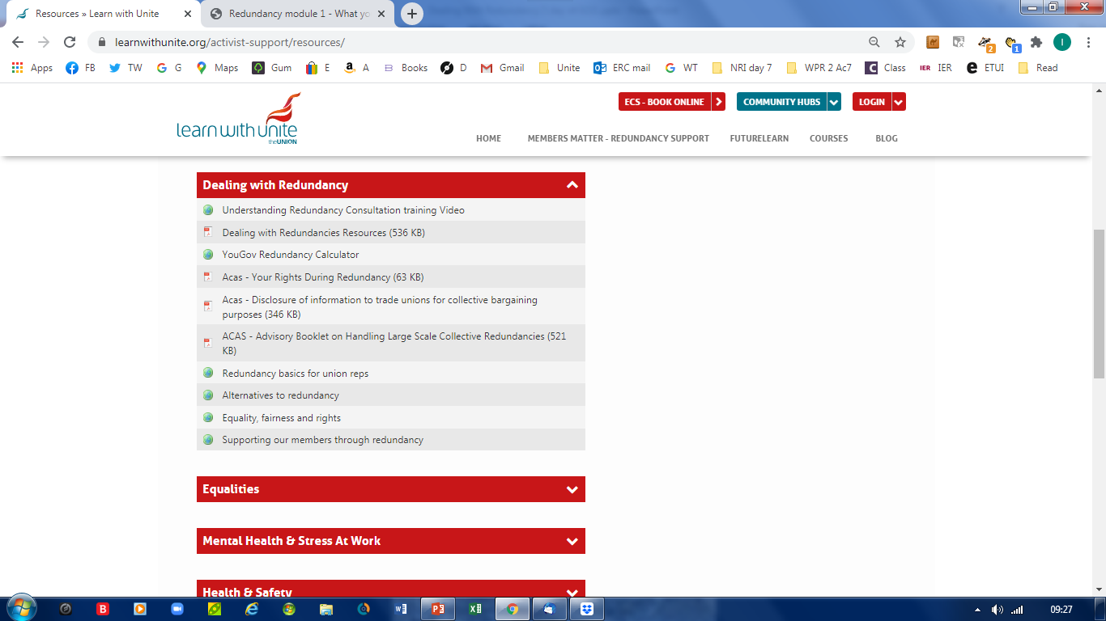
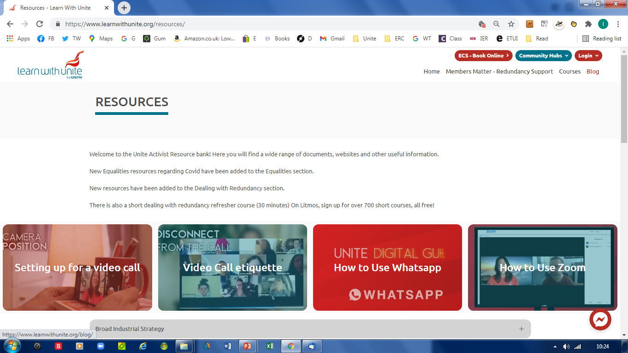
DEALING WITH REDUNDANCY – 3 DAY COURSE
Notes:
Reps resources – click on the Home page, open the reps resources tab, click on the drop down menu showing Dealing with Redundancies to show useful resources.

Slide 18
DEALING WITH REDUNDANCY – 3 DAY COURSE
Notes:
Note: access is through the Learn With Unite site.
New drop down menu for Members / Redundancy Support.
Click on here to take you to the page

Slide 19
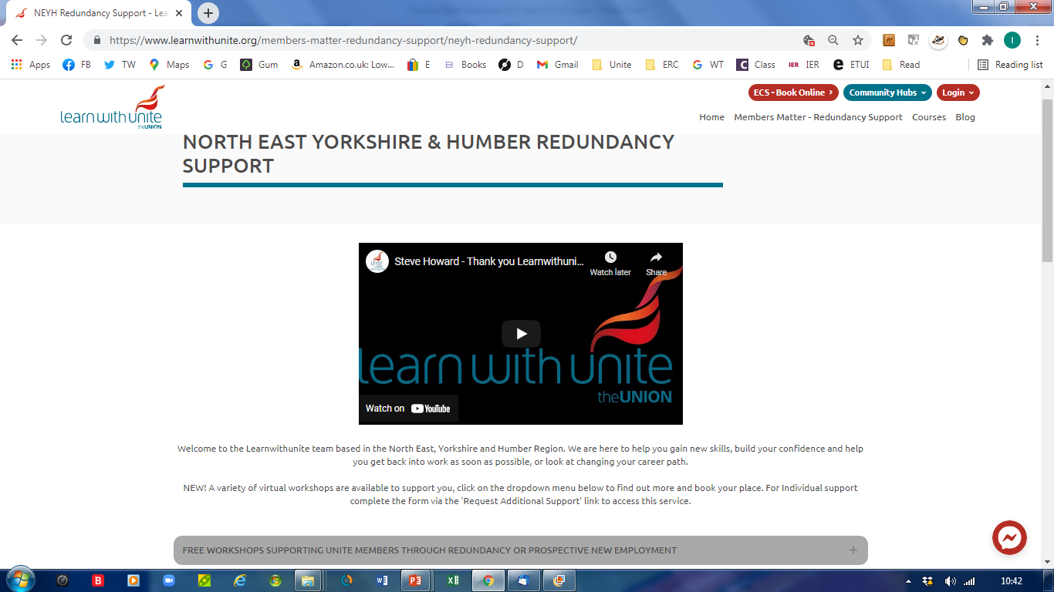
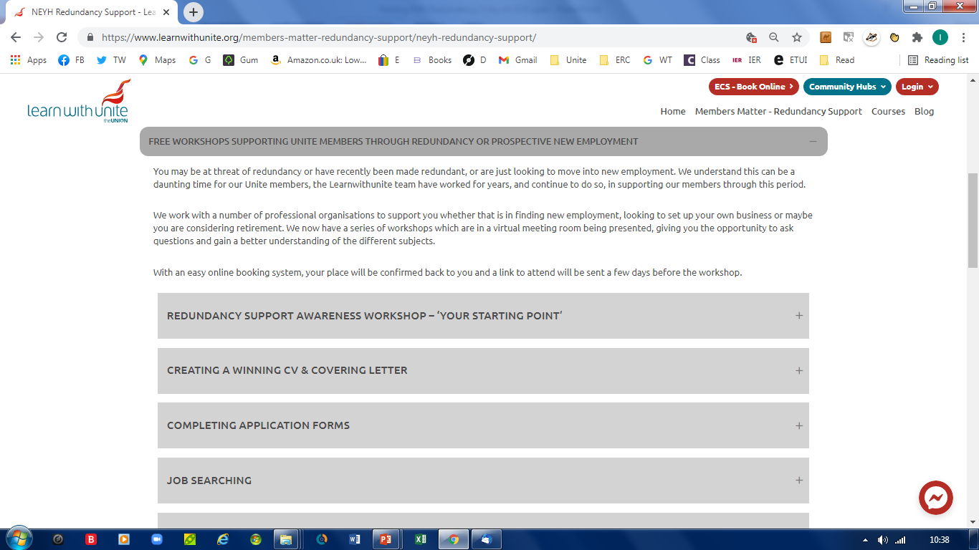
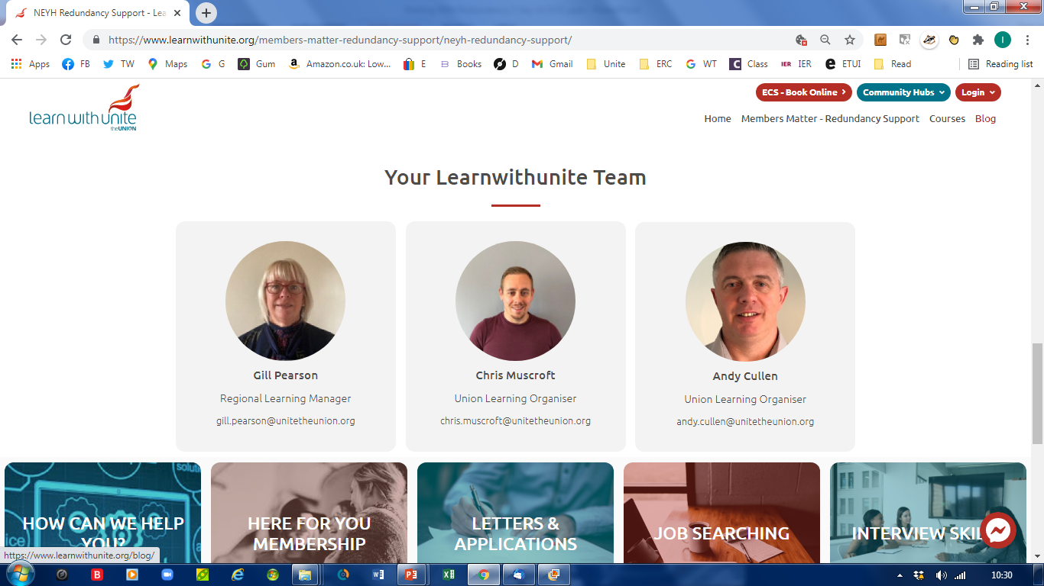
DEALING WITH REDUNDANCY – 3 DAY COURSE
Notes:
Pick out the NEYH region box and click. This takes you to the ‘Redundancy Support’ page. Video currently shows the Support the ULF campaign. Click to introduce the slide for the Learning Team. Note the drop down menu for ‘Free Workshops’. Finally, at he bottom of this page, there are a series of boxes, focus on the ‘Benefits’ and ‘Vacancies’ pages.

Slide 20
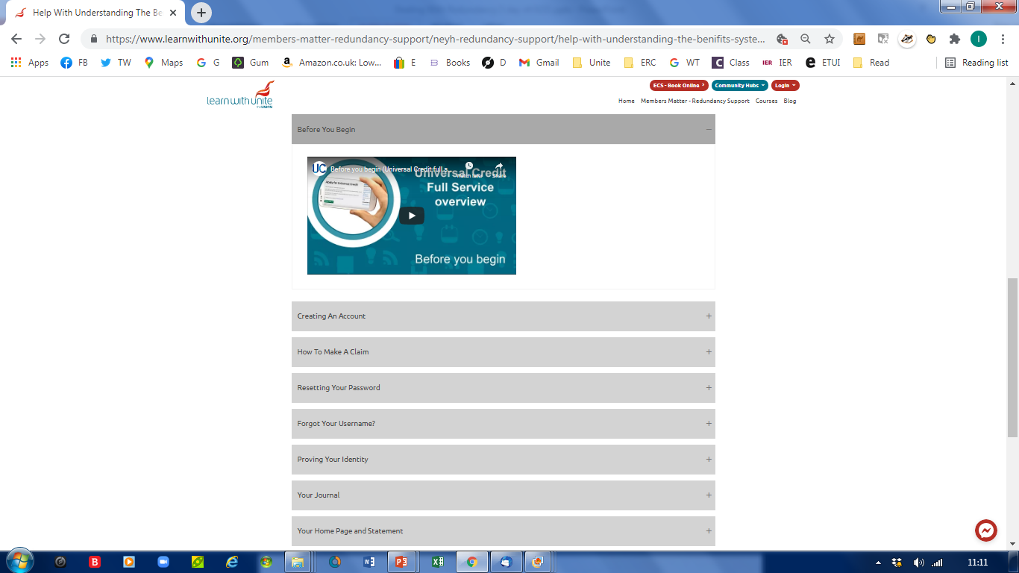
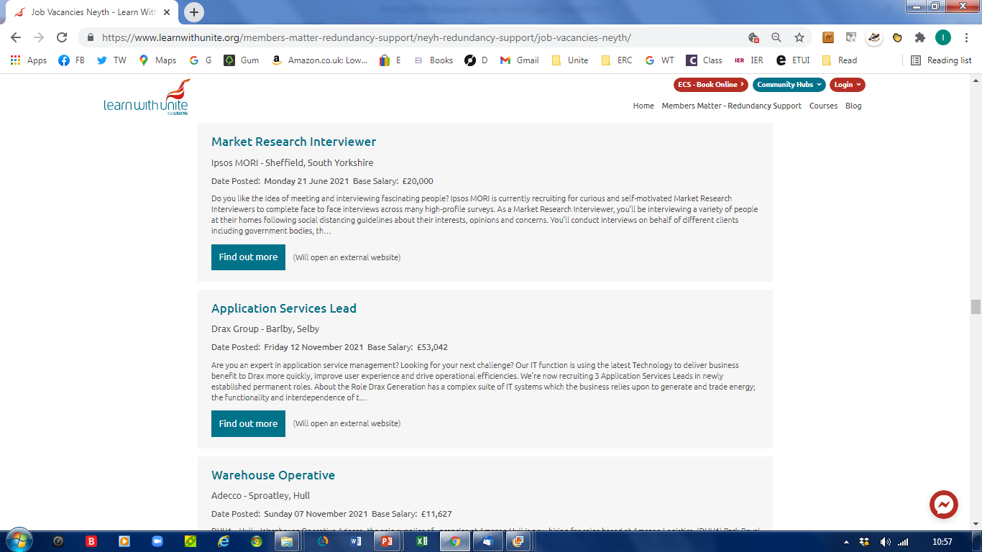
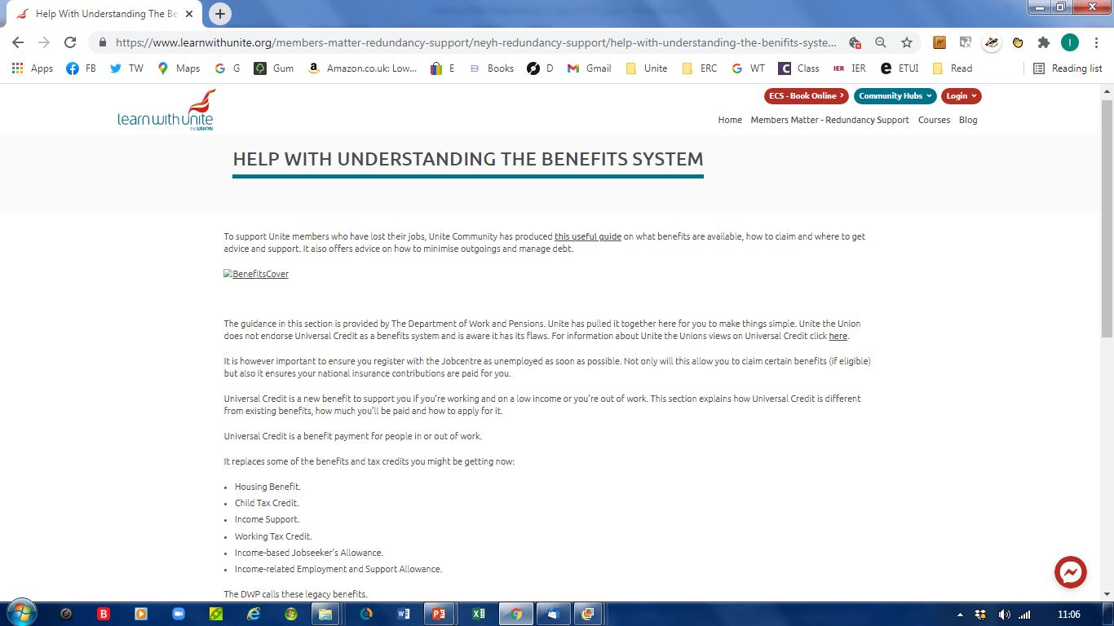
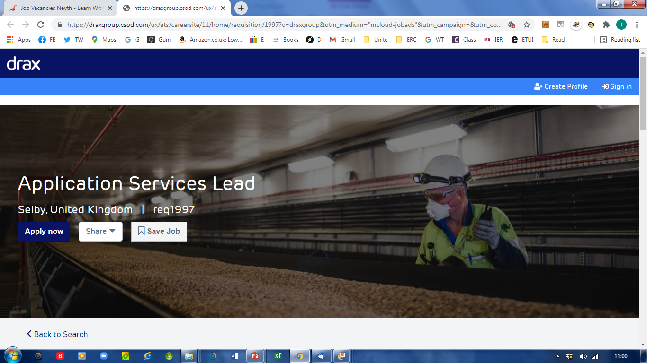
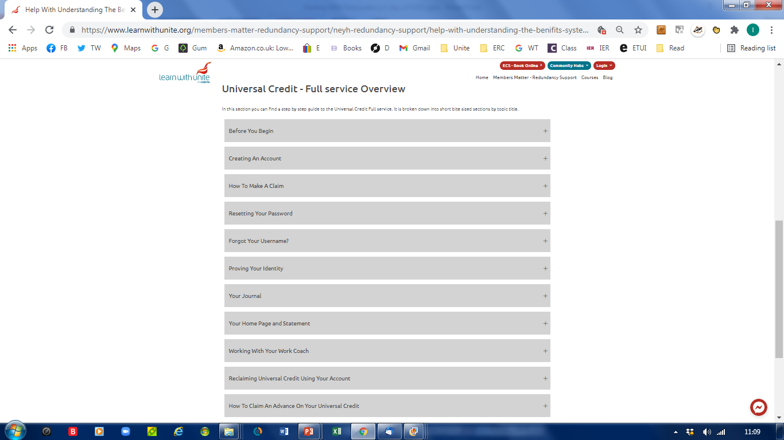
DEALING WITH REDUNDANCY – 3 DAY COURSE
Notes:
This opens the Vacancy page linking live job feed from the likes of Reed, Indeed, Monster etc. identified where they are in the region. Click on the job of interest to take you to the detailed page. Benefits help covers a step by step process for accessing Universal Credit

Slide 21
ACTIVITY 7
FINALLY – WHAT QUESTIONS DO I STILL HAVE?
No doubt you still have questions!
Use what you’ve learned as a platform to research further information e.g.
What legislation do you need to be familiar with?
What policies / procedures does your employer have?
What support can I (and my members) get from Unite?
How do I want to develop from this point?
DEALING WITH REDUNDANCY – 3 DAY COURSE

