Slide 1
Campaigning and alternatives to redundancy
Member support
Trade Unions
Campaign and political offices
Full time officers
Cross union support (including our Community branches!)
Leverage
Media – social networks, press, TV, radio
Political
MP’s
Councillors
Regional bodies – e.g. Local Enterprise Partnership
Academics, public figures, in fact - anyone who will help!!
DEALING WITH REDUNDANCY – 3 DAY COURSE
Notes:
Talk to your officer and the Organising Department about strategies
Don’t dismiss anything that you think may help your cause!

Slide 2
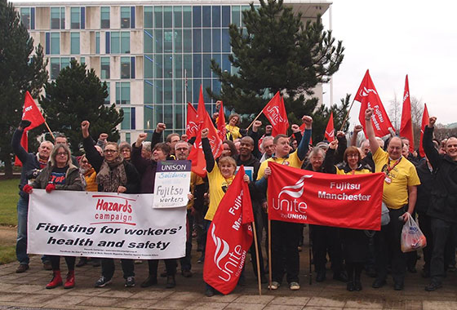
DEALING WITH REDUNDANCY – 3 DAY COURSE
Notes:
Examples of campaign approaches
Clockwise from top left:
Off Shore Industry – using a distinct format to “brand” the issue, make it recognisable
BA: Iconic landmarks across the UK lit up, including Marble Arch, the Houses of Parliament, Harrods, The Angel of the North and the Scottish Parliament
Fujitsu: Redundancies used as a vehicle for clearing out reps - Unite said it is "withdrawing from the process as it is not meaningful consultation as required by the relevant legislation and their participation lends credence to the company's pretence it is. By participating, it would damage any claims of unfair dismissal/claims for protective awards that people who are dismissed, particularly in Manchester, may want to raise."
BAe: Brough mass redundancies – local paper coverage, organised membership

Slide 3
Campaigning and alternatives to redundancy
Alternatives
Reduce overtime
Removal of sub contract and/or temporary labour
Review shift working arrangements
Consider natural attrition / recruitment controls
Transfer sub contracted work back in
Secondment to parts of the organisation that are unaffected
Internal retraining
Redeployment
Relocation
Pay freeze / cut
Revised contract of employment
DEALING WITH REDUNDANCY – 3 DAY COURSE

Slide 4
Campaigning and alternatives to redundancy
Revised / new contract of employment
A contract can only be varied by mutual agreement
However if you reject the new contract and the employer imposes the new one it is not automatically unfair
Continuing to work without agreement to the new terms may imply your acceptance
They may dismiss you then offer new terms – providing they follow the correct process for dismissal
Registering your refusal of the new terms and ‘working under protest’ may constitute industrial action
DEALING WITH REDUNDANCY – 3 DAY COURSE

Slide 5
Alternative work
To help mitigate jobs we can look at:
Redeployment into a suitable alternative job considering:
how similar the work is to your current job
the terms of the job being offered
your skills, abilities and circumstances in relation to the job
the pay (including benefits), status, hours and location
trial period
Relocation – with your existing job or in an alternative role
Secondment to an unaffected area of the organisation
Reskilling / retraining for internal roles
DEALING WITH REDUNDANCY – 3 DAY COURSE

Slide 6
Alternative work
What is ‘reasonable alternative employment’?
Your employer can offer you an alternative job in any way, but unless they follow the rules you can refuse it and get your redundancy pay instead.
Your employer has to:
offer you the new job in writing or orally
make the offer before your current job ends
make sure the new job starts within 4 weeks of your current job ending
give you enough detail about the job to understand what you’d be doing and how it
would be different to your current job
DEALING WITH REDUNDANCY – 3 DAY COURSE

Slide 7
Alternative work
Trying out alternative jobs
You can spend 4 weeks trying out any alternative job you’re offered.
If your employer offers you several alternative jobs you can try each one for 4 weeks.
Your trial period could start up to 4 weeks after your current job ends.
No matter when your trial period starts, you’ll still get 4 weeks to try the alternative job.
Your trial period still only lasts 4 weeks if you’re ill or on holiday for part of it.
You and your employer can agree to extend your trial period if you need training for the job.
Make sure you get your employer’s agreement in writing, with a clear end date.
Your redundancy might be unfair if your employer doesn’t let you try the job before deciding whether to take it.
DEALING WITH REDUNDANCY – 3 DAY COURSE

Slide 8
Alternative work
If you don’t want to take an alternative job
Inform your employer in writing and check that you’ll get your redundancy pay instead.
To get your redundancy pay, you’ll also need to:
refuse the alternative job before your current job ends, or
before the end of the alternative job’s 4-week trial
give a good reason for refusing your new job
A good reason could be about the job itself or about your personal situation e.g.
disruption to your family life, for example, problems with childcare
longer journey to work or lack of public transport
extra costs of getting to work
health issues
lower pay
DEALING WITH REDUNDANCY – 3 DAY COURSE

Slide 9
Support
What might support look like?
Financial
Education
Interview skills
CV writing
Retraining
Outplacement centre/provider
Time off to look for work
DEALING WITH REDUNDANCY – 3 DAY COURSE
Notes:
We are not financial advisors, but Unite does provide access to independent people. E.g. https://www.uniecprestige.co.uk/
Make sure you tie up with and involve your learning organisers

Slide 10
ACTIVITY 5
CAMPAIGNING
Using your workbooks, work as a group to discuss the tasks
DEALING WITH REDUNDANCY – 3 DAY COURSE
Notes:
TASK:
Think about how you would begin to organise a campaign?
Who can help, what sources of support are there?
What skills / resources do you need?
Outline what you would do to start a campaign about a redundancy

