Slide 1
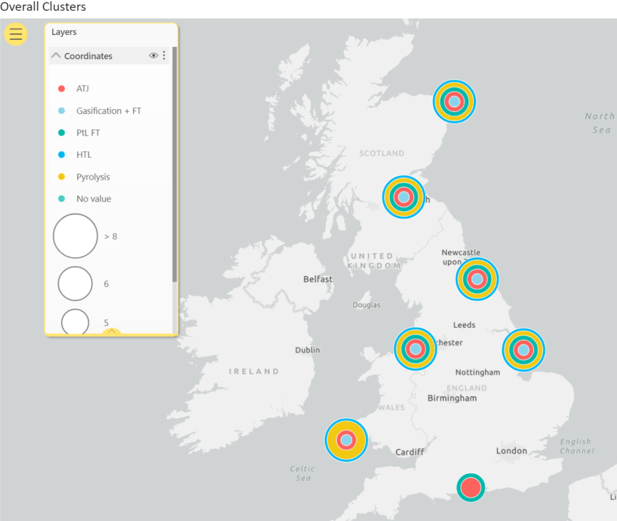
6 primary and 1 secondary SAF clusters have been identified in key industrial areas of the UK, which could utilise a range of SAF technologies
DRAFT
 | Humber (UKE1) | Grangemouth (UKM7) | Merseyside (UKD7) | South Wales (UKL1) | St Fergus (UKM5) | Teesside (UKC1) | Hampshire (UKJ3)
ATJ
Gasification + FT
PtL FT
HTL
Pyrolysis

Slide 2
SAF made from agricultural and forestry residues: supply chain will likely be split between rural and industrial areas
DRAFT
Generally speaking, for agricultural residues and forestry residues, the regions most abundant in feedstock are not in the same locations as enabling infrastructure such as CCS clusters and refineries
We do observe that there are two NUTS-2 regions which have both feedstock and enabling infrastructure – but generally, there is some dislocation between these types of feedstock of the enabling infrastructure.
This reflects what we see in the industry – primary conversion processes are located close to the feedstock, with an intermediate product being transported to areas with enabling infrastructure for upgrading to finished fuels:
  Pyrolysis plants being built alongside sawmills → raw pyrolysis oil transported to refineries for co-processing
This means that jobs will likely reflect this split in the supply chain:
Feedstock
Primary conversion
Upgrading and other enabling infrastructure
Jobs in rural areas
Jobs in industrial areas

Slide 3
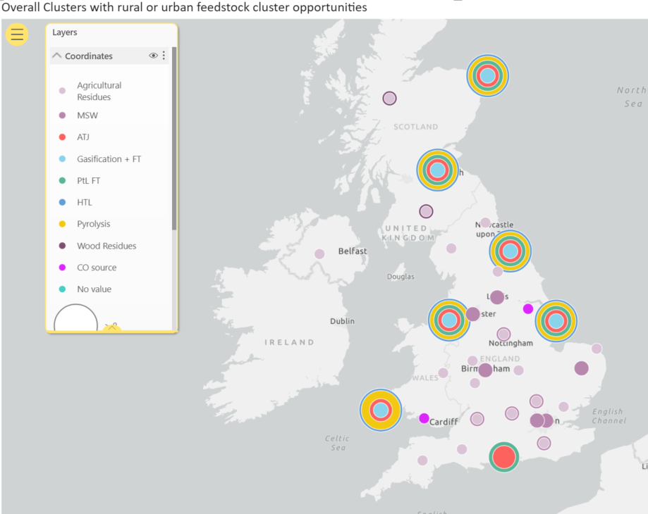
Potentially many rural areas could benefit from and support the development of these SAF clusters
DRAFT
This map aims to demonstrate how nearby regions could provide feedstock and perform the primary conversion step, before transporting the intermediate product to SAF clusters for product upgrading
Multiple rural areas could benefit from the development of the feedstock production and primary conversion steps of the SAF supply chain

Slide 4
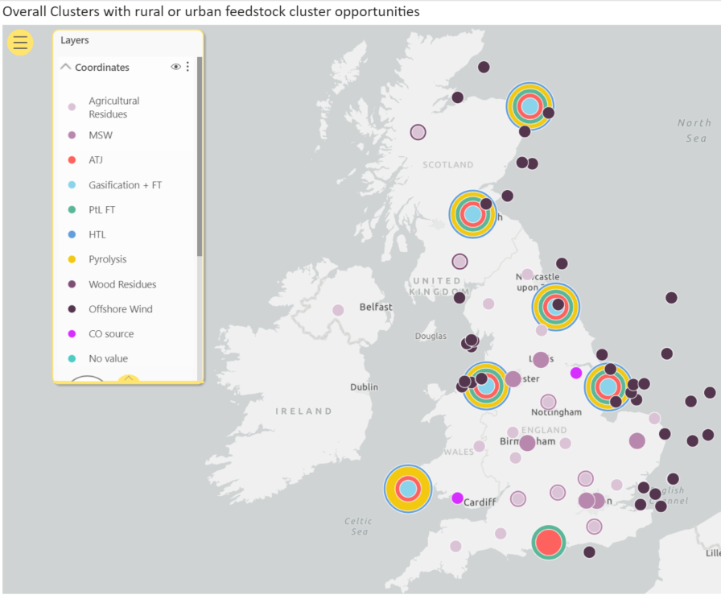
The offshore wind industry could also benefit from the development of a SAF industry
DRAFT

Slide 5
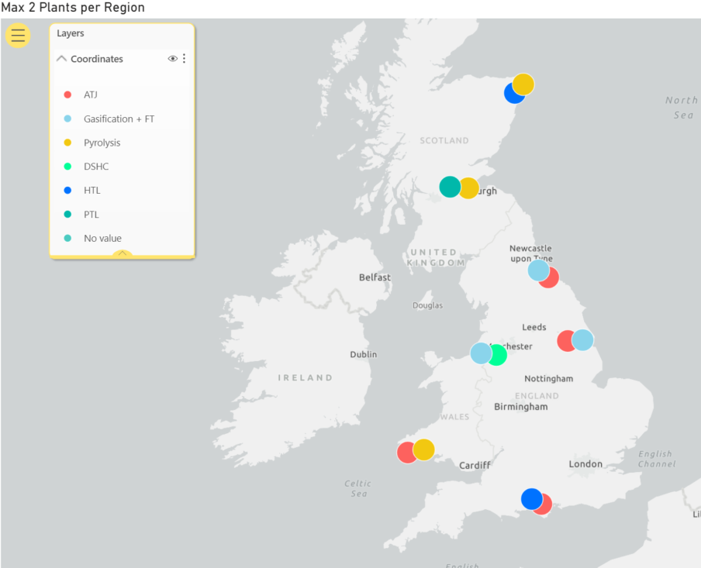
Each SAF cluster could support 2 plants, when a max of 2 SAF plants can be built per cluster
DRAFT
All 6 primary SAF clusters, and the secondary cluster in Hampshire, could have 2 SAF plants under this scenario

