Slide 1
Coshh awareness

Slide 2
Classified
Irritant, harmful, corrosive, toxic, carcinogenic
Wel
Workplace exposure limit (8 hours, 15mins)
Biological agents
Fungi, moulds, bacteria, viruses
Substantial dust
Fine = more risk, respirable dust, concrete

Slide 3
COSHH requirements do not apply to;
Asbestos
Lead
Radiation
Explosives
Medication
Not because they are safe, but because they have their own regulations.

Slide 4
Employer requirements under the COSHH regulations.
The eight steps
Assess risks
Decide on precautions
Prevent or control exposure
Ensure control measures used & maintained
Monitor exposure
Carry out health surveillance
Prepare for accidents and emergencies
Ensure employees are informed, trained and supervised.

Slide 5
Before we can do this, we must appreciate how various substances affect those at work
Ways the substances can enter our systems
How our bodies protect us
What the potential effects are
What the different classifications mean
How each different classified substance causes harm
Safe practice upon exposure

Slide 6
Routes of Entry to the body?
Inhalation
Absorption
Injection / Puncture Wounds
Ingestion

Slide 7
Inhalation;
Breathing in with normal air intake
Main route of entry
Chemical (solvents, welding fumes) or biological (bacteria or fungi)
Sweeping, spraying
Enter lungs, pass to bloodstream – access all areas!

Slide 8
Absorption;
Contact with skin
Enters through pores or a wound
Tetanus, (rusty nails) benzene (petroleum)
Direct access to bloodstream

Slide 9
Ingestion;
Through the mouth
Through to digestive system
Airborne dust
Poor hygiene!

Slide 10
Injection;
Air bubbles
Syringes – abused
HIV, hepatitis

Slide 11
Needle stick injuries;
Don’t put your hands anywhere you can’t see
If you come across needles report to your supervisor
Do not handle the needle unless you are appropriately trained

Slide 12
Needle stick injuries;
Wash well under cold running water without soap and cover with a dry dressing
Do not suck the wound
‘Bleed’ the wound if able
Accompany to nearest A & E, taking needle in puncture proof container if possible.

Slide 13
Natural defences
Skin
Vomit
Stomach acid
Liver / kidneys
Sneeze / cough
Cillary hairs

Slide 14
Potential health risks
Diseases of the skin
Diseases of the respiratory system
Cancer and birth defects
Asphyxiation
Central nervous system disorders
Specific organ damage

Slide 15
Effects on health may be either acute or chronic
Acute;
Short duration, appear rapidly
After short term exposure
Nausea, fainting, asthma attacks
Chronic;
Develop over a log period of time (no symptoms?)
Prolonged or repeated exposures
Cancers, mental illness

Slide 16
Irritant;
Can cause dermatotic or bronchial inflammation
After repeated contact
Concentration more likely damage than exposure time
Bleaches, glues, solvents

Slide 17
Harmful;
Most common
May pose risk if swallowed, inhaled or penetrates the skin
Bitumen-based paints, trichloroethylene & other chemical cleansers

Slide 18
Toxic or very toxic;
Impede function of organs (kidneys, liver, heart etc)
Poisonous
Mercury, pesticides

Slide 19
Corrosive;
Attacks living tissue
Normally by burning
Usually strong acid or alkali
Oven cleaners, dishwasher crystals

Slide 20
Carcinogenic;
Promote cancers
Abnormal development of body cells
Asbestos, creosote

Slide 21
Safe practice – harmful substance
Contact with eyes?
Rinse immediately with plenty of water, seek medical advice
Wash thoroughly before eating, drinking or smoking
Do not breath vapour / spray / dust
Avoid all contact

Slide 22
Safe practice – corrosive substance
Wear suitable gloves and eye / face protection
Immediately remove contaminated clothing
Contact with eyes?
Rinse immediately (for 15 minutes) with plenty of water, seek medical adviceContact with skin?
Wash immediately with plenty of water
Avoid all contact

Slide 23
Safe practice – toxic / very toxic substance
Wear suitable PPE (clothing, gloves, eye / face protection)
Contact with eyes?
Rinse immediately with plenty of water, seek medical advice
Contact with skin?
Wash immediately with plenty of water
In case of accident, or if you feel unwell, seek medical advice immediately
Avoid all contact

Slide 24
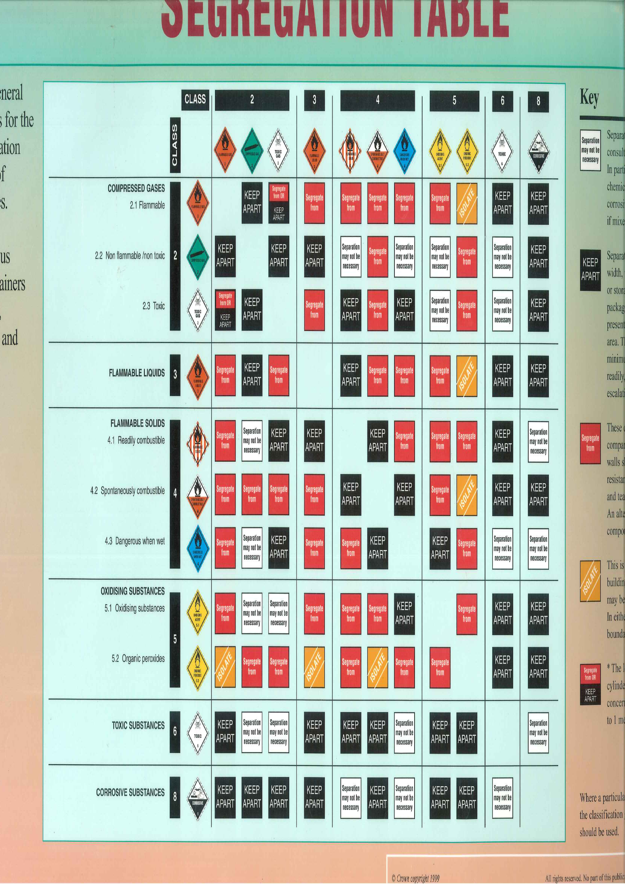
Storage
Some materials must not be stored together.
The safety data sheet will list materials which have to be segregated.
HSE’s “storing packaged dangerous substances: segregation table” gives further guidance

Slide 25
Conclusion
Ensure you are happy with all of the information related to a substance
Ensure you are happy that the ‘8 steps’ have been followed
And controls are in place!
And controls are relevant!
Do not assume a substance is safe
Ensure you know where to access the relevant information.

