Slide 1
Belonging or welcoming?
Neurodiversity in the Workplace
Notes:
It’s easy to say that the disabled are welcome in the workplace. Saying something and doing something about it are different. The attitude of managers matters and this must be carried forward in anti-discriminatory practice. Countering discrimination means working for a society in which they belong in the same way as everyone else.
In the public sector, the public sector equality duty reminds us of the need to be proactive in promoting equality for the disabled, rather than just reactive in making reasonable adjustments. This can be achieved through Equality Impact Assessments.

Slide 2
What is neurodiversity?
When we discuss ‘neurodiversity’ we are using a new word (Singer, 1998)
To discuss an old concept .
It has not just been invented
Notes:
Neurodiversity is a new word to describe a range of conditions experienced by people of all ages. More than 15% of people in Britain are neurodivergent or neurodiverse, as opposed to neurotypical (the other 85%).

Slide 3
US OR THEM?
When we discuss ‘neurodiversity’
Are we talking about other people . . .
Or are we talking about ourselves?
What language do we use?
Notes:
One important question is ‘are we talking about other people’ or ‘are we talking about ourselves’? It makes a great deal of difference.
“In the autism community, many self-advocates and their allies prefer terminology such as “Autistic,” “Autistic person,” or “Autistic individual” because we understand autism as an inherent part of an individual’s identity — the same way one refers to “Muslims,” “African-Americans,” “Lesbian/Gay/Bisexual/Transgender/Queer,” “Chinese,” “gifted,” “athletic,” or “Jewish.”” https://autisticadvocacy.org/about-asan/identity-first-language/
Note though that this does not well for ADHD…
People may have different opinions, and this may come down to whether autism is thought of as positive or negative.

Slide 4
Notes:
In this course we will be looking at two models of disability – the social model and the medical model. The social model is the one that we will use. It asks about society and the barriers it puts in place which prevent a disabled individual from full inclusion and participation. These barriers can take many forms.

Slide 5
Notes:
These barriers might be physical (for example some steps which prevent a wheelchair user from entering a building, inaccessible public transport, lack of disabled parking spaces), social (for example, poverty or low income, discrimination, poor job prospects), or psychological (for example negative attitudes that lead to discrimination).

Slide 6
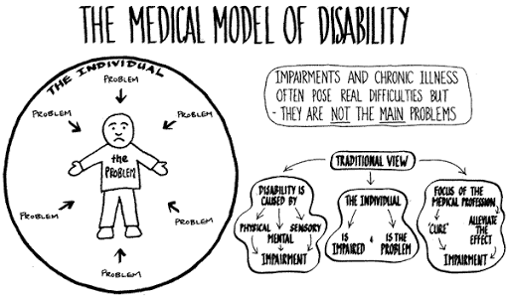
Notes:
The medical model of disability sees the individual as the cause of the problem, for example the individual might have physical or mental impairments. In this model the response of society is to remove the impairments, (to cure someone) or to minimise the impact of the impairment on the individual.

Slide 7
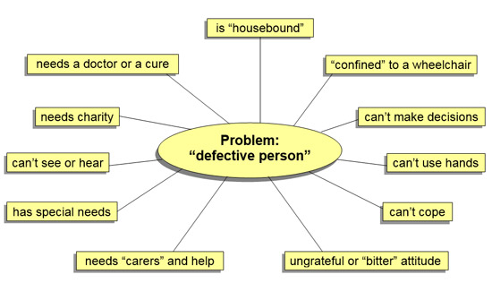
Notes:
In the medical problem the disabled person, or at least their disability, is the problem, not society. One stereotype might be sending someone for counselling because they are upset at being discriminated against and called names because of their disability.

Slide 8
Descriptions and definitions
Some people’s brains process and interpret information:
Differently than others
In a way society does not expect
Notes:
Neurodiversity is a word which highlights the difference between how some people experience the world and think about it differently. Society makes assumptions about how the brain works. Some people’s minds process information differently, in a way that society does not expect.

Slide 9
Definitions: Spectrum
Each form of neurodiversity has a range of characteristics
These vary from individual to individual
Spectrum in this context means ‘range’
Notes:
Most forms of neurodiversity have characteristics which vary between individuals. People who are neurodiverse experience their condition(s) uniquely. That is why they are called spectrum conditions.

Slide 10
THINKING ABOUT neurodiversity
According to ACAS, 15% of the British population is neurodivergent:
ADHD (attention deficit hyperactivity disorder)
AUTISM (including Asperger’s Syndrome)
Dyslexia (a language processing disorder)
Dyspraxia (developmental coordination disorder)
Notes:
These are hidden disabilities and developmental disorders.

Slide 11
THINKING ABOUT neurodiversity
What is the experience of neurodivergent individuals:
In the workplace?
In society?
In Unite the union?
Notes:
What is the lived experience of neurodivergent individuals in the workplace in society and in Unite? Are they discriminated against? How can they belong without discrimination?

Slide 12
What does the EQUALITY ACT 2010 say?
S6(1) A disability is:
A physical or mental impairment
That has a substantial (not minor or trivial)
Or long-term negative effect (12 months or more)
On the ability to do normal daily activities

Slide 13
What does the equaLITY ACT 2010 say?
Abide by the Public Sector Equality Duty:
Eliminate unlawful discrimination, harassment and victimisation as well as other conduct that is prohibited by the Equality Act 2010
Advance equality of opportunity between people who share a relevant protected characteristic and those who do not
Foster good relations between people who share a protected characteristic and those who do not
Notes:
Public sector organisations should do an Equality Impact Assessment to ensure that all policies, procedures and decisions are evaluated to make sure that they take into consideration the needs of the disabled (as with all people with protected characteristics). This Equality Impact Assessment is part of the Public Sector Equality Duty, which applies specifically to the public sector, and is designed to prevent discrimination from occurring, rather than rectifying it once it has occurred.
Tutor notes: Share link:
https://www.equalityhumanrights.com/en/advice-and-guidance/public-sector-equality-duty

Slide 14
What does the EQUALITY ACT 2010 say?
Make reasonable adjustments for the disabled
YOU MUST avoid, remove, or minimise any disadvantage:
Experienced by the disabled person (in comparison to a non-disabled person)
Caused by provision, criterion, practice, or physical features
Or provide auxiliary aids to assist them
Notes:
Private sector organisations must make reasonable adjustments for the disabled.

Slide 15
What does the EQUALITY ACT 2010 say?
Different types of disability:
Visible disabilities
Hidden disabilities
Notes:
Disabilities may be visible or hidden. If someone is in a wheelchair we might assume that they have a disability, relating to restricted mobility, this is a visible disability. Not all disabilities can be seen. The neurodiversities that we are discussing in this course are hidden disabilities. Whether the disability is visible or hidden, it remains a disability and it is a protected characteristic under the Equality Act section 6. That begs the question, how do we know whether someone is disabled or not? How do we know if they need reasonable adjustments made for them? Perhaps, we need to plan in advance, for example to install a loop system for the hard of hearing, regardless of whether there are any people present who use a hearing aid with the loop setting.

Slide 16
Access to buildings
Steps may prevent a person in a wheelchair, or using a walking frame, from getting into a building:
Solution 1: build a ramp
Solution 2: suggest they use the side door*
Solution 3: buy a portable ramp**
Solution 4: offer to carry them***
Notes:
If we think of an example of disability and reasonable adjustments, we might think of a building with a flight of steps up to its front entrance, but flat access to the side door/ back entrance. What solutions can we think of?
We could build a ramp, we could suggest they use the side door, we could buy a portable ramp, or we could install a buzzer at the top of the steps for people to press if they need assistance, and then we could carry them into the building. Clearly, not all of these are either sensible, ethical, or legal.
The steps may prevent access to people with reduced mobility. They might have a wheelchair, or use a walking frame, or even need to use one of these, but fail to do so. It is not the wheelchair that defines the disability, nor the walking frame, but the mobility of the person, in this context.
Some people with dementia find patterned floors difficult, because of changes to depth perception, and they find it difficult to go from one type of flooring to another. They might see that as a barrier. This is the kind of thing that could be planned for in architectural design, or in an Equality Audit of a building. Hidden disabilities are significant and need to be planned for. Every individual is different, so the adjustments that they need may differ:
Depending on the nature of their disability
Depending on the severity of their disability
Depending on how their disability affects them that day

