Slide 1
Autism and workplace discipline
Disciplinary hearings and Employment Tribunals
Notes:
Autism Spectrum Disorder, is the technical term from the American Psychological Association Diagnostic and Statistical Manual 5th edition, for Autism. It also includes Asperger’s, a diagnosis that is no longer given. This presentation considers the vulnerability of people with autism to disciplinary hearings and at employment tribunals. It is based on research by Clare Allely and Ann Creaby-Attwood into the forensic vulnerabilities of people with autism, that is their increased vulnerability to being charged or convicted with crimes.
Reference: Allely, CS and Creaby-Attwood, A Sexual offending and autism spectrum disorders http://dx.doi.org/10.1108/JIDOB-09-2015-0029

Slide 2
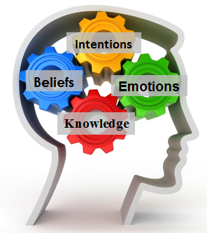
What makes people with autism vulnerable?
Impaired Theory of Mind
Notes:
People with Autism are more vulnerable to being taken to a disciplinary hearing and losing at an employment tribunal for a number of reasons. The first reason is that they have an impaired theory of mind. In social communication a person who is neurotypical is more likely to understand what the other person is thinking and feeling. The person with autism has impaired social communication and social interaction, meaning that, to different extents, they will not know what the other person is thinking or feeling. For example, they may find body language including facial expressions harder to read, making a negative reaction from a colleague or manager harder to understand.
Note that neurotypicals can also suffer from poor theory of mind, being unable to know what the autistic person thinks or feels. There is a special place in workplace assistance programmes for people with autism to be supported in their social communication and in understanding that of others.

Slide 3
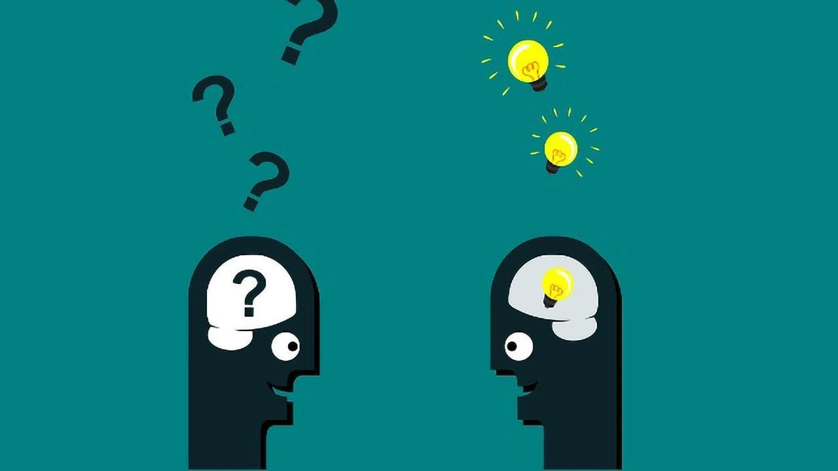
What makes people with autism vulnerable?
Impaired communication
Alexithymia
Notes:
The person with autism has impaired social communication and social interaction, marked by trouble finding the words to say what they mean (this is called alexithymia). They may also suffer difficulty knowing how they feel and what they have experienced bodily, due to problems with interoception.

Slide 4
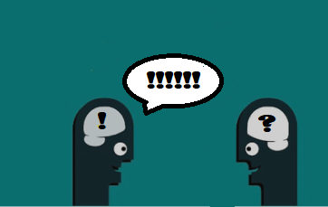
What makes people with autism vulnerable?
Special interests
Perseveration
Inertia
Hyperfocus
Repetitive and stereotyped behaviours
Notes:
If a person with autism can get a job related to their special interest, it can become a strength for them, but a person with autism is more likely to focus on their own interests, even when the other person is not interested. A person with Autism may not know that they are boring the person they are speaking to.
People with autism have restricted interests and become persistently preoccupied with things, as though they have single track minds and can’t change what they are thinking about. This is autistic inertia, and can affect them when they try to change focus from one activity onto another.

Slide 5
What makes people with autism vulnerable?
Insistence on sameness, inflexible adherence to routines, or ritualized patterns of behaviour
Dislike of difference, change to routine and disorder
Notes:
In the workplace, a person with autism may insist on doing things a certain way, all the time, regardless of whether it is the way that a manager wants them to do something. They are vulnerable to procedural changes in the workplace. They are likely to be inflexible and unwilling to change, since they dislike difference, change to routines and what they perceive as disorder.
A person with autism may be more suited to some jobs than others. A library is a good example of a strictly ordered workplace, where everything has its place.

Slide 6
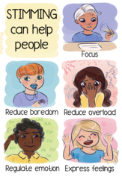
What makes people with autism vulnerable?
Stereotyped or repetitive motor movements, use of objects, or speech
Notes:
They may also have annoying habits such as “flicking a rubber band or twirling a piece of string, or repetitive activities involving the senses (such as repeatedly feeling a particular texture).” (Reference: National Autistic Society: https://www.autism.org.uk/advice-and-guidance/topics/behaviour/stimming) This self-stimulation is called stimming, and is mostly harmless, since it can help the person with autism focus, reduce their boredom, reduce social overload, as well as help them regulate their emotions and express their feelings.
Stimming can however be really annoying to other people.

Slide 7
What makes people with autism vulnerable?
Highly restricted, fixated interests that are abnormal in intensity or focus
Notes:
They may be passionate about a cause, or a special interest, leading to apparent fixation upon it during working hours.
Although special interests vary, they can include Antarctica and penguins. If they work in a Zoo, taking care of penguins, this will be a huge asset to them, but if they do not, it could make them vulnerable due to an inability to think about other things when they need to.

Slide 8
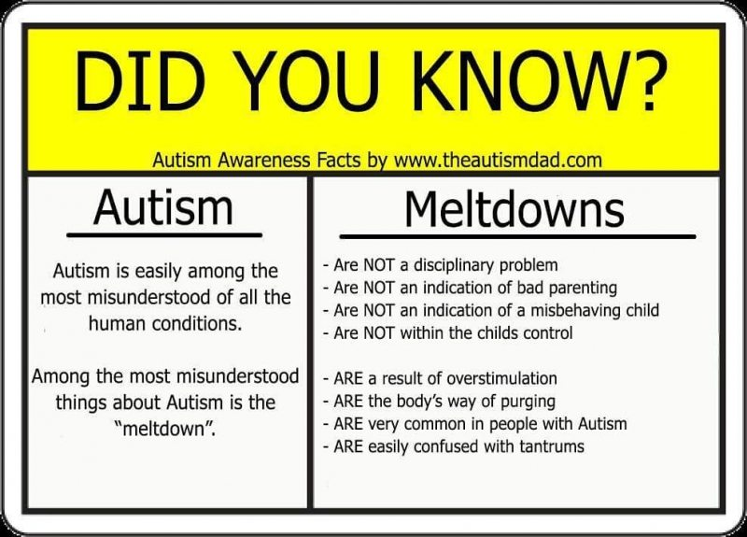
What makes people with autism vulnerable?
Oversensitivity to sensory stimulation
Undersensitivity to sensory stimulation
Meltdowns when the coping strategies fail
Notes:
People with autism may have meltdowns when they are over or under-stimulated due to differences in sensory perception and toleration of social interaction. Meltdowns are more commonly seen among children.
A meltdown may appear to be a disciplinary issue in the workplace, but melt-downs can be managed if the person with autism is able to take time out, if overstimulation is managed, and if coping strategies are put in place to support them in the workplace.

Slide 9
What makes people with autism vulnerable?
Suggestibility
Immaturity
Lack of theory of mind
Notes:
People with autism may be more suggestible than their peers, failing to understand either the social interactions, nor the unwritten rules of society which would prevent a neurotypical worker from doing what others are encouraging them to do. Being egged on by others, lack of impulse control and immaturity, can lead to inappropriate conduct, including sexual misconduct, since how they act is not properly assessed by them in terms of how it would be viewed by others.

Slide 10
What makes people with autism vulnerable?
Immediate confessions
Lack of impulse control
Memory problems
Problems organising their work
Notes:
Acting without thinking, and taking other people literally can be compounded by immediate confessions of guilt, even when they do not know what they are being accused of, nor the motivation attributed to their actions by neurotypicals.
People with autism can also suffer from poor executive function, leading to memory problems, and problems managing time and juggling their work-load. Failing to meet deadlines, or failing to manage multiple projects at the same time can be dealt with by means of reasonable adjustments.

